Slide 1

Peril and Promise: New Digital Technologies and the ACQF
Martin Hall
Emeritus Professor, Graduate School of Business, University of Cape Town
Non-Executive Director, Advanced Secure Technologies Ltd

Slide 2


Primary objectives of the ACQF
Comparability of qualifications
Facilitating learner mobility
Partnerships that transcend national borders
Sharing information across the AU, and worldwide
Meeting each of these objectives effectively and efficiently can benefit from new and emerging digital technologies

Slide 3

Equity of access to the internet
the elephant in the room
1998: 95% of Africa’s internet connection points were in South Africa. Egypt 2nd with 2% of continental connectivity
Today, 68% of the world’s population is online. But in Africa, just 38% of the population is online, and women are 37% less likely to be online than men
86% of those who have Internet access in Africa are mobile-only, depending on small screens and variable network quality
UN Broadband Commission’s global affordability target is that an entry-level mobile data plan of 2GB per month should be no more than 2% of average monthly per capita income. But in 2024, the average cost for countries in Africa was 4.2% per capita
Equitable access to the Internet is an enabling condition for prosperity in Africa, and a necessary condition for meeting the ACQF’s primary objectives

Slide 4

Why qualification fraud matters
The success of a National Qualifications Framework depends on trust and confidence in the qualifications that it registers and certifies
Qualification fraud is $50 billion a year global industry, growing rapidly using new digital technologies such as Artificial Intelligence
Evidence for the extent of qualification fraud across Africa is incomplete and available for only 29 countries. But representative evidence from Morocco, Egypt, Nigeria, Benin, Sierra Leone, Kenya, Somalia and South Africa confirms that qualification fraud is a pan-African issue
Qualification fraud is often transnational, evading local jurisdiction. The ACQF is the ideal mechanism for assisting AU member states in restoring confidence in the integrity of qualifications

Slide 5
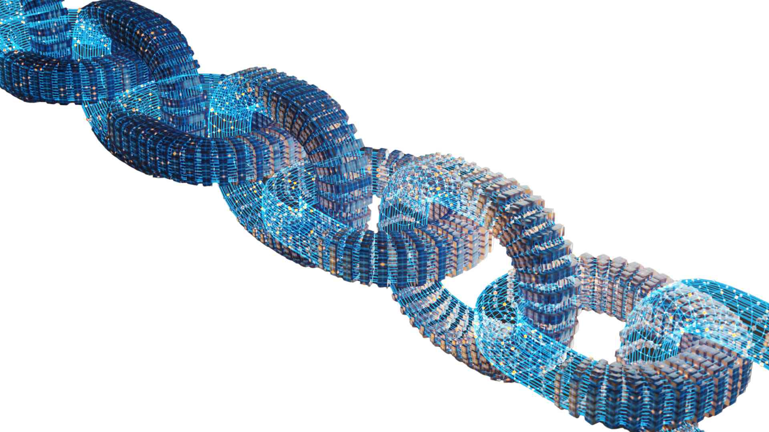
Secure digital credentialing: towards Zero Trust Architecture
 | credentialing | verification
Stage 1: Perimeter Security | Minimal protection | Not available | Level 1
 | Managed password protection | Manual, delayed, partial | Level 2
 | Multifactor authentication | Manual, delayed, partial | Level 3
Stage 2: Zero Trust Architecture | Digital encryption | Automated, instant, comprehensive | Level 4
 | Integrated adaptive security | Automated, instant, comprehensive and within the issuer’s domain | Level 5

Slide 6

Why Level 5 Zero Trust Architecture Matters – an example
Digital encryption, with every credential secured using a blockchain application and tamper free
Credentials are both stored and verified within the issuing organization’s secure digital domain
Verification is instant, fully automated and cost free, with access controlled by the qualification holder
Adaptive security keeps pace with dark-side digital capabilities, for example by integrating biometric facial recognition to prevent impersonation
Complies with the current W3C standard for Verified Credentials

Slide 7

Three digital technologies that will help the ACQF meet its primary objectives:
Micro-credentialing
Qualification authentication services
Generative Artificial Intelligence

Slide 8



Micro-credentialing: secure digital badges
A micro-credential is a small, self-contained unit of learning
Secure digital badges enable accessibility, portability and verification
A secure badge has an image representing the awarding body and contains tamper-free metadata fields that define the credential
For the ACQF, micro-credentialing with secure digital badges will facilitate learner mobility between AU nations
For the ACQF, micro-credentialing with secure digital badges will enable collaboration between universities in different countries
Micro-credentialing with secure digital badges will facilitate the ACQF objective of creating “an African education and qualifications space”

Slide 9

Qualification authentication services
Legacy authentication services depend on information provided by universities and awarding bodies and central databases: expensive to run, long response times and subject to input errors
Stage 2 Zero Trust Architecture enables instant authentication at almost no cost, replacing manual services and central databases, significantly reducing costs, the risk of error and vulnerability to fraud
Here’s how it works…..

Slide 10

Digitally enabled authentication: an example
HEDD is division of Jisc, the NPO that provides all British universities with digital services. HEDD’s fully automated service works this way:
the issuer’s secure digital certificates system is fully integrated with HEDD’s web domain, removing the need for central databases and manual handling
The third-party seeking authentication gets permission from the credential holder and logs the application on the HEDD webpage, paying the required fee
HEDD automatically verifies that permission has been granted, authenticates the qualification against the issuer’s secure database and reports the outcome to the third-party, keeping a full record of the the authentication transaction

Slide 11

Generative Artificial Intelligence
Curriculum planning and course design: searching very large amounts of publicly available data against carefully designed prompts, producing succinct reports to specified presentation formats
Personal tutoring: intelligent agents trained to respond to student inquiries with a series of questions which lead the learner towards discovering the solution for themselves
Access to information: the ability to access sources of knowledge very quickly and comprehensively, and to assemble succinct and fully referenced summaries
New forms of assessment: continuous formative assessment and individualised, project-based assignments, enabled by GenAI teaching assistants
Adapted to mobile-first delivery to address Africa’s digital divide

Slide 12

Nothing is different, everything has changed
“There’s no chance that the iPhone is going to get any significant market share” Steve Balmer, CEO of Microsoft, 2007
Defining characteristics of exponential change: long periods of slow development leading to sudden and transformative eruptions
Digital technologies are here to stay, and exponential change will continue to drive disruption
Take nothing for granted and continuously evaluate the perils and promises of new innovations as they come onstream
“Once upon a time, there was an ocean. But now it's a mountain range. Something unstoppable set into motion. Nothing is different, but everything's changed” Paul Simon, Poet, 2010

