Slide 1
African Continental Qualification Framework (ACQF) Forum The National Qualification Framework Alignment with Technical and Vocational Education and Training(TVET) in Ghana
By
Sampson Damptey Tetey
Director, Accreditation, Assessment and Certification
Commission for Technical and Vocational Education and Training (CTVET)
30th July 2025 to 1st August, 2025
South Africa

Slide 2
Harmonised Acts for Education System in Ghana
Two Legal Documents
Education Regulatory Bodies Act(ERBA) 1023 of 2020
Pre-Tertiary Education (P.E) Act 1049 of 2020)

Slide 3
The Education Regulatory Bodies Act(ERBA) 1023 of 2020
Education Regulatory Bodies Act (ERBA) 1023 of 2020
Part 1 Ghana Tertiary Education Commission
Part 2 Commission for Technical and Vocational Education and
Training (CTVET)
Part 3 National Teaching Council
Part 4 National School Inspectorate Authority
Part 5 National Council for Curriculum and Assessment
Part 6 Administrative, Financial and Miscellaneous

Slide 4
The Education Regulatory Bodies Act(ERBA) 1023 of 2020
ERBA 1023 of 2020 merged the erstwhile NABPTEX and COTVET into a new body called;
Commission for Technical and Vocational Education and
Training (CTVET).
ERBA 1023 of 2020 merged the erstwhile NCTE and NAB into a new body called;
Ghana Tertiary Education Commission (GTEC).

Slide 5
The Object of GTEC
The Objects of GTEC are to regulate tertiary Education in all its forms with a view to promote;
efficient and effective administration and accreditation of tertiary education institutions
principles of the provision of consistent quality of service by tertiary education institutions
advancement and application of knowledge through teaching, scholarly research and collaboration with industry and the public sector ; and
the development of appropriate human capital for the sustainable advancement of the national economy

Slide 6
The Object of CTVET
The Object of CTVET
The objects of the Commission are to:
regulate,
promote and
administer
technical and vocational education and training for transformation and innovation for sustainable development

Slide 7
Selected CTVET Specific Functions
CTVET under ERBA 1023 of 2020
43, 1 (m);
Accredit;
programmes
institutions
centres
facilitators
assessors and
verifiers
at the formal, informal, non-formal, technical and vocational education and training institutions to ensure quality delivery

Slide 8
Selected CTVET Specific Functions
CTVET under ERBA 1023, 2020
43, 1 (c)
Develop and implement a national assessment and certification system in the technical, vocational education and training sector;
43.1 (n)
collaborate with tertiary institutions and relevant agencies to implement competency based training programmes on the National Technical and Vocational Education and Training Qualifications Framework

Slide 9
Two Major Policy Reform Areas for TVET in Ghana
ERBA Act 1023 highlights two broad Policies for TVET in Ghana;
Competency Based Training as a curriculum for all TVET institutions in Ghana
(Pre-Tertiary, Tertiary, Private, Public, Formal Informal
and Non-Formal)
8-National Technical and Vocational Education and
Training Qualifications Framework (NTVETQF)

Slide 10
Definition for Competency Based Training in Ghana
Competency Based Training is an industry-led and demand-driven education and training programme based on industry generated standards (occupational standards).
The occupational standards are the basis upon which the;
Programme (Curriculum),
Learning Materials,
Assessment Instruments and
Marking Guidelines are designed and developed

Slide 11
Competency Based Training in Ghana
Technical Universities’ Act 922 of 2016, Section 3 (c); stipulates that;
. “all Technical Universities should use Competency Based Training and Practice oriented approach in teaching, organization and delivery of courses.
Page 37 of the Education Strategic Plan 2018-2030 states, “Strengthened competency-based skills development in TVET”.

Slide 12
The 8-Level National TVET Qualifications Framework for TVET Sector in Ghana
Level 8: Doctor of Technology (D. Tech)
Level 7: Master of Technology (M. Tech)
Level 6: Bachelor of Technology (B. Tech)
Level 5: Higher National Diploma (HND)
Level 4: National Certificate II
Level 3: National Certificate I
Level 2: National Proficiency II
Level 1: National Proficiency I

Slide 13
Key Features of the 8-Level NTVETQF
The NTVETQF requires the following;
Assessment and Certification of Full CBT Programmes only
Accreditation of Institutions, Centres, Programmes, Facilitators, Assessors, Internal and External Verifiers are required
It has level descriptors (Knowledge, Skills and Attitude)
It requires credit accumulations for Core and electives programmes
Formatives assessment used during facilitation to determine learner’s progress of learning
Summative assessment used at the end of every Unit and for certification of learners
External Verification system used to confirm summative assessment

Slide 14
Key Features of the 8-Level NTVETQF
The National TVET Qualifications Framework;
The NTVETQF was first approved by Parliament of Ghana under the erstwhile COTVET Legislative Instrument L.I. 2195 in 2012 for implementation.
The NTVETQF has been strengthened in the new Act ERBA 1023 of 2020 as a qualification framework for the TVET sector in Ghana

Slide 15
Joint Accreditation Between GTEC and CTVET at the Tertiary Level
Part 2 of ERBA (CTVET)
43 (2)
The Commission, in conjunction with the Ghana Tertiary Education Commission shall accredit technical and vocational education and training programmes and institutions at the tertiary level
Part 1 of ERBA (GTEC)
8, 3 (a)
The Commission shall, in conjunction with the Commission for Technical and Vocational Education and Training accredit technical and vocational education and training programmes and institutions at the tertiary level

Slide 16
National Qualification Framework for Ghana
GTEC 8, 4(a)
The Commission (GTEC) shall in collaboration of relevant regulatory bodies and relevant institutions develop and implement a National Qualification Framework and Learner Qualifications Framework at the Tertiary level.
Following the above provision, GTEC together with CTVET and other relevant institutions has developed a comprehensive “Ghana National Qualifications Framework” GhNQF

Slide 17
The 10-Level NQF and other Policies and Guidelines
10-Level Comprehensive NQF that incorporates all components of the education and training sector from basic, pre-tertiary through to tertiary education.
The Ghana Credit Accumulation and Transfer System (CATS) Policy and Guidelines
The Ghana Recognition of Prior Learning Policy

Slide 18
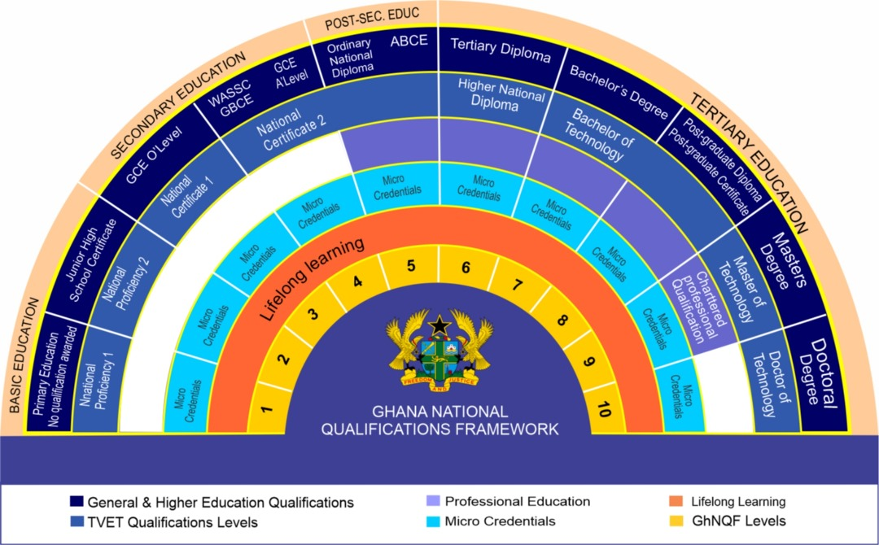
The Proposed 10-Level Ghana National Qualifications Framework

Slide 19
Thank you very much

