Slide 1




Transforming Qualifications Management Through Digital Innovation: Kenya’s Journey Toward Transparency & Inclusion
Presented By: Haron Chege | KNQA ICT
Get Started

Slide 2

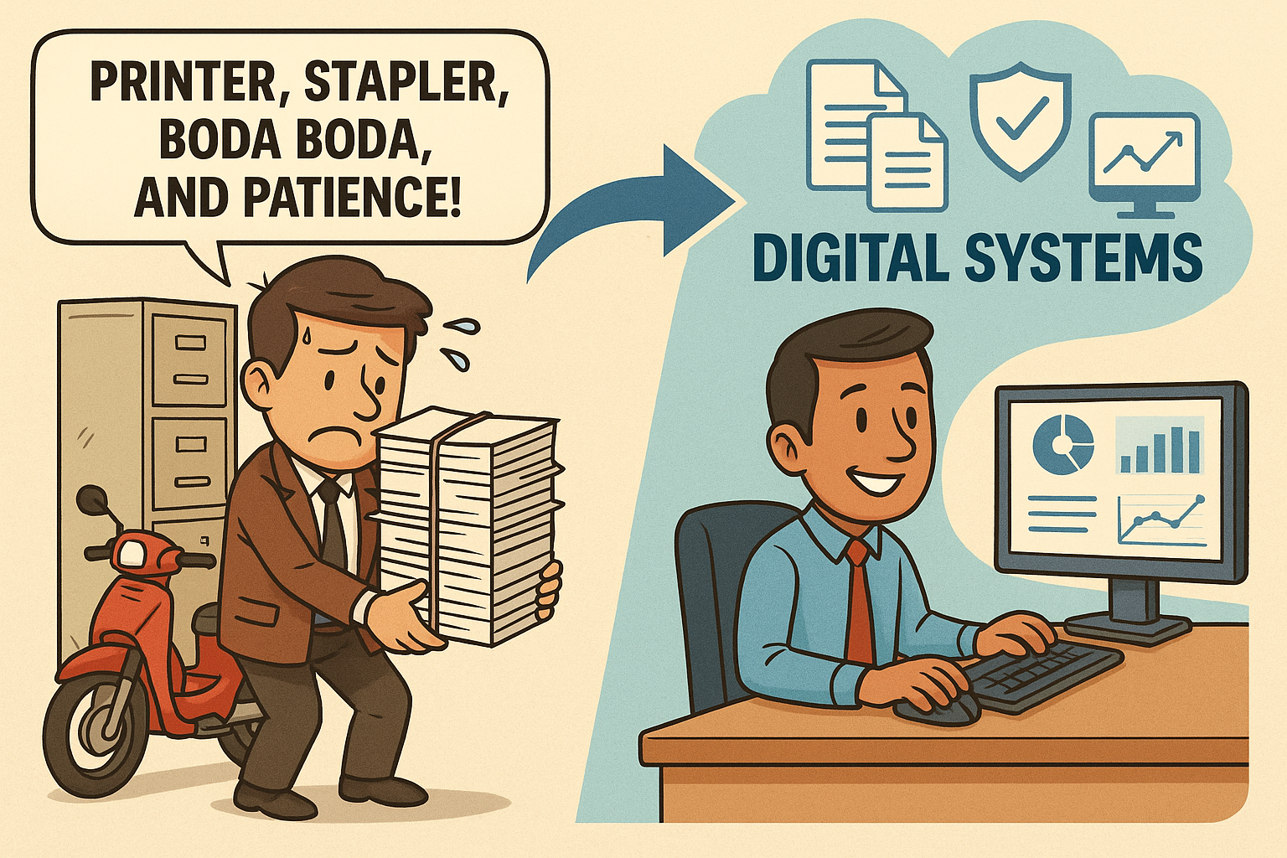
BEFORE DIGITAL: THE BODA BODA QUALIFICATION ERA

Slide 3

WHY THE BODA BODA QUALIFICATION ERA

Slide 4










Launching a New Era in Qualifications
1 Mins
2 Mins
5 Mins
1 Mins
1 Mins
Introduction
Digital Ecosystem Overview
System Highlights
Impact & Analytics
Challenges & Lessons Learned
A quick nod to the Kenya National Qualifications Authority (KNQA), the powerhouse behind this innovative shift. Let’s dive into their vision!

Slide 5
















KNQF ACT OVERVIEW
The KNQF Act (Cap. 214) established KNQA to coordinate and harmonize all qualifications in Kenya.
Database Section 8 (e)
01
It mandates KNQA to maintain a national qualifications database and promote transparency, comparability, and trust in qualification.
Recognition National & International
Trust Quality Assurance
02
To achieve this, KNQA has developed digital platforms that support quality assurance, data management, and inclusive recognition of learning.
Comparability Harmonization
03

Slide 6



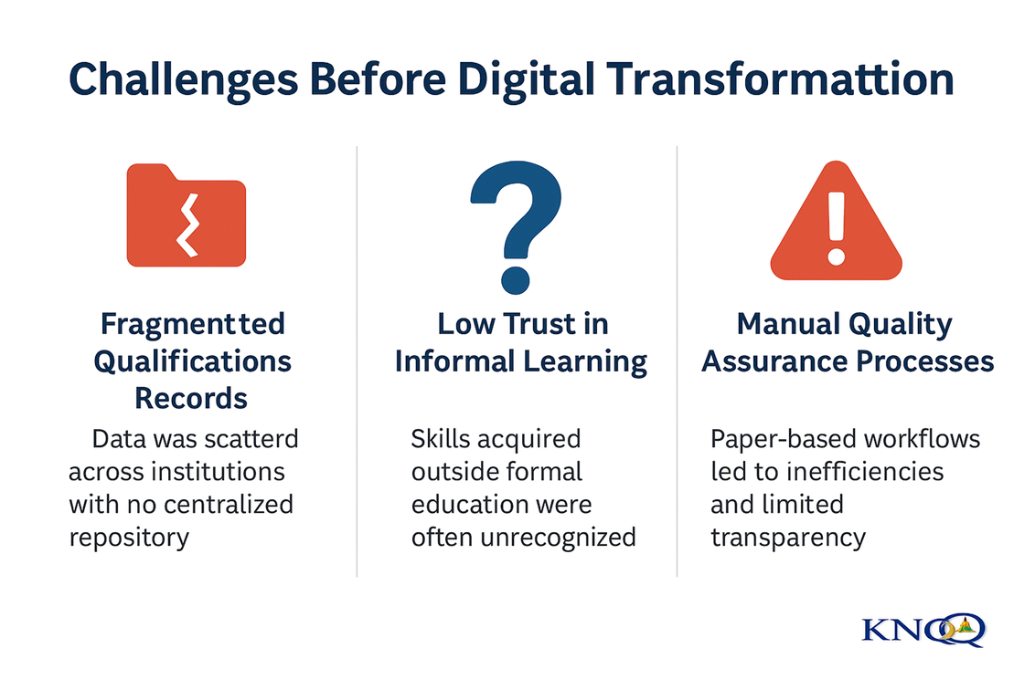
OBSTACLES IN THE PRE-DIGITAL ERA
Fragmented Qualification Records: Data was scattered across institutions with no centralized repository for national visibility.
Low Trust in Informal Learning: Skills and competencies acquired outside formal education were often unrecognized or undervalued.
Paper based and disjointed workflows led to delays, inefficiencies, and limited transparency in qualification validation.

Slide 7





Impact of Pre-Digital Challenges
Before Digital Transformation: What Was at Stake
Slowed Recognition Processes — Manual workflows delayed alignment, validation, and recognition of qualifications.
Increased Risk of Fake Qualifications — Weak verification systems allowed fraudulent credentials to go undetected.
Poor Visibility for Decision Making — Policymakers and institutions lacked reliable, real-time data for planning and reforms.
100%
The results are always better than expected.

Slide 8

Integrated Digital Platforms
The National Qualifications Database (NQD)
The Qualifications Alignment and Validation Portal (QAV Portal)
The Recognition of Prior Learning Management Information System (RPL MIS Portal)
www.knqa.go.ke

Slide 9


INTRODUCTION - NQD
National Qualifications Database (NQD) is a comprehensive relational database that acts as a central repository for all the Qualifications in Kenya.
With maturity, NQD will enable KNQA to report accurately on most aspects of Qualifications in Kenya.
This will also aid in the fight against fake and fraudulent Qualifications.

Slide 10






NQD Modules
01
02
03
04
05
QAB Registration
Qualification Registration
Graduates Registration
Alignment of Qualifications
Qualification Verification
Explore the building blocks of the NQD! From registering qualifications to verifying credentials, these modules are the heart of Kenya’s digital transformation.

Slide 11

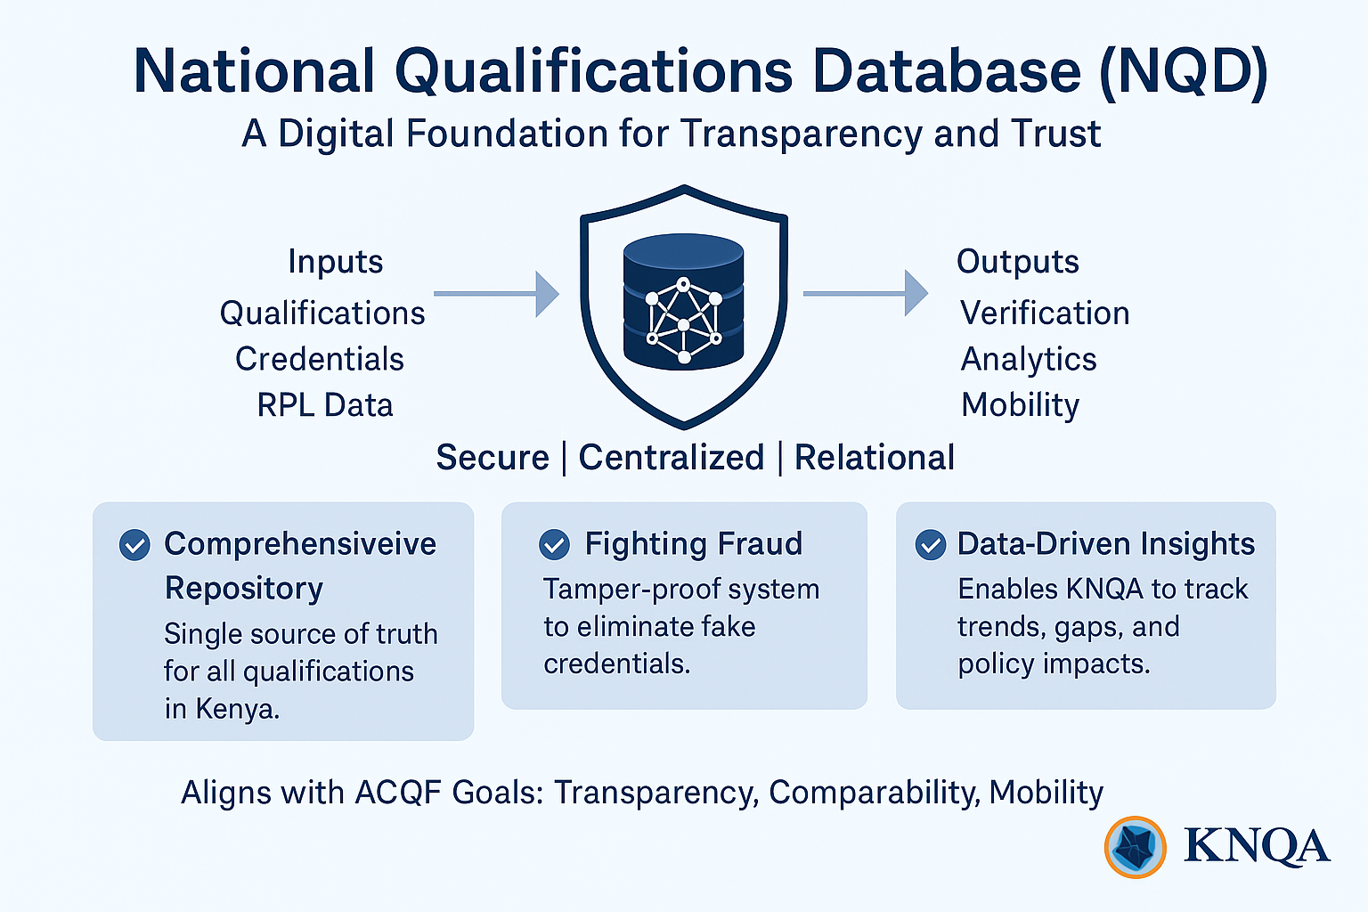

Slide 12
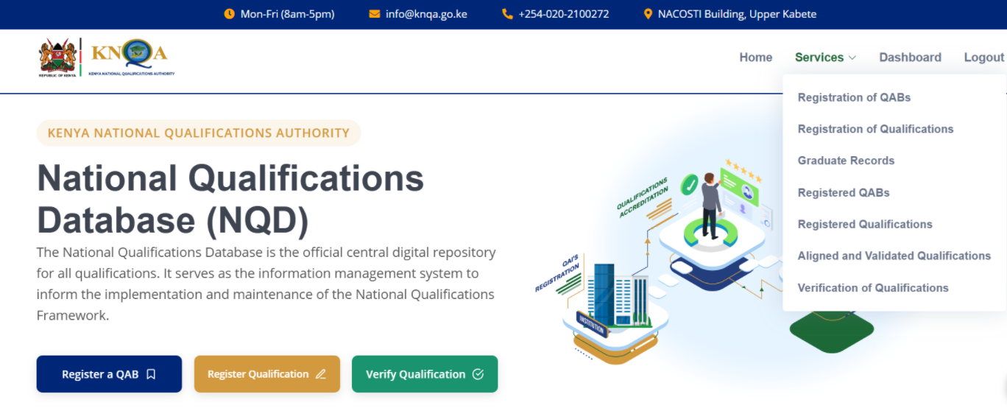
Screenshot of Qualification Database

Slide 13


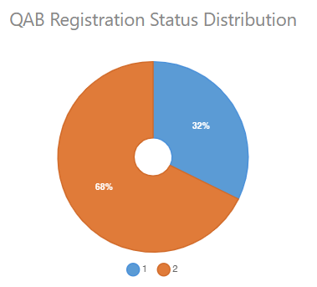
ANALYTICS & REGISTRATION
QAB’s
Category | Mapped QAB’s | Registered QAB’s | Un- Registered QAB’s
Foreign Institutions | 22 | 6 | 16
National Assessment & Examination Bodies | 3 | 2 | 1
Professional Examination Boards | 5 | 3 | 2
Specialized Institutions | 18 | 8 | 10
National Polytechnic | 33 | 26 | 7
Universities | 80 | 7 | 73
Total | 161 | 52 | 109
Statistics

Slide 14

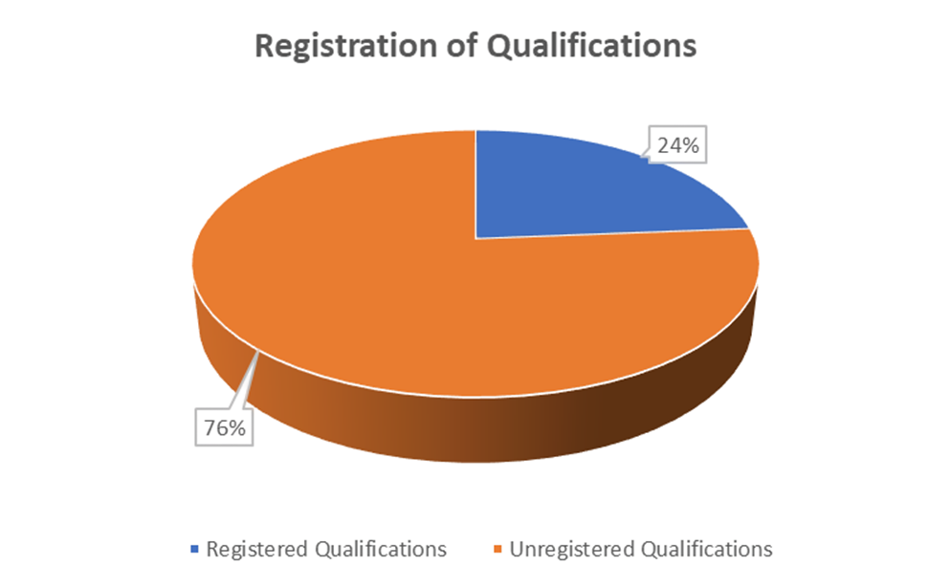
ANALYTICS & REGISTRATION
Qualifications
Category | Mapped Qualifications | Registered Qualifications | Un- Registered Qualifications
Foreign Institutions | 89 | 45 | 44
National Assessment & Examination Bodies | 1,022 | 824 | 198
Professional Examination Boards | 213 | 19 | 194
Specialized Institutions | 442 | 13 | 429
National Polytechnic | 400 | 348 | 52
Universities | 4,409 | 311 | 4,098
Total | 6,575 | 1,580 | 5,025
Statistics

Slide 15


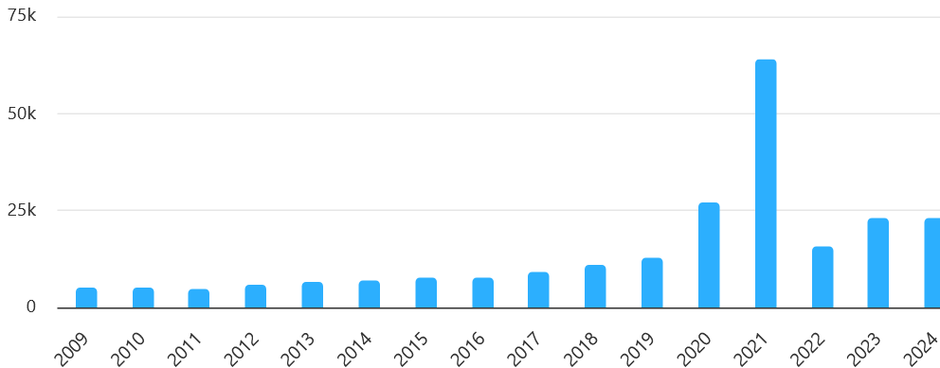
ANALYTICS & REGISTRATION
Graduates
Category | Graduates
2009 | 4,998
2010 | 5,065
2011 | 4,904
2012 | 6,032
2013 | 6,654
2014 | 6,881
2015 | 7,527
2016 | 7,795
2017 | 8,972
2018 | 10,879
2019 | 12,267
2020 | 27,163
2021 | 64,169
2022 | 15,913
2023 | 22,934
2024 | 23,080
Kenya’s qualifications journey to life with a compelling image of progress and innovation.

Slide 16

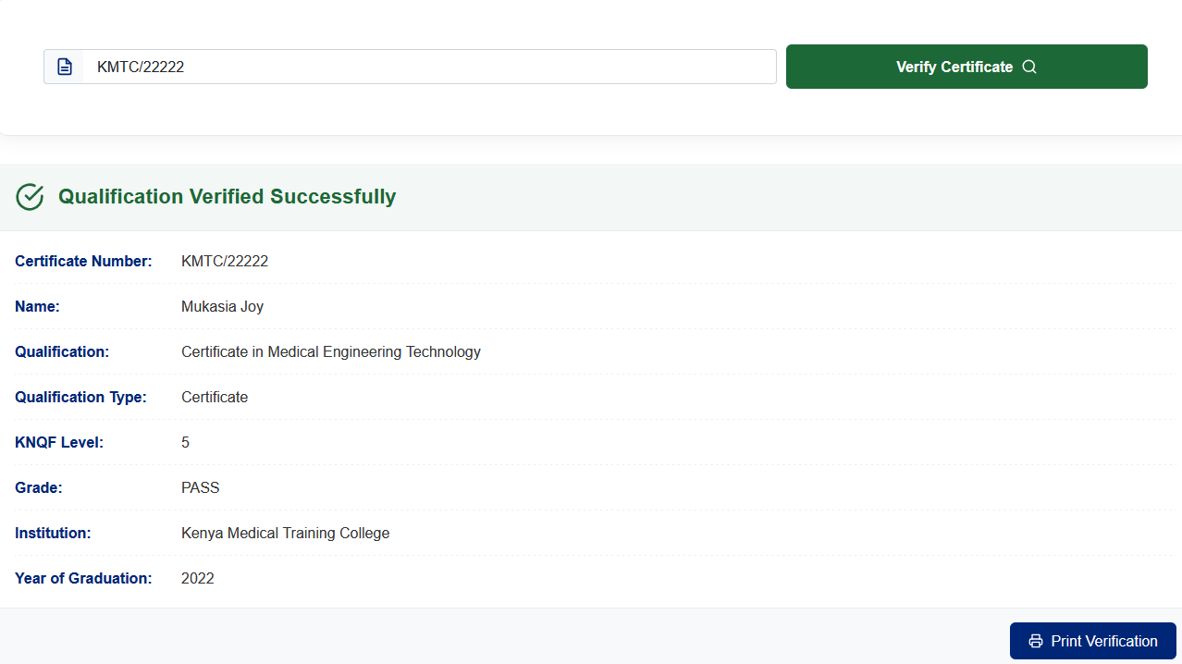
ANALYTICS & ALIGNMENT
Qualifications Verification

Slide 17
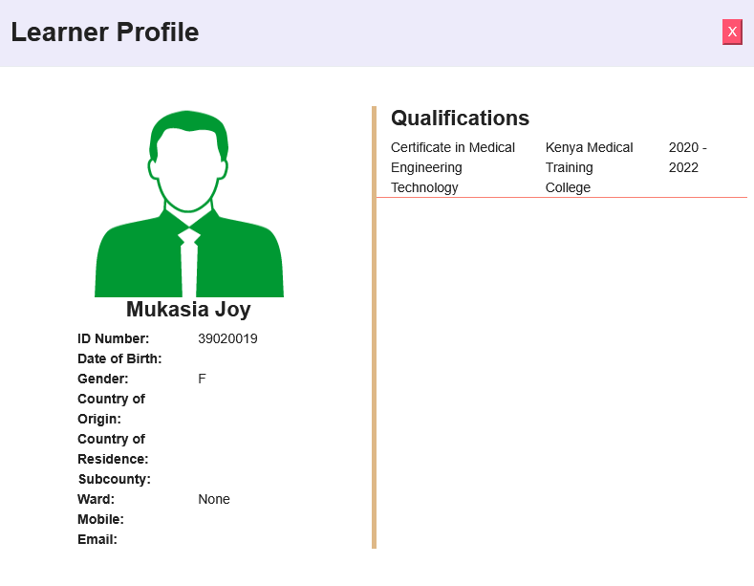
ANALYTICS & ALIGNMENT
Credential Authentication

Slide 18


Qualification Alignment & Validation (QAV) Portal
The QAV Portal is an online platform developed by KNQA to facilitate the submission, alignment, and validation of both national and foreign qualifications
The QAV Portal is an automated online system established by KNQA to facilitate the submission and processing through alignment and validation—of both national and foreign qualifications into the Kenya National Qualifications Framework (KNQF).
Key Features:
Allows applicants to create personal profiles, upload documents, and make payments online.
Ensures only qualifications that meet KNQA standards are validated and aligned to the KNQF framework
Validated qualifications are admitted into the National Qualifications Database (NQD).
Purpose: Guarantee that only authentic and genuine and aligned qualifications are recognized and admitted into the country

Slide 19
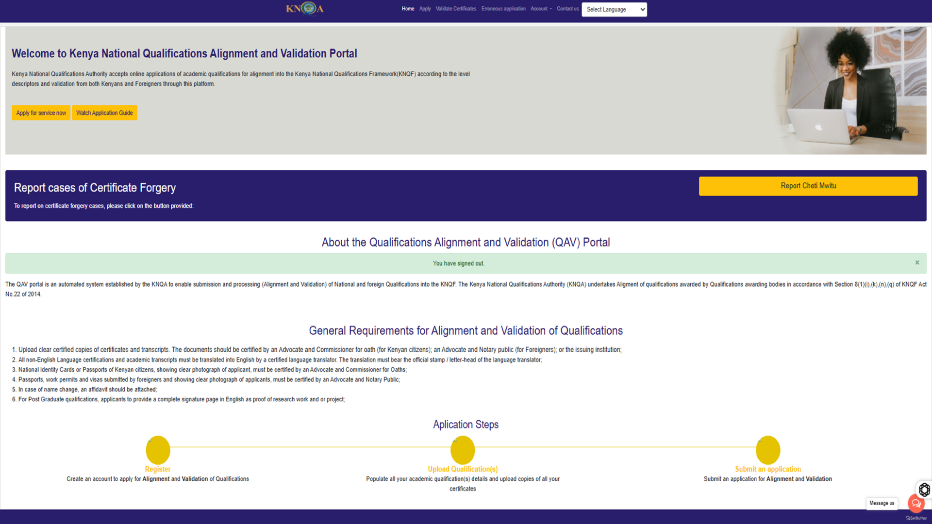

Slide 20
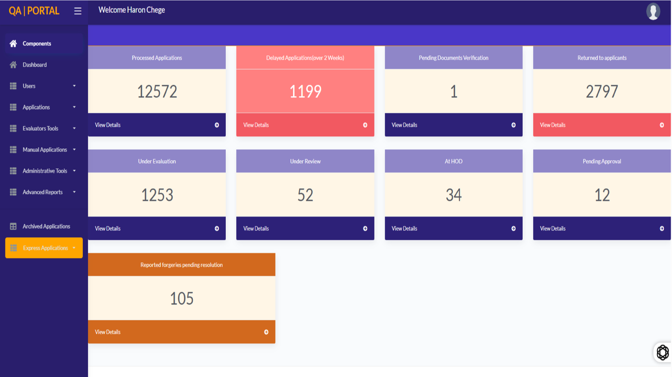

Slide 21
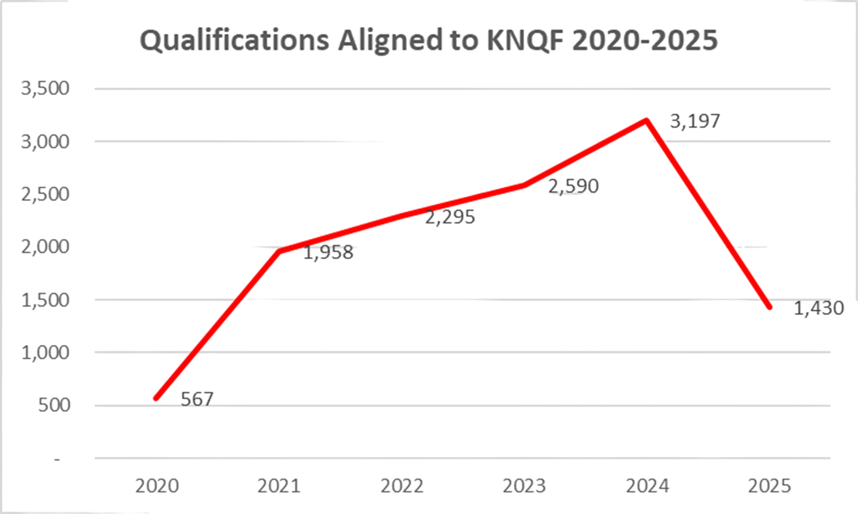
ANALYTICS & ALIGNMENT
Annually
Year | Number
2020 | 567
2021 | 1,985
2022 | 2,295
2023 | 2,590
2024 | 3,197
2025 | 1,430

Slide 22

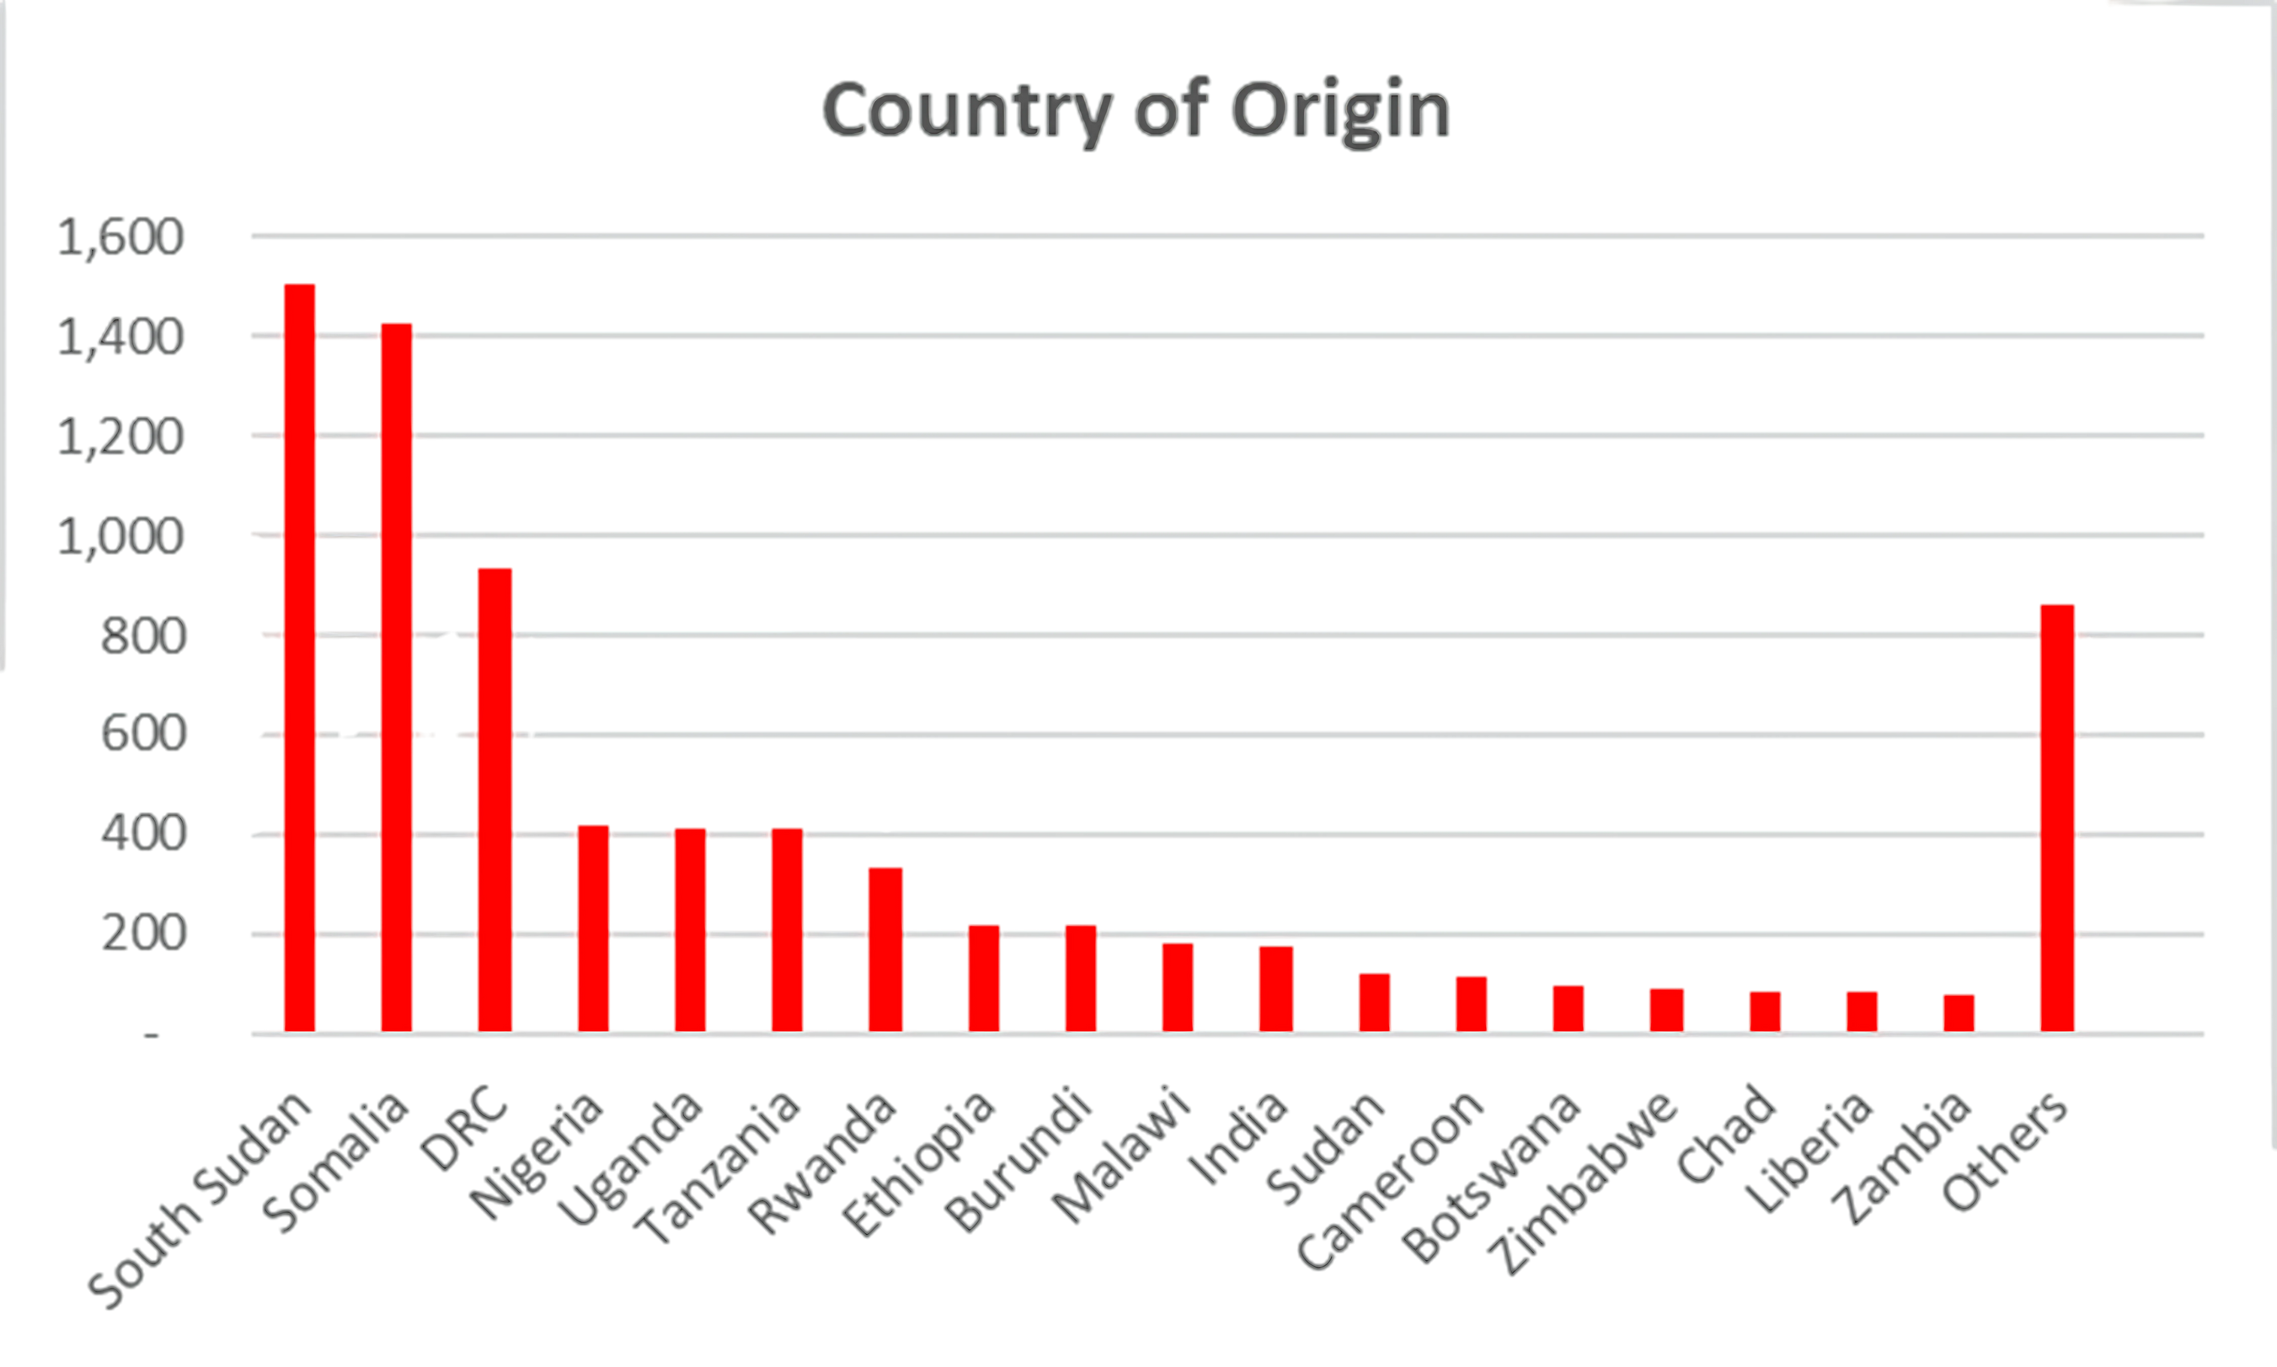
Country of Origin
Country | Qualifications
South Sudan | 1,502
Somalia | 1,425
DRC | 933
Nigeria | 420
Uganda | 413
Tanzania | 410
Rwanda | 322
Ethiopia | 219
Burundi | 217
Malawi | 178
India | 176
Sudan | 121
Cameroon | 116
Botswana | 95
Zimbabwe | 89
Chad | 82
Liberia | 80
Zambia | 75
Others | 859
Analytics reveal the global reach of the alignment process, boosting transparency.

Slide 23



RPL MIS
Recognition of Prior Learning Management Information System (RPL MIS) is a system that automates the process used to identify, assess and certify a candidate's knowledge.
Skills and competencies acquired in non-formal or informal learning, such as work or life experiences, against prescribed standards or learning outcomes.

Slide 24
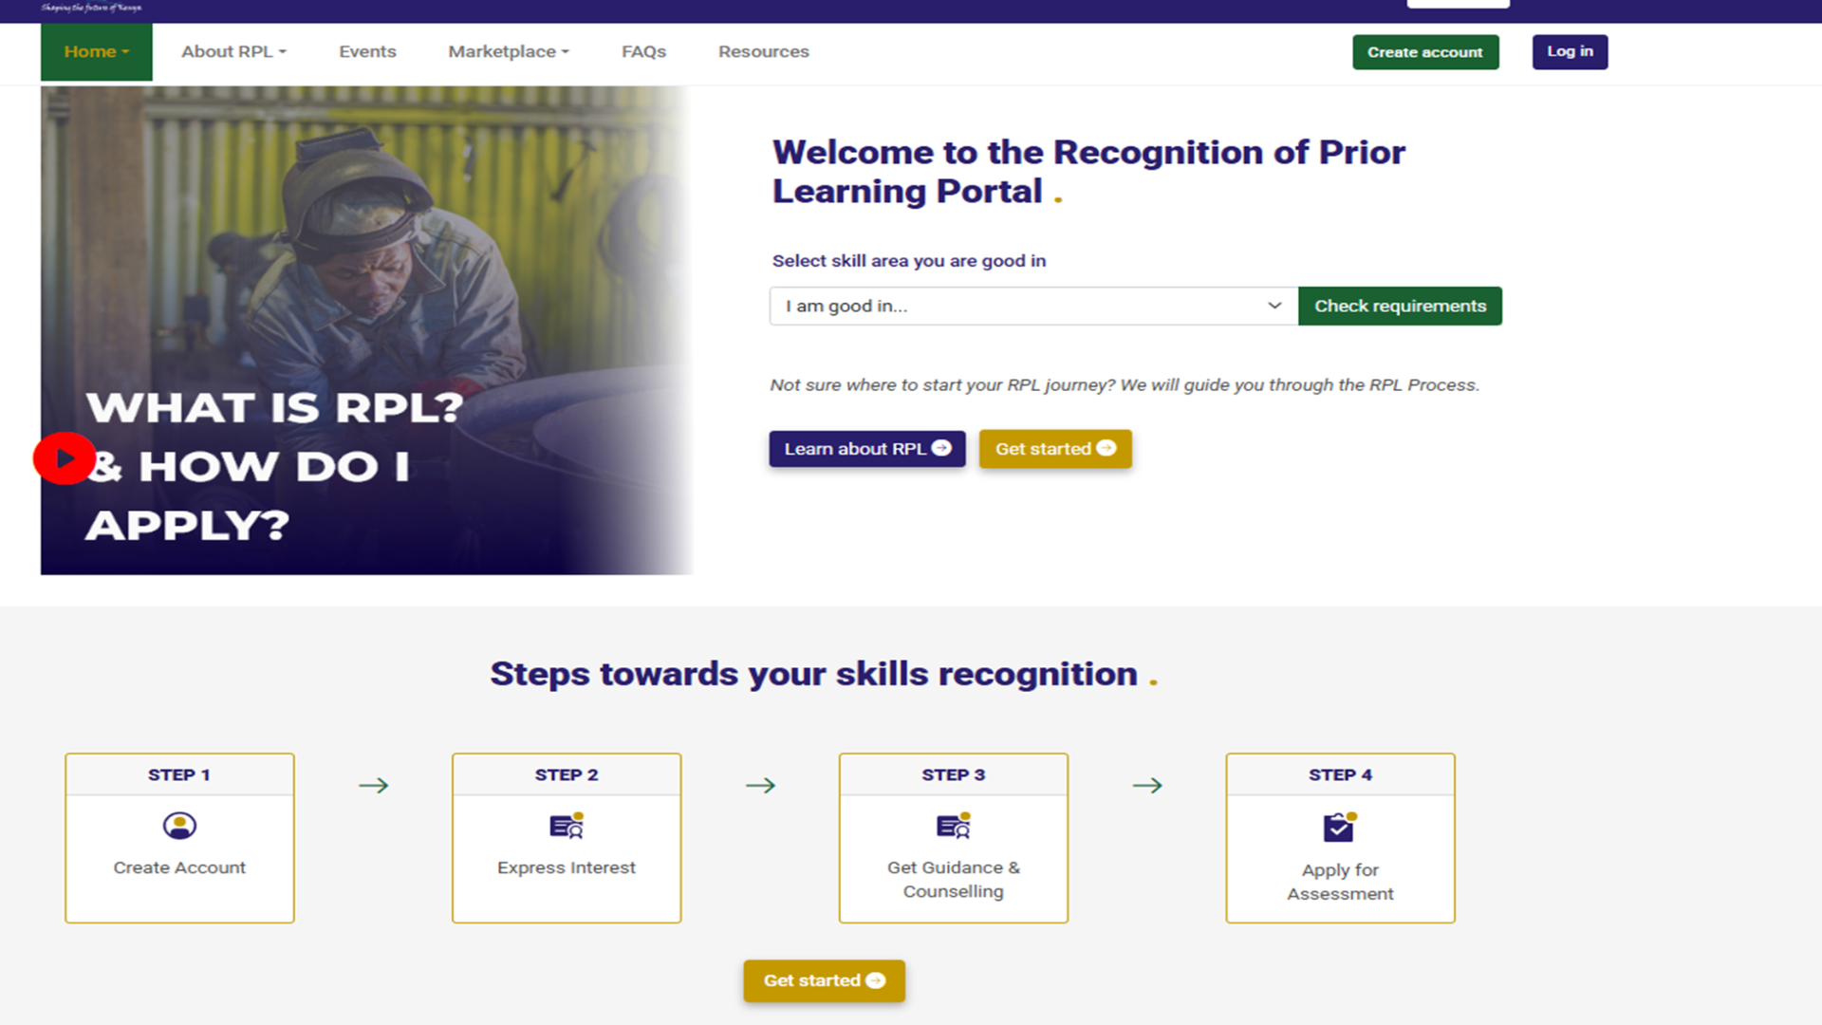

Slide 25
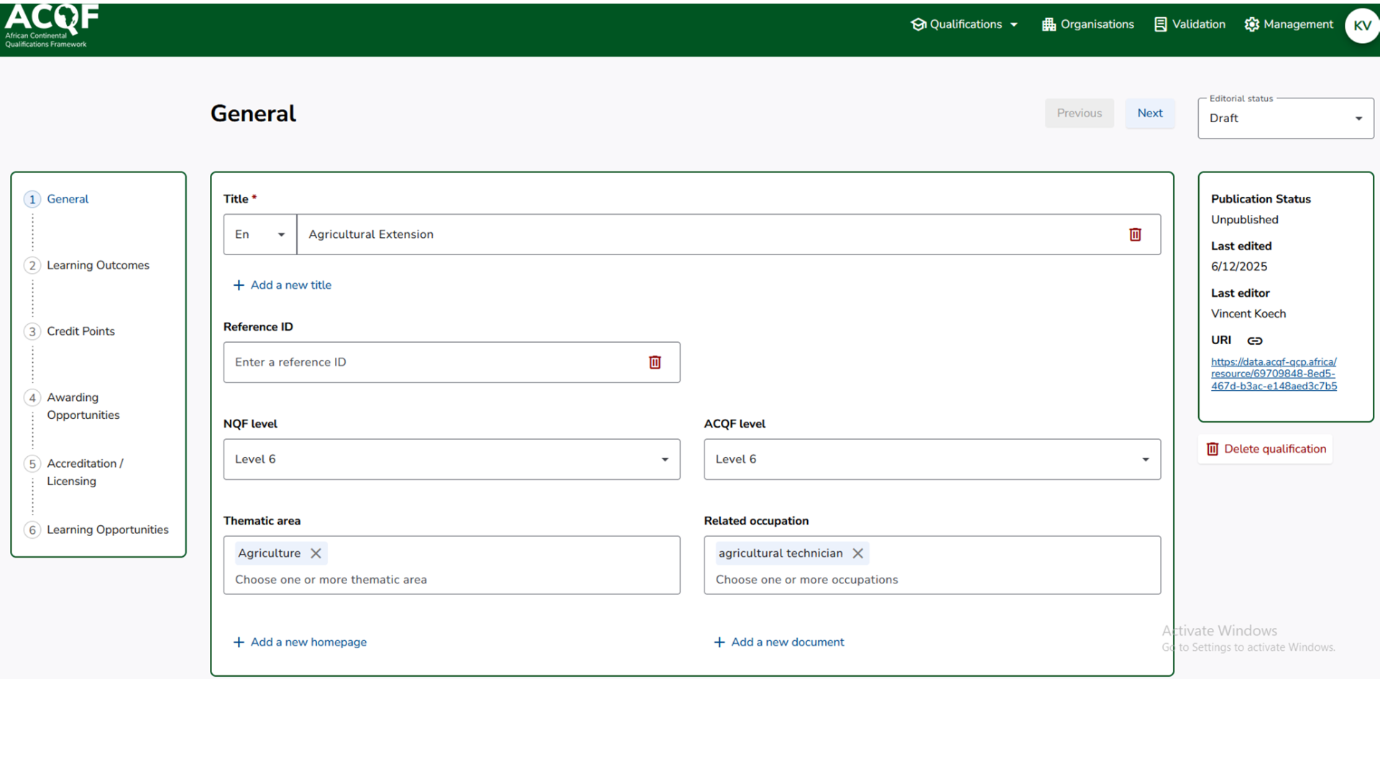


Slide 26







Increased Risk of fake Qualifications
Slowed Recognition
Processes
Poor Visibility for decision making and policy.
A stark reminder of what’s at stake—slow processes, fake credentials, and limited data.

Slide 27



CHALLENGES & LESSONS LEARNED
Cybersecurity Risks: Safeguarding sensitive qualification data against breaches.
Data Validation: Ensuring accuracy and authenticity of submissions across systems.
Technical Capacity: Limited digital skills and infrastructure in some institutions.
Lessons Learned:
Modular System Design: Allowed phased implementation and easier upgrades.
Stakeholder Engagement: Early and continuous involvement improved system adoption.
User-Centered Approach: Systems built around actual user needs enhanced usability.
Today, we honor the dreams, courage, and resilience of every African child.

Slide 28

FUTURE DIRECTIONS
What’s Next: Advancing Kenya’s Digital Qualifications Ecosystem
Interoperability with ACQF QCP: Strengthen linkages with continental platforms to support qualification comparability and mobility.
Enhanced Analytics & Blockchain: Leverage advanced data analytics and explore blockchain for secure, tamper-proof credentialing.
User Education & Support: Expand training and onboarding to boost adoption and system literacy across stakeholders.
System Integrations: Improve integration between KNQA platforms (QAV, RPL MIS) and external systems (eCitizen, NEA MIS, Immigration IPRS)

Slide 29





Realizing the Vision Through Digital Innovation
KNQA’s digital systems are delivering on the promise of inclusion, trust, and transparency in qualifications management. Kenya’s journey demonstrates how integrated digital platforms can create a credible, accessible, and accountable, qualifications ecosystem. It offers a strong continental model for digital transformation aligned with the goals of the ACQF.
Call to Action: Let us continue to collaborate, innovate, and build systems that recognize every learner, every skill, and every qualification.

Slide 30




Thank you…

