Slide 1



Mobility in Qualifications and Credentials
AU Initiatives: Digital and Non-Digital

Slide 2

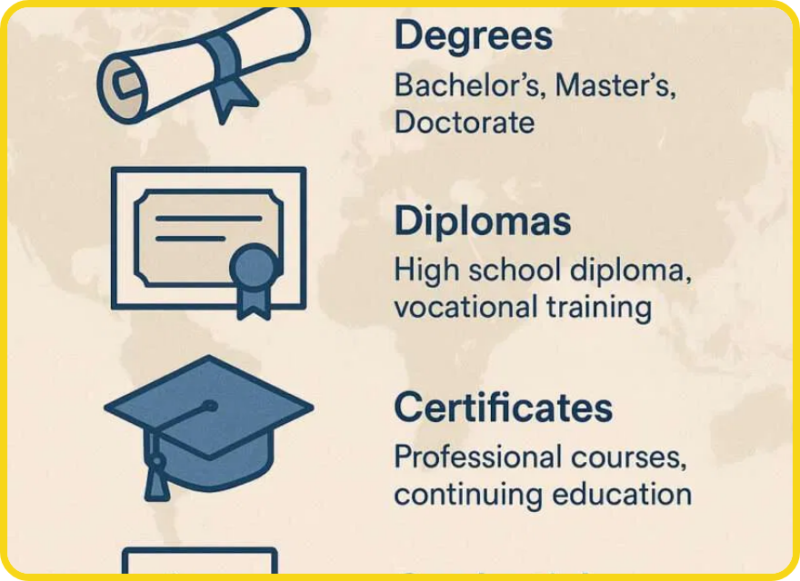



Understanding Qualification Mobility
Qualification mobility
refers to the ability of individuals to
Types of Qualifications
have their qualifications and credentials recognized across
different countries and regions.
For Africa, this mobility is crucial as it:
Facilitates labor migration and skills utilization
Supports regional economic integration
Addresses skills shortages in key sectors
Academic Degrees
Diplomas
Enhances educational and professional opportunities
Without effective credential recognition, Africa loses an estimated 10-15% of potential economic value from skilled labor mobility.
Certificates
Professional Credentials

Slide 3




Challenges in Qualification Recognition
Underutilization of Skills
Lack of Credential Portability
Qualified professionals unable to practice their professions due to non-recognition of their qualifications, leading to brain waste and deskilling.
Absence of mechanisms to ensure qualifications are recognized across borders, hindering labor mobility and regional integration.
Limited Policy Coordination
Varying Qualification Systems
Insufficient coordination between migration, education, and labor market policies, creating barriers to effective qualification recognition.
Diverse education and qualification systems across countries with different standards, making comparability and recognition difficult.
"These interconnected challenges require a coordinated continental approach to qualification mobility."

Slide 4







AU Strategic Initiatives
ACQF
AfCFTA
African Continental Qualifications Framework
-
African Continental Free Trade Area
- Facilitates
Promotes transparency and comparability of
professional mobility across borders.
qualifications.
AU TVET Strategy
PAQAF
Technical and Vocational Education
- Makes
Harmonisation and Quality Assurance
-
education systems responsive to labor markets.
Establishes harmonized accreditation systems.

Slide 5
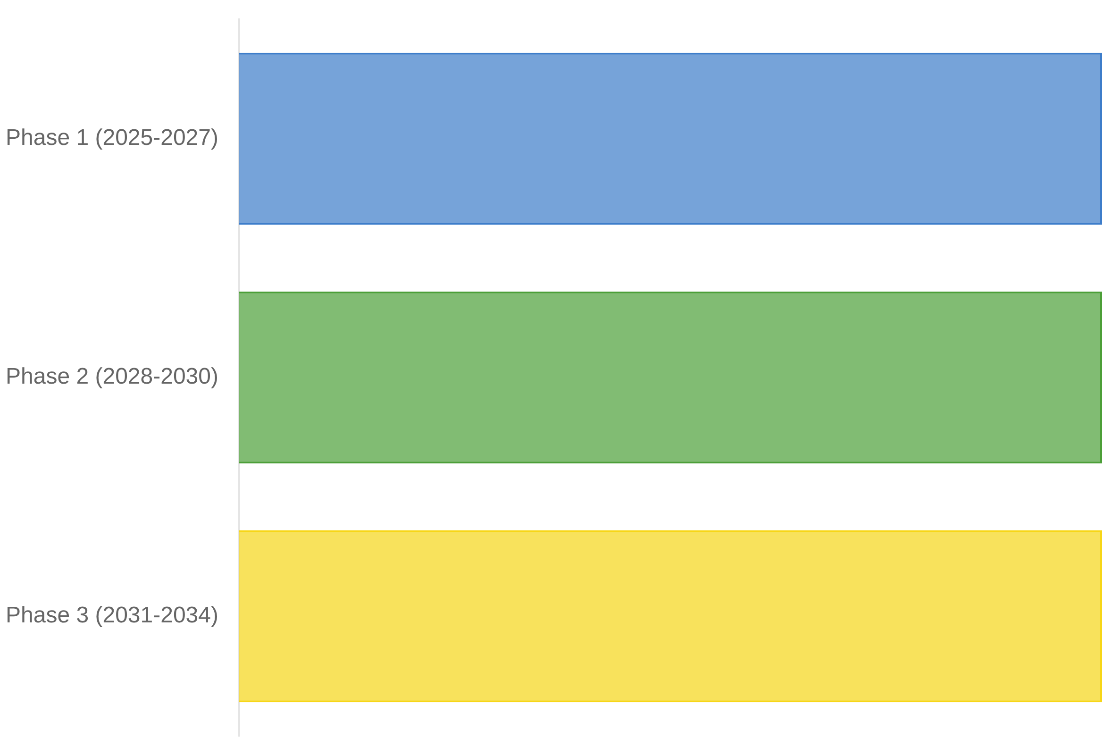




AU TVET Strategy (2025-2034)
The
AU Technical and Vocational Education and Training
Implementation Timeline
(TVET) Strategy
aims to make education systems more
flexible, inclusive, and responsive to labor market needs
across Africa.
Key Elements for Qualification Mobility
Skills partnerships between countries and regions
Harmonization of TVET qualifications across the continent
Mutual recognition frameworks for skills and competencies
Recognition of prior learning and informal skills

Slide 6


Pan-African Quality Assurance and Accreditation Framework (PAQAF)
PAQAF
HAQAA
African Standards and Guidelines for Quality Assurance (ASG-QA)
AQRM for Institutional Evaluation/Data
HAQAA
Capacity Building Trainings in Quality Assurance for National QA Agencies
HAQAA
African Continental Qualifications Framework
EU/ETF
African Credit Accumulation and Transfer System
HAQAA
Addis Recognition Convention
UNESCO
Pan African QA and Accreditation Agency
HAQAA
CESA 2035/ Second Ten-Year Implementation Plan of Agenda 2063
**Tools and action lines for transparency between systems, trust,
a common language for quality, mobility and recognition, embedded in Agenda 2063

Slide 7
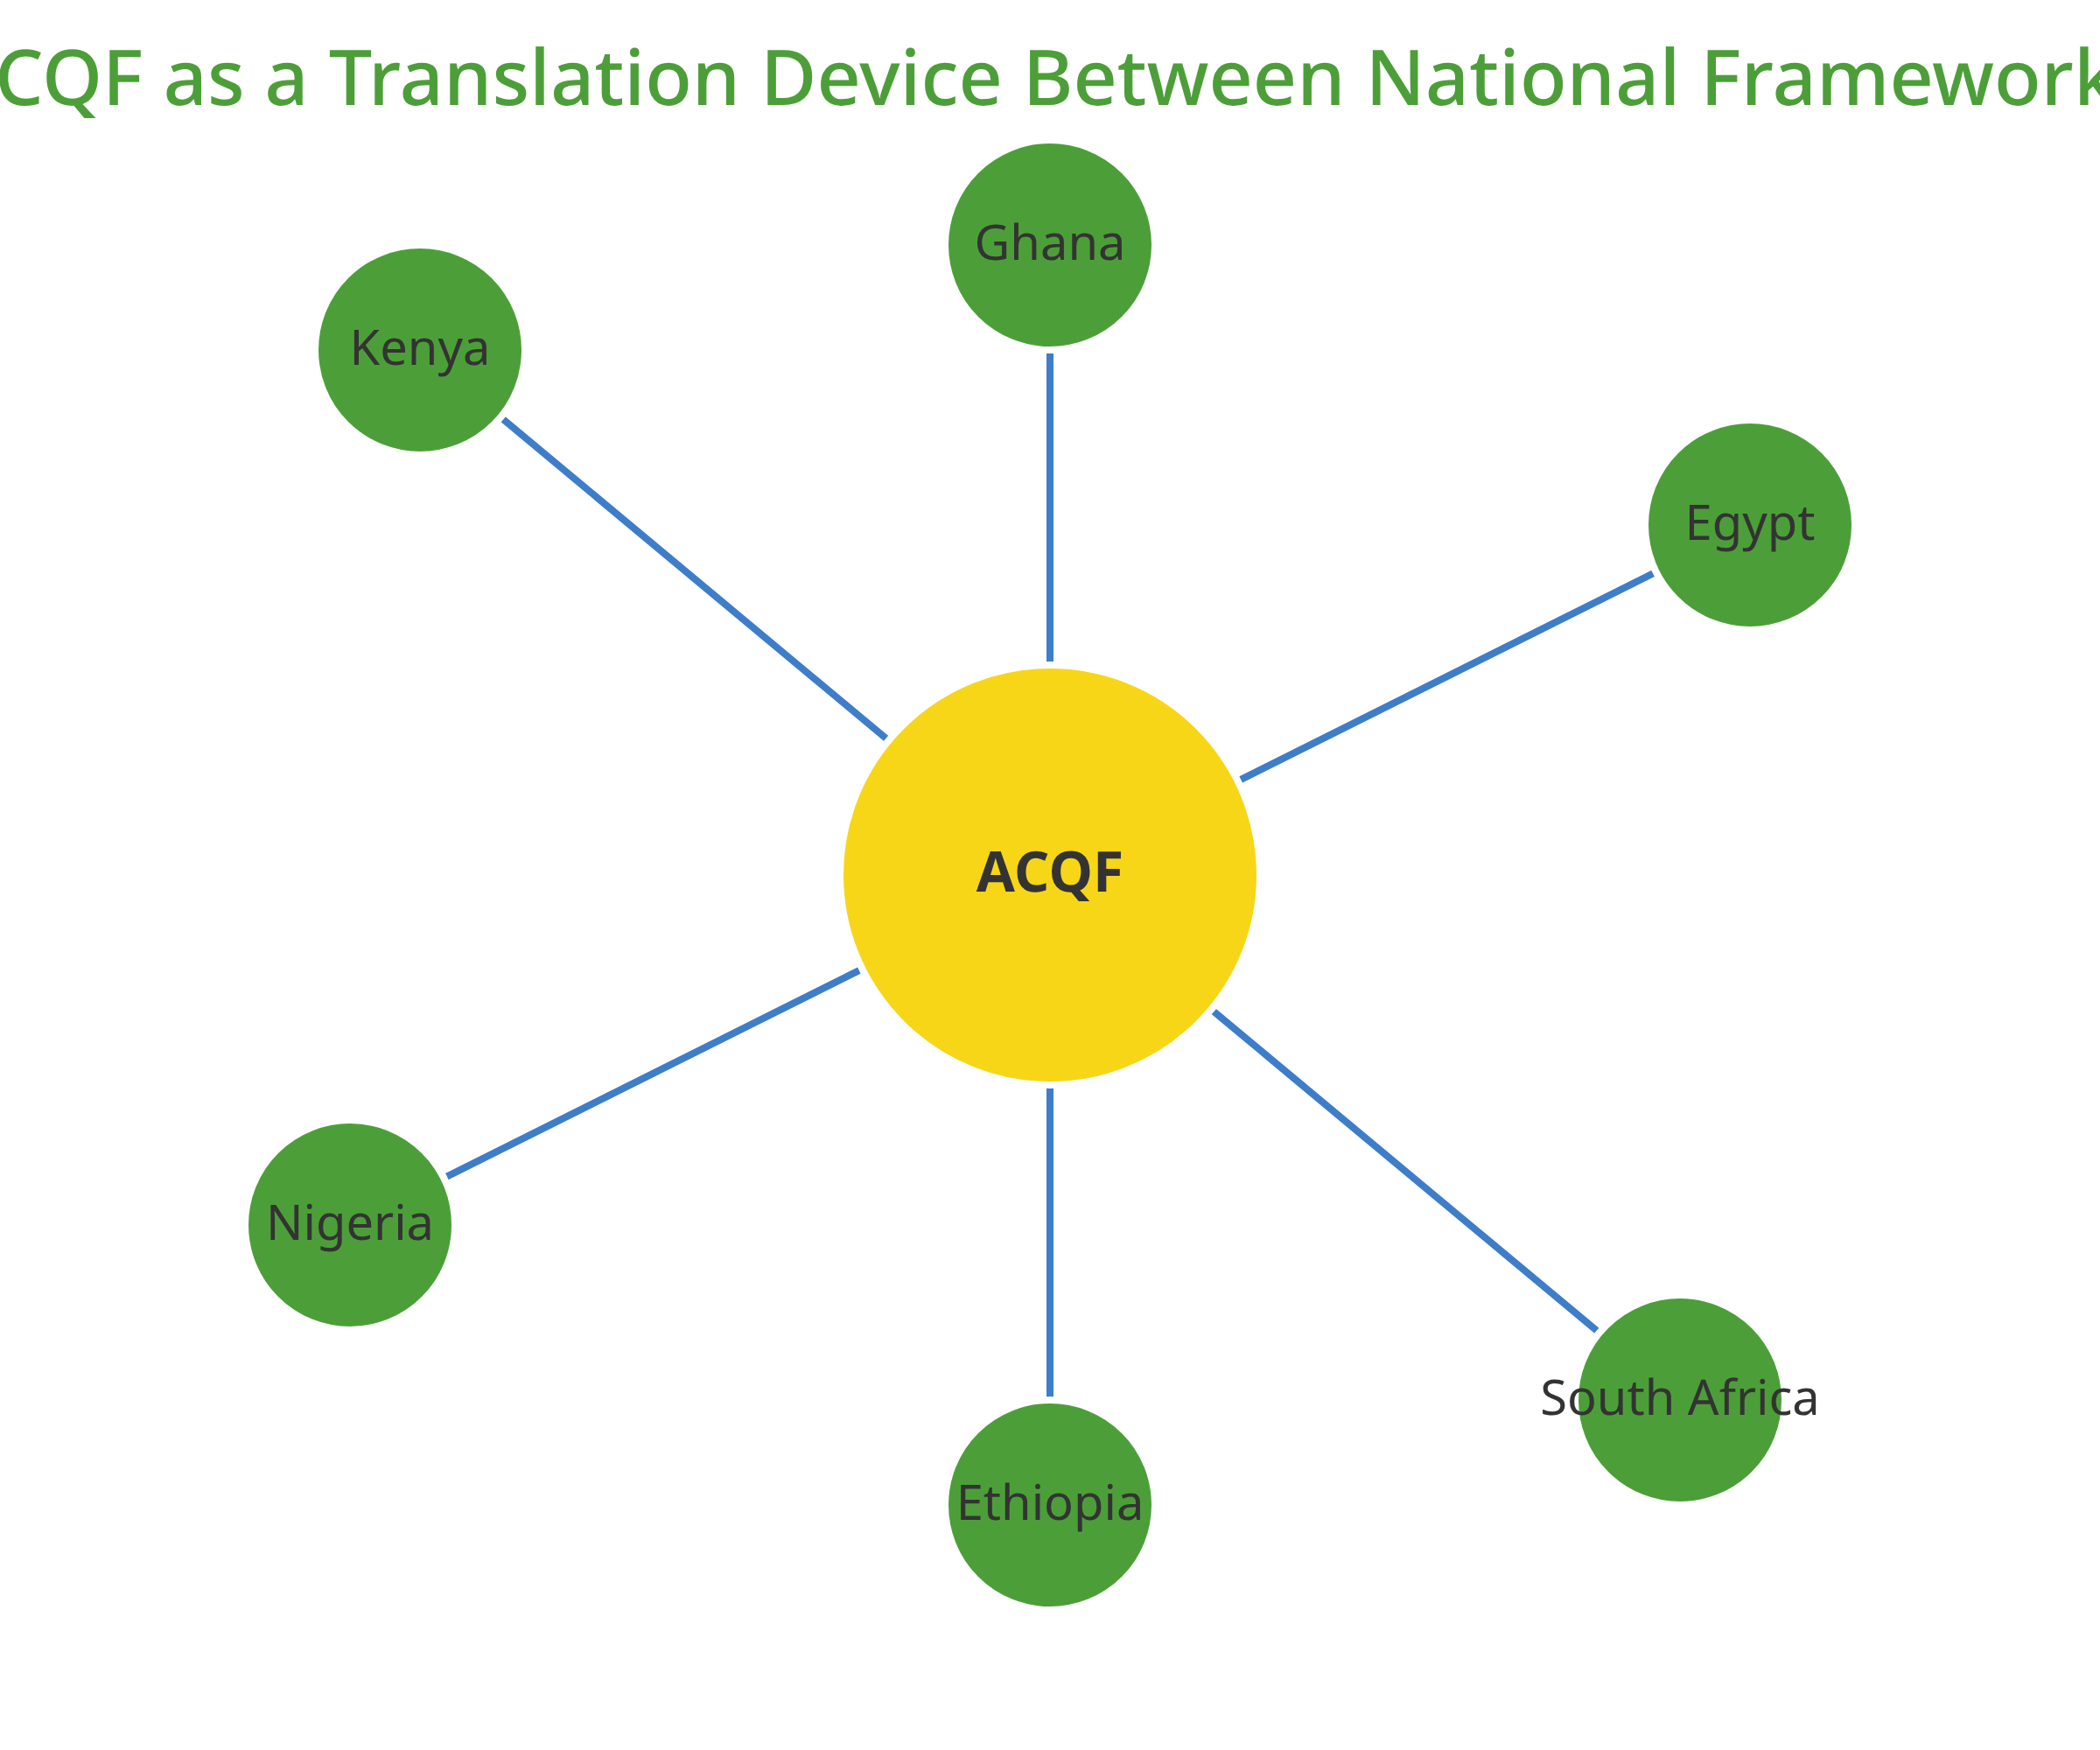


African Continental Qualifications Framework
The
African Continental Qualifications Framework (ACQF)
is a
policy instrument designed to enable comparison and mutual
recognition of qualifications across Africa.
Key Objectives
Promote transparency and comparability of qualifications
Facilitate mutual trust between qualification systems
Enable credit transfer and recognition of prior learning
Support continental mobility of learners and workers

Slide 8








African Credit Transfer System
The
African Credit Transfer System (ACTS)
is a tool developed
How ACTS Works
under the HAQAA initiative to facilitate the recognition and
transfer of learning achievements between higher education
institutions across Africa.
Institution A
Credits Earned
Institution B
Country 1
ACTS Format
Country 2
Key Features
Standardized credit measurement based on student workload and learning outcomes
Credits Recognized
Continental framework compatible with international credit systems
Qualification Mobility Achieved
Supports academic mobility and lifelong learning pathways
Benefits of ACTS
Enhances student and academic mobility across Africa
Integrates with the African Continental Qualifications Framework (ACQF)
Promotes transparency and trust between institutions
Facilitates qualification recognition and credit accumulation
Supports the implementation of the AfCFTA's provisions on services

Slide 9
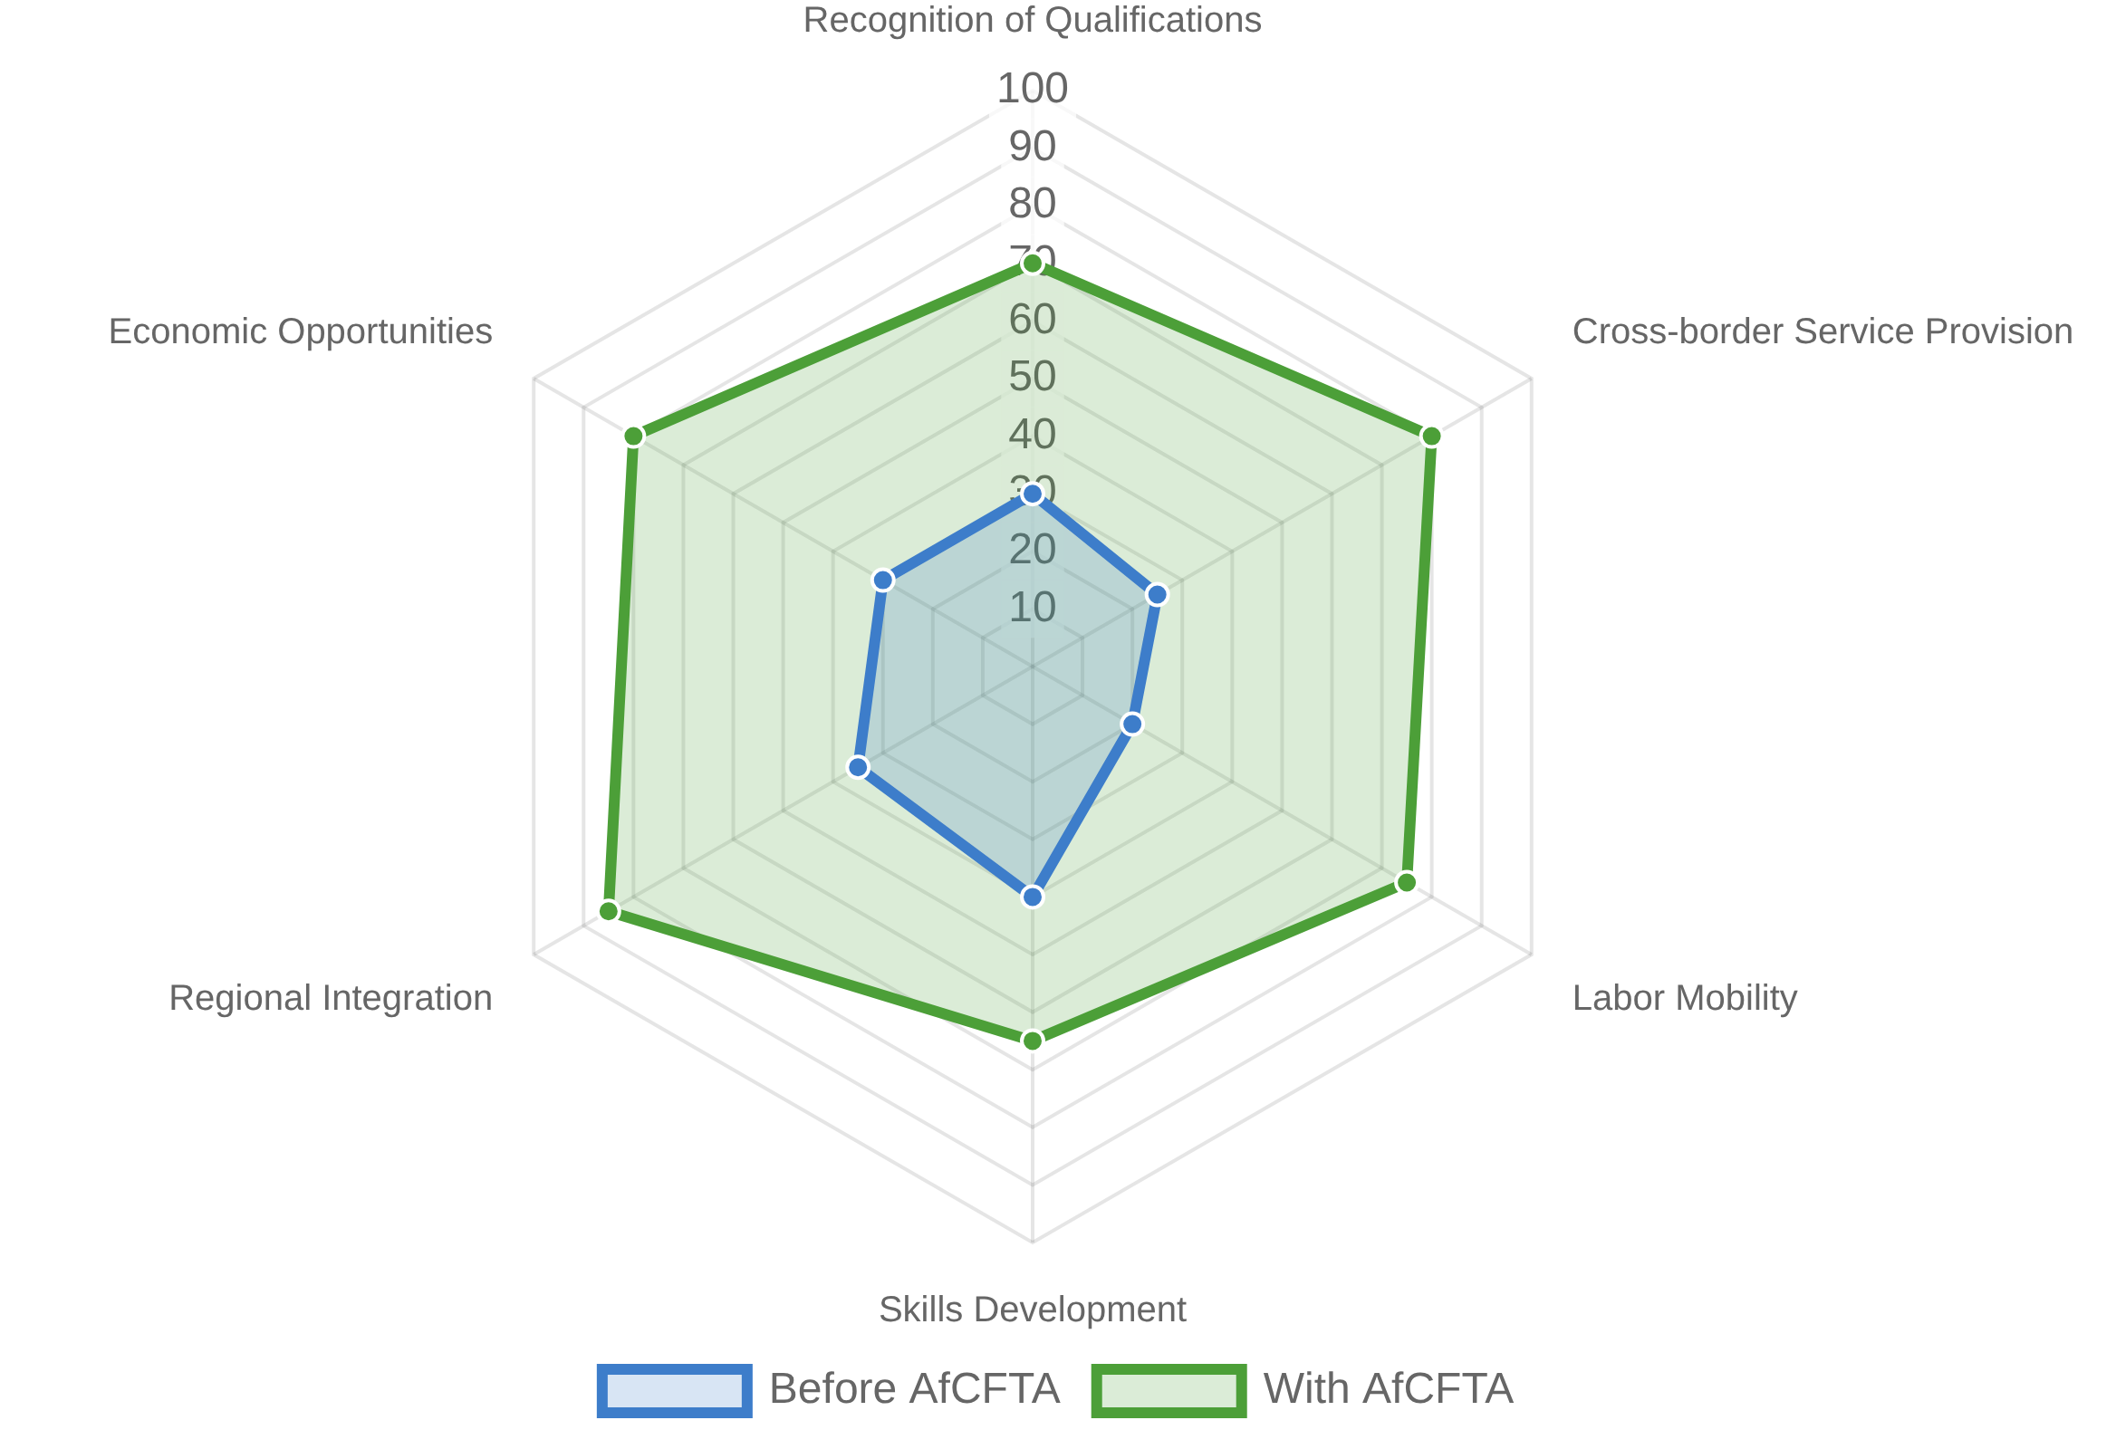




AfCFTA and Professional Mobility
The
African Continental Free Trade Area (AfCFTA)
creates a
AfCFTA Impact on Professional Mobility
single market for goods and services, facilitating the free
movement of business professionals and investments.
Key Provisions for Qualification Mobility
Mutual Recognition Agreements (MRAs) for professional qualifications
Cross-border provision of professional services
Temporary movement of natural persons for business purposes
Harmonization of education and training standards

Slide 10



Digital vs Non-Digital Approaches
Digital Approaches
Non-Digital Approaches
Digital Credentials
Paper-Based Documentation
Electronic certificates and badges that can be verified online and shared instantly across borders.
Traditional certificates and diplomas requiring physical handling and manual verification processes.
Online Verification Systems
In-Person Verification
Centralized databases allowing real-time verification of qualifications by employers and institutions.
Face-to-face assessment of skills and qualifications through interviews and practical demonstrations.
Blockchain for Credential Verification
Traditional Recognition Agreements
Secure, tamper-proof records of qualifications that can be trusted without third-party verification.
Bilateral or multilateral agreements between countries or institutions for qualification recognition.
Virtual Mobility
Physical Mobility
Remote learning and assessment allowing students to gain qualifications from institutions across borders.
Movement of students and professionals across borders for education, training, and employment.

Slide 11

Future Outlook and Next Steps
Key Takeaways
Qualification mobility is essential for Africa's economic integration and development, enabling the continent to leverage its human capital effectively.
The AU has developed strategic instruments (ACQF, AfCFTA, TVET Strategy, PAQAF, and its tools ) that work together to create a comprehensive framework for qualification recognition and mobility.
Recommendations for Advancing Qualification Mobility
1
Strengthen national qualification frameworks and align them with the ACQF
2
Expand AfCFTA's scope on services and professional mobility
3
Recognize informal and experiential learning through validation mechanisms
4
Invest in data systems and labor market intelligence
"Transforming migration from a challenge into a strategic development lever for Africa"

