Slide 1
Digitising Qualifications for Improved Mobility: Global Linked Data Pilot
ACQF Continental Forum
30 July - 1 August, 2025
Scott Cheney, Chief Executive Officer
We encourage reuse and remix of this resource with attribution to Credential Engine.

Slide 2
About Credential Engine
Our Mission: Credential Engine is a non-profit whose mission is to map the qualifications and credentials landscape with clear and consistent information, fueling the creation of resources that empower people.
Our Vision: We envision a future where millions of people worldwide have access to information about qualifications and credentials that opens their eyes to the full range of opportunities for learning, advancement, and meaningful careers.
How we accomplish our Mission and Vision:
Facilitating the evolution of a common infrastructure, data standard, and language
Global input from experts through fully transparent and open working groups
Deep partnerships and collaboration
Empowerment
Notes:
Scott’s notes:
Not a representative of the US
Created by foundations to address needs in the credential and skills marketplace
The CTDL is open source
We facilitate its development through open processes to the data standard is also fully open
Our governance has been recognized for being open and inclusive
GDN Signatory
We are starting initiatives to publish and map QFs around the world, then turn to quals, microcredentials, skills, and QA
Trusted Issuer Registry work

Slide 3


Credential Engine’s Open Technologies
Transforming credential information into linked open data means it can be shared, connected, and used across applications beneficial to everyone.
Credential Transparency Description Language (CTDL)
The only common language that describes key features of credentials, credentialing organizations, competencies, and quality assurance bodies. It is the description language for describing credentials and includes 1,300+ defined CTDL terms. (credreg.net)
Credential Registry
More than a database, the Registry collects and connects credential data described with CTDL to support an open applications marketplace. Anyone can get familiar with CTDL data (credreg.net) and use the Credential Finder (https://credentialfinder.org) - a tool for seeing all of the data in the Credential Registry.
Notes:
Credential Transparency Description Language (CTDL): https://credentialengine.org/credential-transparency/ctdl/ Credential Registry: https://credentialengine.org/credential-transparency/credential-registry/

Slide 4
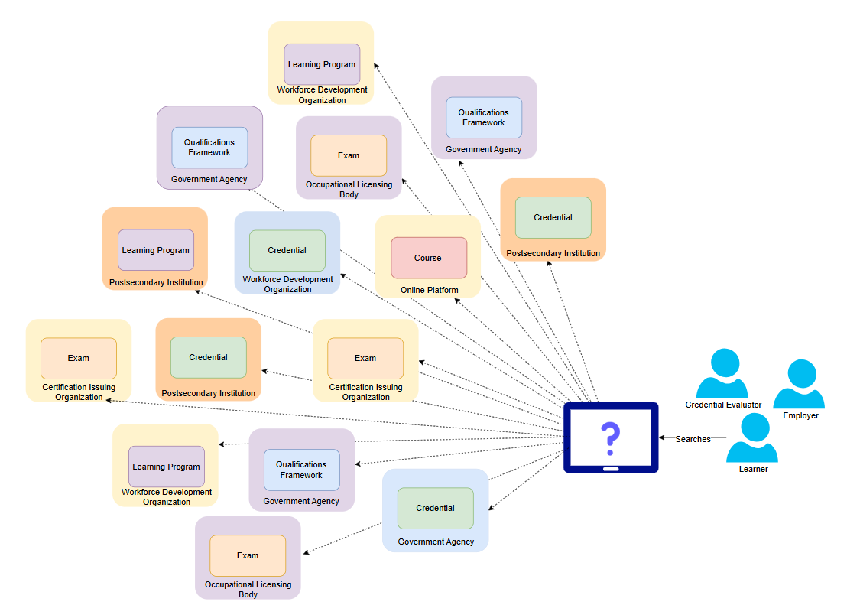
Problem: Essential information about qualifications, skills and competencies, quality assurance, and qualification frameworks, and more is scattered, difficult to find (even for AI), and does not move expeditiously as compared to data about finances, market transactions, travel bookings, etc.
Notes:
This is how it looks currently, numerous searches are needed to find and get information about credentials and their relationships to QFs and pathways.

Slide 5
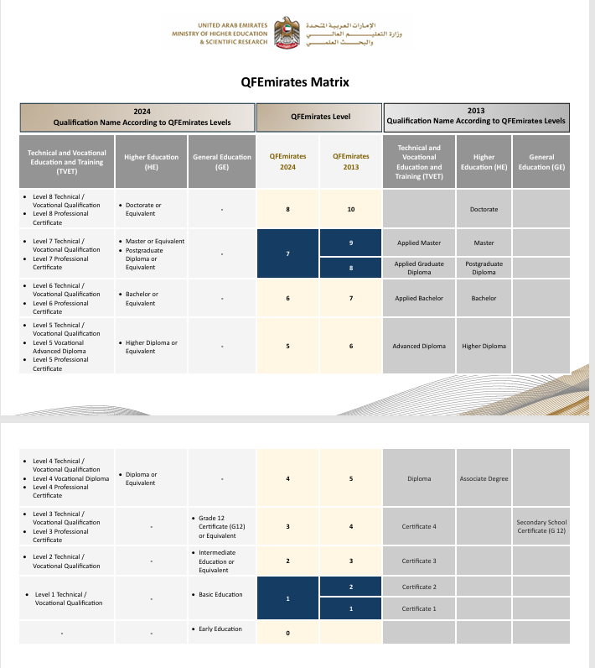
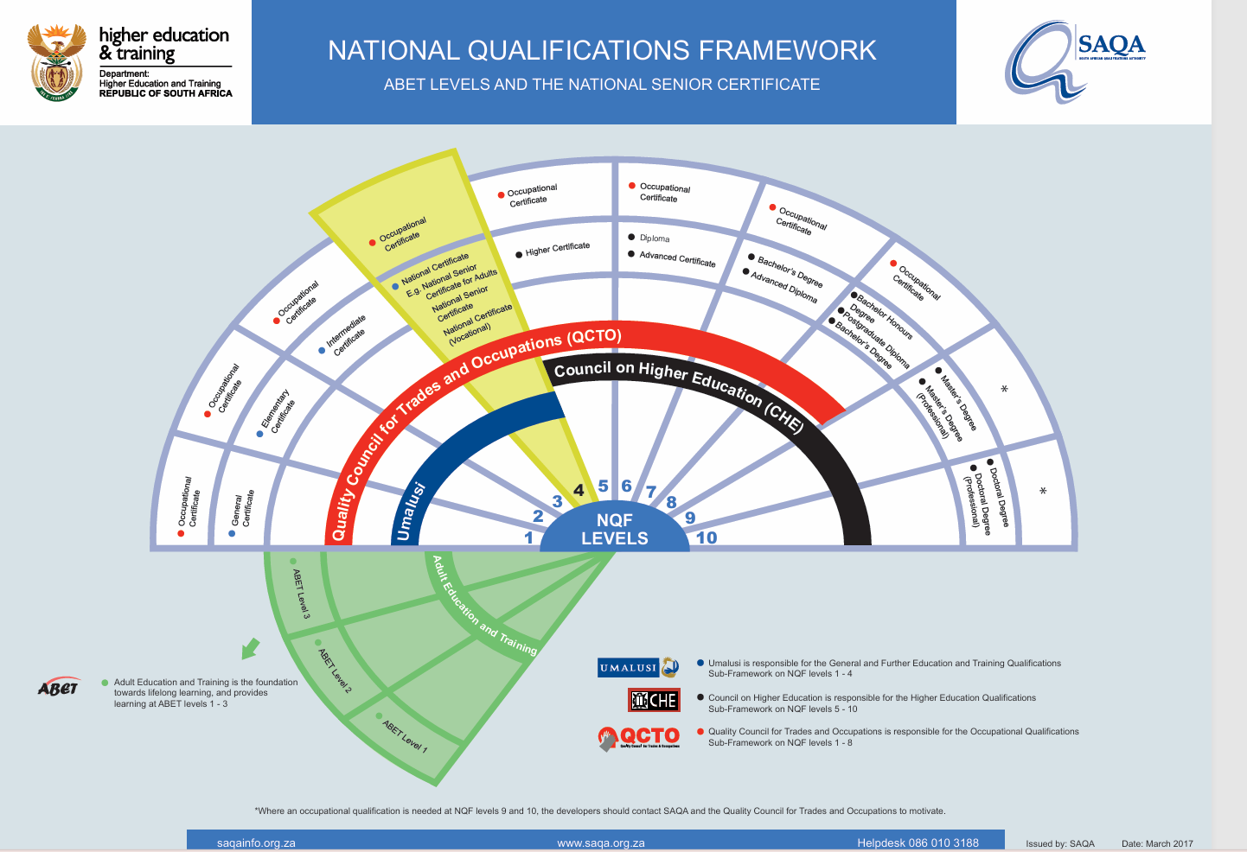
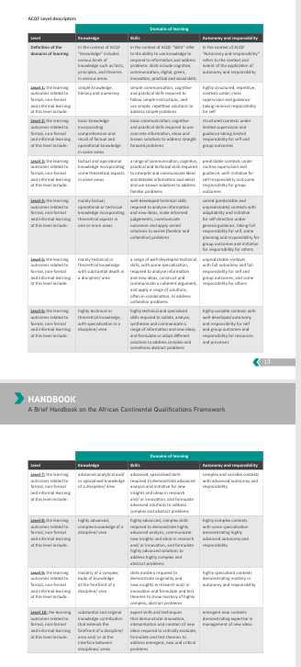
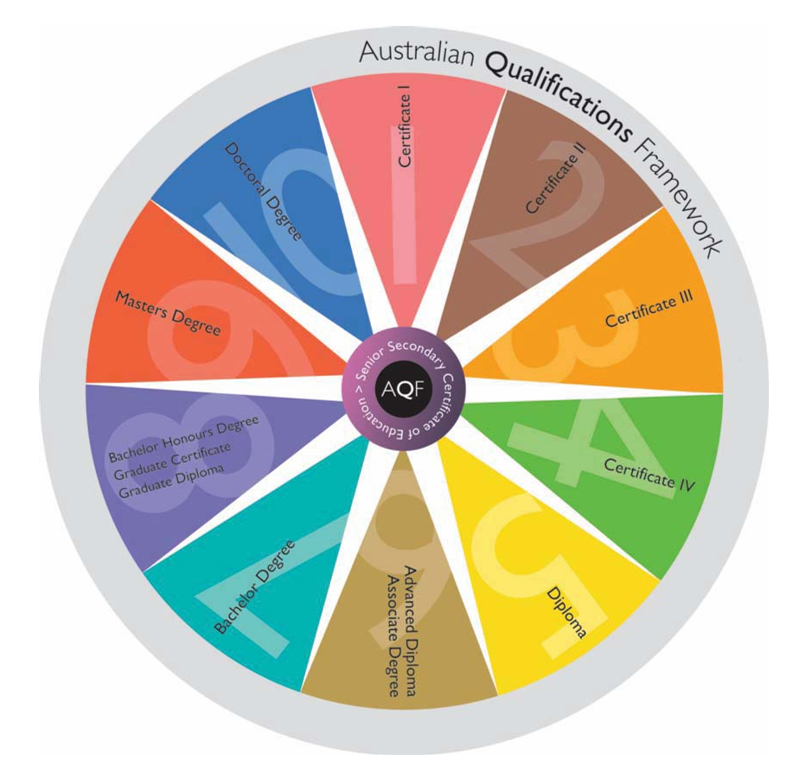
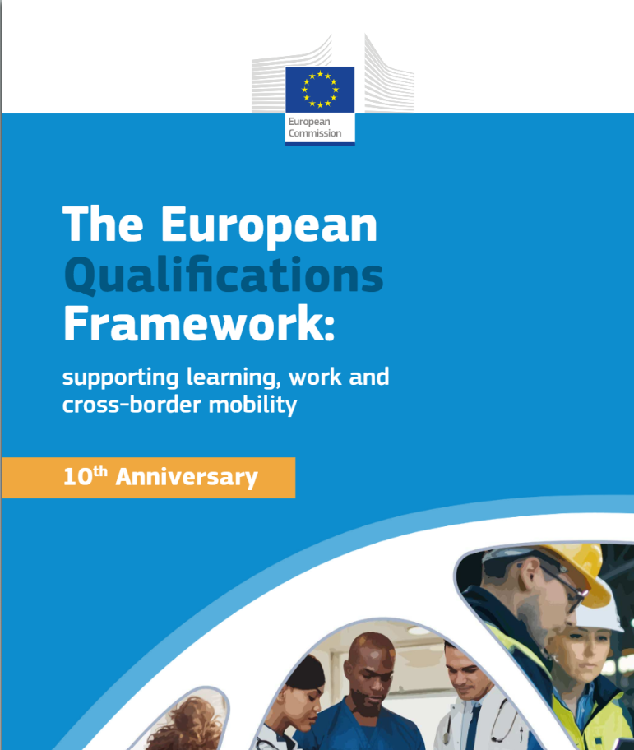
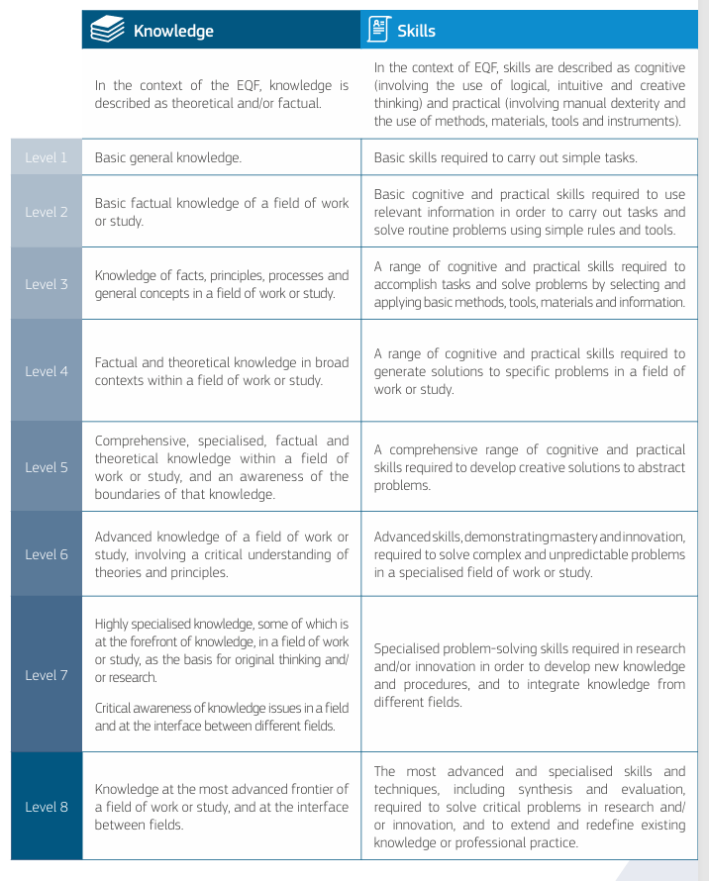
Qualification Frameworks: Many Shapes and Sizes
National Qualification Centre - United Arab Emirates
Australian Qualifications Framework
South African Qualifications Authority
The European qualifications framework - Publications Office of the EU
African Continental Qualifications Framework
1
5
3
4
2

Slide 6

CTDL: A Common Language for Qualification Ecosystems
CTDL support clear, consistent, and reliable understanding of qualifications and related information.
Built on W3C standards for linked open data, ensuring interoperability across systems.Does not change national or regional frameworks while improving global transparency and mobility.
Creates a common structure for describing qualifications and related information.
Ensures data is clear, comparable, and machine-readable.
Provides global interoperability of qualifications.
Supports multilingual data using language maps (linked translations)
CTDL is available under an open license, allowing any organization, government, or institution to use it without restrictions.

Slide 7
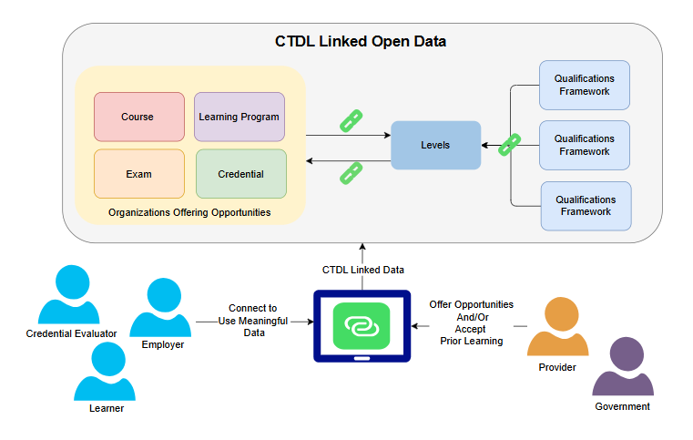
Opportunity: Use modern technologies built on open-source global web standards support structured, open, linked and interoperable data (SOLID), and support trusted sharing, comparison, and verification in a fraction of the time, and requiring less staff time and expense, to support greater learner mobility and learning portability.
Notes:
CTDL solves a critical problem by linking information together making it transparent, comparable, reusable and globally relevant.

Slide 8
CTDL: Describing Credentials and Linking Qualification Frameworks
CTDL goes beyond just describing qualifications. It provides structured data on important details and links data, including credentials to qualification framework levels.
Credentials/Qualifications | Qualification Frameworks
Accreditation & Recognition Costs and Credits Delivery Modes Time to Complete Financial Assistance Requirements Qualification Framework Levels Skills and Competencies Support Services …and more | Alignments and reference mappings to other frameworks progression levels Competencies Descriptors Jurisdiction Progression Levels Scope Terminology / Glossary …and more

Slide 9
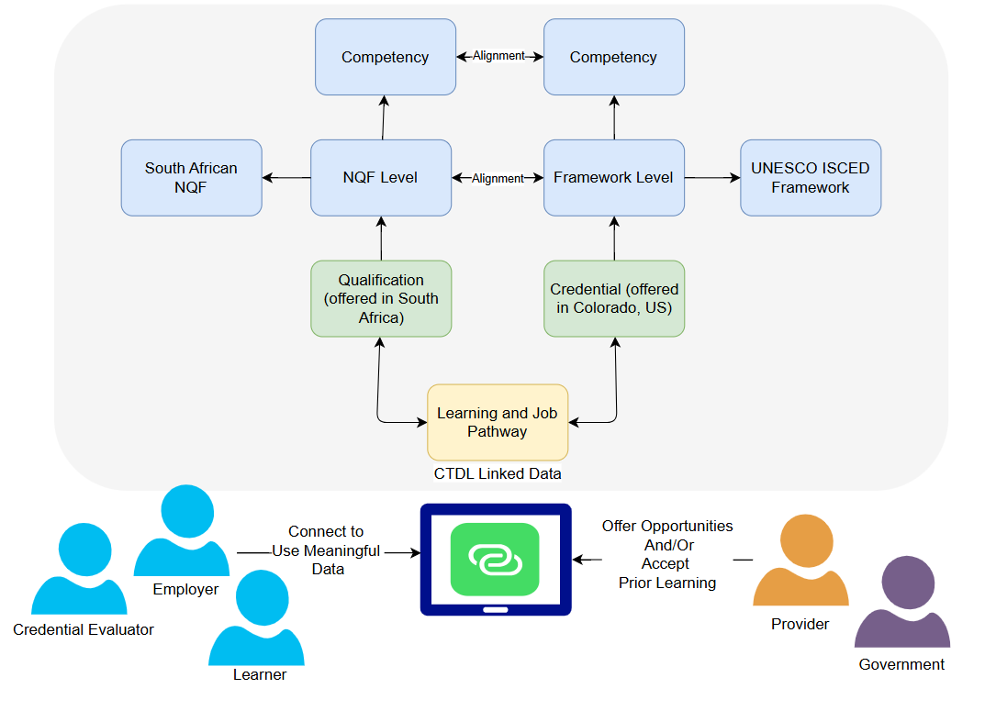
Solution:
Structure learning and job pathway information as linked data supporting connections and flows to power tools and ensure trust in and verifiability of descriptions of and issued credentials.

Slide 10

CTDL’s Global Relevance
CTDL supports qualifications worldwide by enabling clear, structured descriptions that align with different national systems. It is not tied to any single country but can meet global needs due to its key attributes:
Supports language maps, allowing data to be shared in multiple languages.
Built on W3C standards for linked open data, ensuring interoperability across systems.
Functions as a living language, evolving to accommodate diverse requirements.
Describes qualifications as intended by the source authorities, respecting regional definitions and structures.
CTDL helps bridge differences between qualification systems, improving global recognition and access to learning and career opportunities.

Slide 11
Qualifications Framework Use Cases
Examples of use cases CTDL supports:
Search and Discovery: Search and discover qualifications frameworks across different education systems and geographic areas.
Enhancing Mobility: Enabling greater transparency and mobility for learners and workers by allowing for faster sharing qualifications information for review, verification, and approval.
Granularity of Levels as Data: Represent the granularity of levels and their definitions as data, making it possible to display them in tables, graphs, or other formats for analysis and comparison.
Asserting Alignments Between Frameworks: Assert alignments between the granularity of levels between qualifications frameworks, helping to ensure consistency and clarity in understanding educational progression.
Alignments with Other Resources: Assert alignments between various types of qualifications, credentials, assessments, and other resources to specific levels within a qualifications framework, facilitating better alignment of education, training, and workforce needs.

Slide 12
CTDL in Action Globally
2025-2026 Initiatives
Expanding CTDL to more completely cover all terms related to qualifications and qualification frameworks around the world.
Publishing Qualification Frameworks, qualifications, skills, and quality assurance indicators with as many countries as possible.
Developing alignment maps across all frameworks and qualifications, and supporting development of tools and resource to benefit countries and learners..
Examples of International Sandbox Pilots and Testing:
SAQA - Publishing NQF, sampling of healthcare credentials, learning outcome frameworks, and their level alignments,
Open University of Japan - Publishing and consuming micro-credential information in Japanese.
Bhutan and Jamaica in partnership with AACRAO - Publishing credentials of all types.
Netherlands - Preparing to publish credentials.
Quality assurance pilot to publish QA actions included European Quality Assurance Register for Higher Education (EQAR)
Only public information is used—no personal, student, or confidential data is required or collected.

Slide 13
SAQA Proof of Concept

Slide 14
SAQA/Credential Engine POC: Success Criteria
South African NQF: Publish the NQF
Qualifications / Credentials: Link credentials in 2 industries/sectors across levels and types of credentials that will be linked to the qualifications framework progression levels. Show the competencies required for the credentials.
Selected Industry/Sector: Healthcare at secondary and postsecondary levels and occupations that require an occupational license.
Use cases:
As a learner, I need to discover credentials (healthcare) and where they are located in pathways to the career I want in ways to assure my mobility.
As a credential evaluator, I need to support learner mobility and identify specific types of credentials and document their alignment to progression levels in the country where the credential is offered and issued and its comparability to the qualifications framework in the country determining its portability.
As an employer, I need to understand the credentials and the skills/competencies job candidates have and how credentials are comparable to my country’s QF and where they are in a pathway progression.
As a provider, I need to ensure that all learners have the information they need to determine pathways and support mobility and portability.

Slide 15
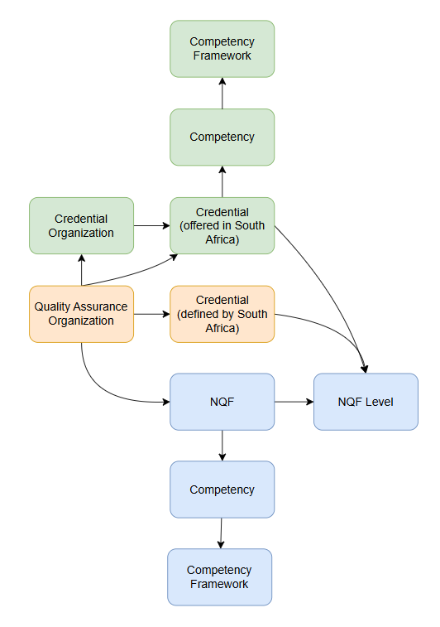
SAQA/Credential Engine POC: Status
The following has been initially selected and published to the Credential Registry Sandbox:
South African NQF: Includes progression levels, descriptors, and competencies
Selected Field: Health Sciences and Social Services
Two (initial) universities:
University of Limpopo
Sefako Makgatho Health Sciences University
Sampling of Health Sciences and Social Services credentials: Offered by University of Limpopo and Sefako Makgatho Health Sciences University (Source of information is the SAQA qualifications search https://regqs.saqa.org.za/search.php)
Linked to the NQF progression level
Linked to the related competency framework
Competency Frameworks: The Exit Level Outcomes with the credentials

Slide 16
Global Qualifications Frameworks as Data Pilot: Using SOLID Principles to Advance Transparency and Mobility

Slide 17
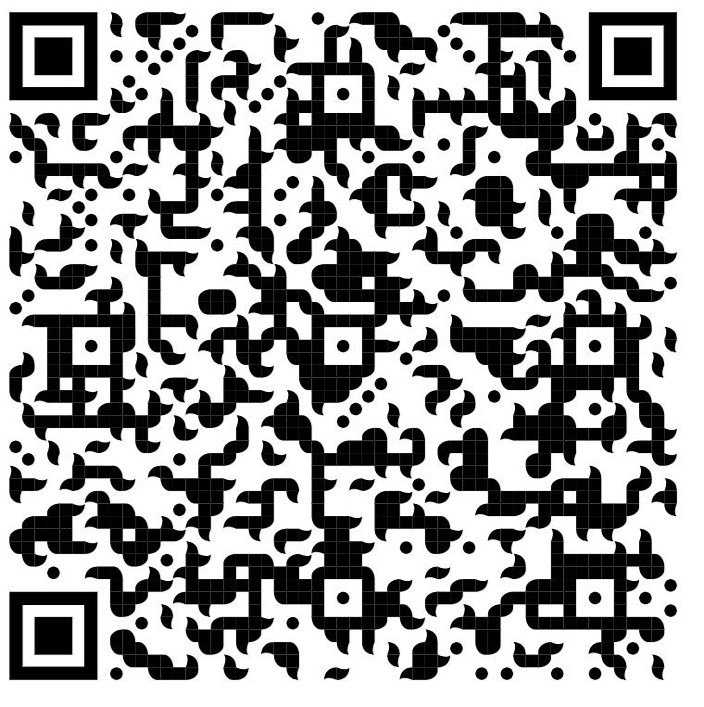

Invitation to Join: QF CTDL Publishing Pilot
Credential Engine, in partnership with SAQA, the Groningen Declaration Network, and AACRAO, is supporting a global pilot to demonstrate how qualifications frameworks and their alignments—both between levels and between qualifications and levels—can be published as structured, open, linked and interoperable data (SOLID) using the Credential Transparency Description Language (CTDL).
Goal of the Pilot: Demonstrate how national and regional public information about qualifications frameworks and related credentials can be structured as open, linked data using CTDL, improving global transparency, comparability, and mobility, while respecting national context.

Slide 18


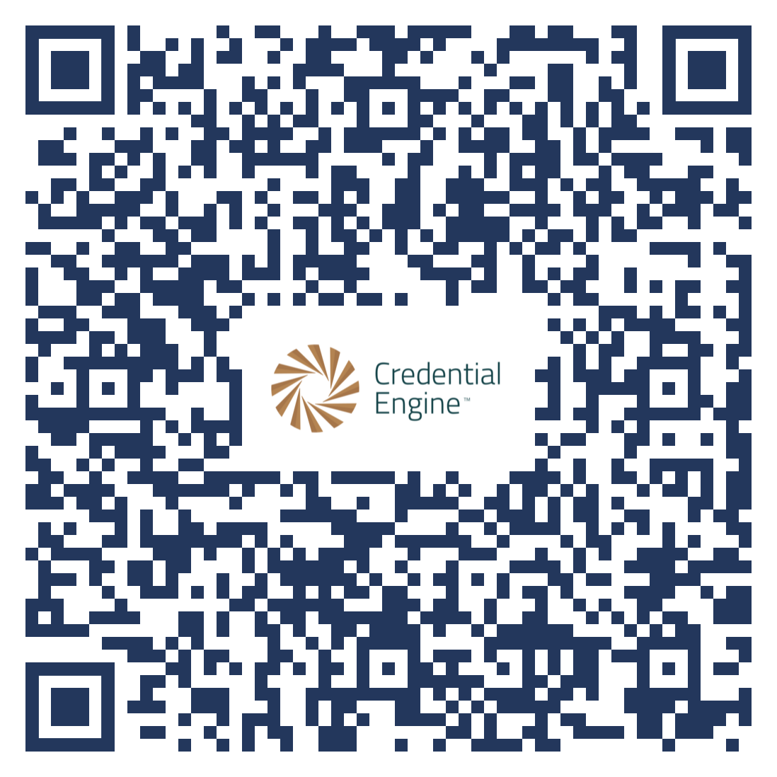
For More Information
Scott Cheney
Chief Executive Officer
scheney@credentialengine.org
Jeanne Kitchens
Chief Technology Services Officer
jkitchens@credentialengine.org
Website: credentialengine.org Email us: info@credentialengine.org Technical Information: credreg.net Credential Finder: credentialfinder.org Find @CredEngine on Social Media
Scan to learn more about Credential Engine and our work on Qualification Frameworks!

