Slide 1



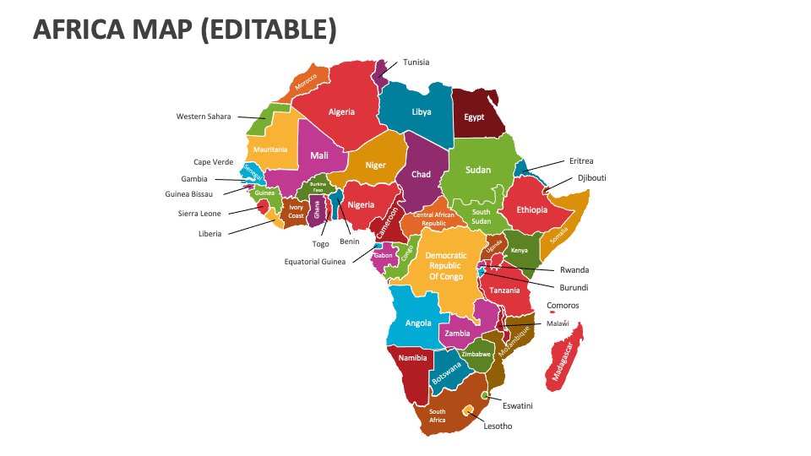
5th ACQF Network Forum
July 30 – Aug 1, 2025
CLUSTER NOMINATIONS & REFLECTIONS FROM PLENARY

Slide 2
CLUSTER NOMINATIONS
Positions | Cluster 1: Referencing & Recognition | Cluster 2: QCP & Digitalisation | Cluster 3: Research on NQFs, RPL, CATS, QA | Cluster 4: Collaboration & Knowledge Sharing
Chair | Fiona Ernesta - Seychelles) | Mr Haron Chege - Kenya | Mr Jericho Kashiya - Zambia | Ms. Ivey Koin - Kenya
Vice Chair | Vice-Chair - Laurent Ndaywel - DRC | Vice-Chair: Ms Omotola Akindolani – South Africa | Mr Massamba Seck ANAQ-SUP (Vice Chair) - Senegal | Mr. Private Mchenga - Malawi
Secretary | Alberto Landim - Cape Verde | Secretariat: Mr Oladapo Coulson-Olowu - Sierra Leone | Ms Gabisile Hlatshwako - Eswatini Qualifications Authority (Secretariat) | Mrs. Noella Baker-Albert (Seychelles)
Notes:
campaugns

Slide 3
WHAT IS OUR TAKE HOME?
QCP Roadmap: Phase 1: Stakeholder Engagement, awareness raising & short term vision (2025); Phase 2 & 3 – Longterm national vision and hand over (2026); Peer learning continues; complete ACQF-QCP Country Worksheets
Referencing of NQFs to ACQF – ongoing.
Synergy with the various AU Strategies: Linking ACQF to the Africa Credits and Transfer System (ACTS); AfCFTA; PAQAF; the AU 2025-2034 TVET Strategy.
Activities of the ACQF Network Technical Clusters:
Cluster 1: Referencing & Recognition of Qualifications
Cluster 2: QCP & Digitalisation
Cluster 3: Research on NQFs, RPL, CATS, QA etc.
Cluster 4: Collaboration & Knowledge Sharing
Legal establishment of the ACQF Network.
Notes:
campaugns

Slide 4



