Slide 1


Support to African Continental Qualifications Framework (ACQF-II)
Project Update
Presenter: Maria Rosenstock,
European Training Foundation
30 September 2025 https://acqf.africa

Slide 2
ACQF-II Project (2023 – 2026): Support to the implementation of the African Continental Qualifications Framework (ACQF II), financed by the European Union, implemented by ETF in cooperation with African Union Commission, the regional communities and member states
ACQF – Continental Tool, African Union Policy Initiative based on policy document validated in July 2023, in Addis Abeba
ACQF Network – launched in January 2025 to support and sustain the implementation of the ACQF and its Qualifications and Credentials Platform

Slide 3
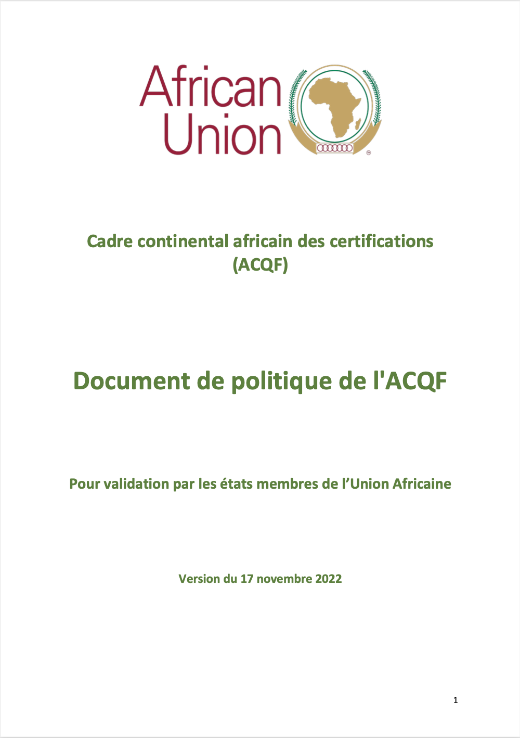

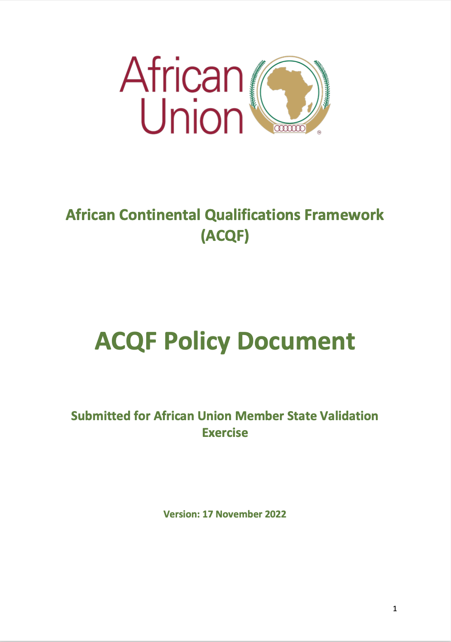
https://acqf.africa/resources/policy-guidelines/acqf-policy-document-upon-validation-by-au-member-states-en-fr-pt

Slide 4
Objective
To contribute to improved mobility and lifelong learning opportunities for African youth, as a result of:
enhanced comparability and transparency of qualifications
enhanced recognition of skills and diplomas
improved mutual trust and information-sharing between qualifications frameworks and systems on the continent.

Slide 5
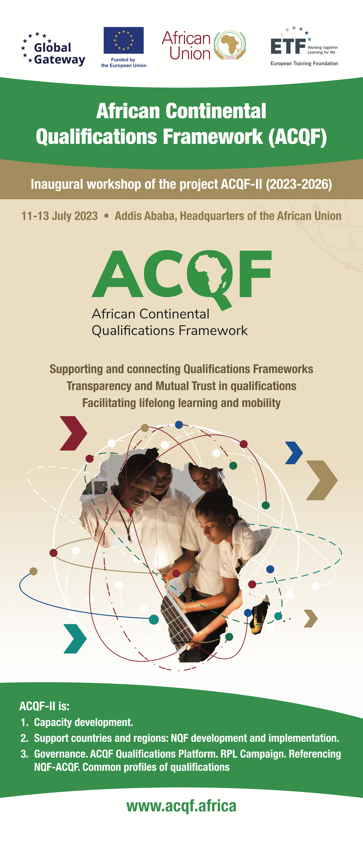
Main areas of activity of the ACQF
1.Referencing of national qualifications frameworks and systems to the ACQF, following agreed criteria and procedures.
2. Support recognition of prior learning – development of guidelines and approaches, inventory of RPL systems on the continent, information campaign
3. ACQF Qualifications and Credentials Platform (QCP) and management information system
4. Common occupational profiles: Development of qualifications profiles adequate for common continental use (e.g.: related with economic integration / AfCFTA).
5. Capacity development in NQFs, RPL, CATS. Online, onsite, hybrid.
6. Advocacy, communication, networking and cooperation: among African stakeholders and other RQFs globally
7. Analysis, monitoring and evaluation: for continuous improvement.

Slide 6
Capacity building – examples
Continental Forums
Thematic campaigns
3rd Forum, Nairobi, Kenya – October 2024 (RPL)
4th Forum, Victoria, Seychelles – November 2024 (Micro-credentials)
5th Forum, Johannesburg, South Africa – July 2025 (Digitalisation of credentials)
Handbooks and Guidelines
Handbook on RPL for Practitioners
Handbook on Micro-credentials

Slide 7
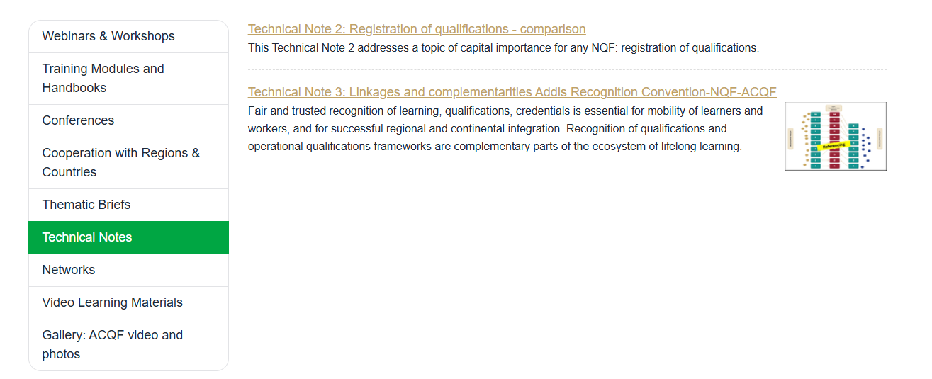
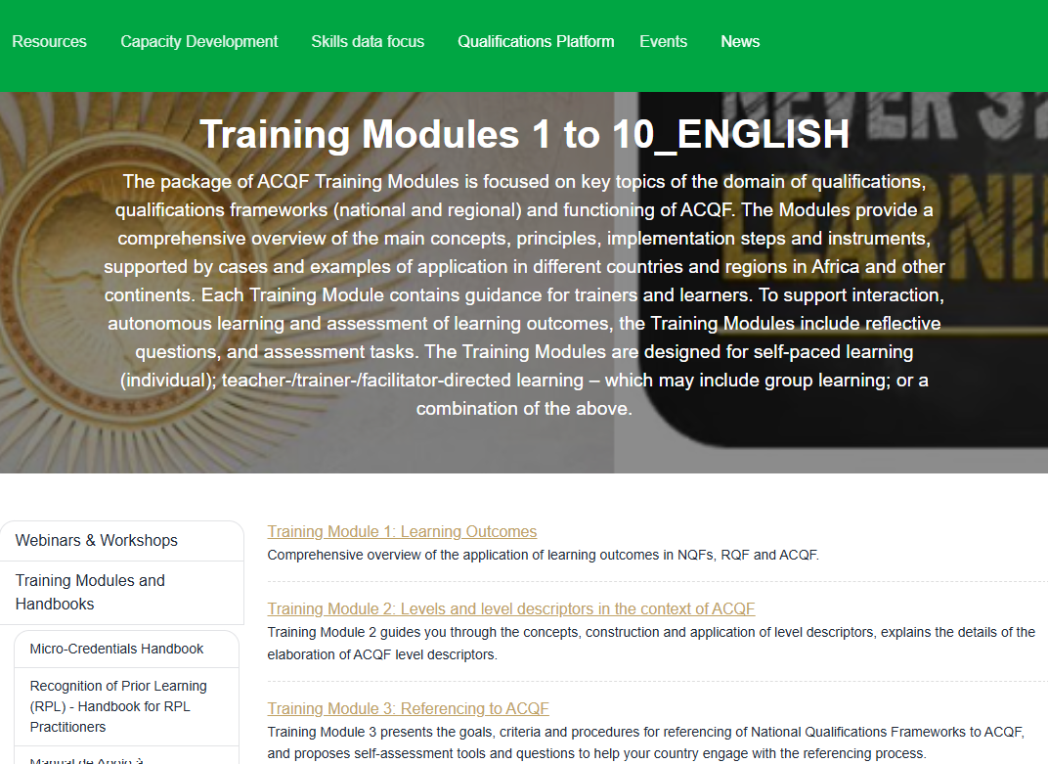
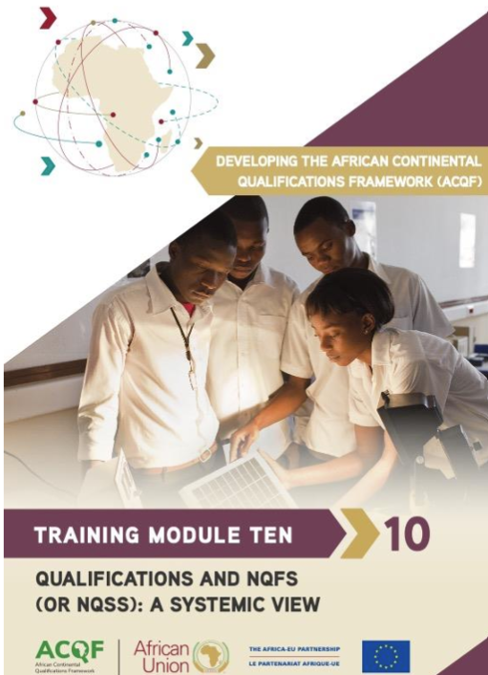
Capacity building materials - visit https://acqf.africa

Slide 8
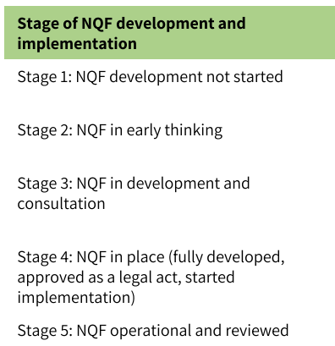
Support to NQFs
GOAL:
increase the number of countries with NQFs at stages 4 and 5 (implemented or advanced) equipped with qualifications database and monitoring systems.

Slide 9
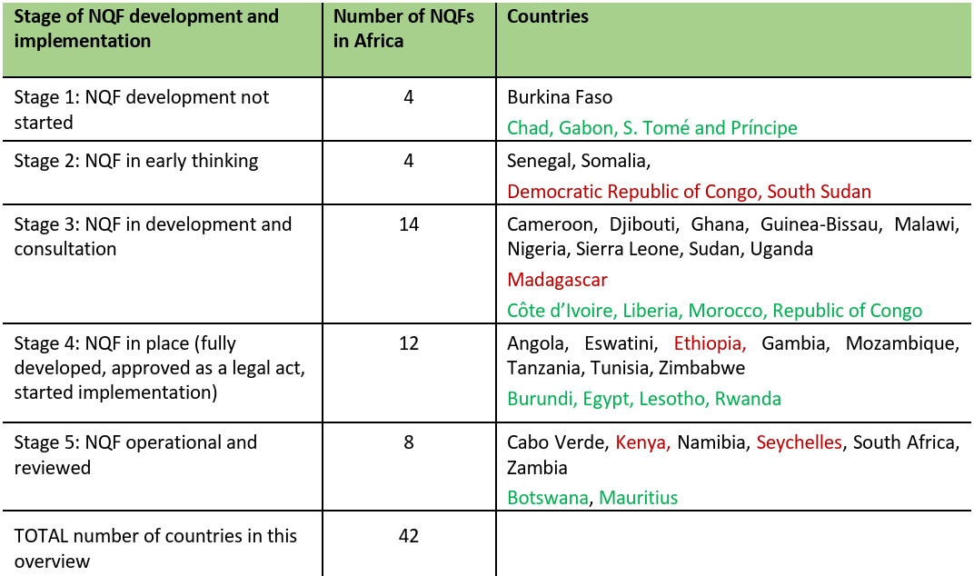
2024 ACQF Survey: NQFs in Africa
https://acqf.africa/resources/surveys-acqf-ii-nqf-rpl-micro-credentials/survey-of-national-qualifications-frameworks-in-africa-analytical-report

Slide 10







Technical support to NQFs in 2025
Botswana:
review of 9 policies (RPL, referencing, assessment…)
Eswatini:
Development of RPL policy, proposal for RPL pilot
Malawi:
Review of NQF document
DR Congo: development of NQF and Qualifications Authority
Support to Regional Communities
SADC QF: CATS and RPL Guidelines
EAC: Regional TVET Framework
UEMOA: capacity building on NQFs
Cameroon:
pilot RPL scheme, operational documents
Guinea-Bissau:
Operationalisation of NQF Office, manuals, procedures
Somalia:
policies on NQF, CATS and RPL
Senegal:
NQF concept, stakeholders’ consultations
Mozambique: monitoring and evaluation of NQF
Sept 2024 Luanda: 2nd Forum NQF Authorities
New collaboration requests: Mauritius, Zimbabwe
Seychelles:
Micro-credentials policy
Zambia:
NQF review, consultations

Slide 11
Referencing – connecting and creating trust
      Presentation and publication of a Referencing report explaining clearly:
      relationships between NQF and RQF levels
      detailed information about national qualifications (QA arrangements, Recognition of Prior Learning, register of qualifications)
ACQF Referencing
criteria:
Level descriptors
Learning outcomes
Transparency on inclusion qualifications in NQF and register
Quality assurance
      Possibility to indicate RQF levels next to the NQF levels in databases and on national certificates/diplomas
    .
    c

Slide 12
ACQF referencing
Pilot referencing with 8 countries in 2024
Capo Verde, Eswatini, Kenya, Lesotho
Seychelles, South Africa, Zambia, Zimbabwe
2025 Full referencing reports – 2 drafts

Slide 13
Making information open, connecting qualifications databases and reaching people
    The ACQF Qualifications and Credentials Platform (QCP) - available for ACQF countries with virtual space for country-specific data management
    Manual and automatic data publication
    Public interface
    QCP team available for support

Slide 14
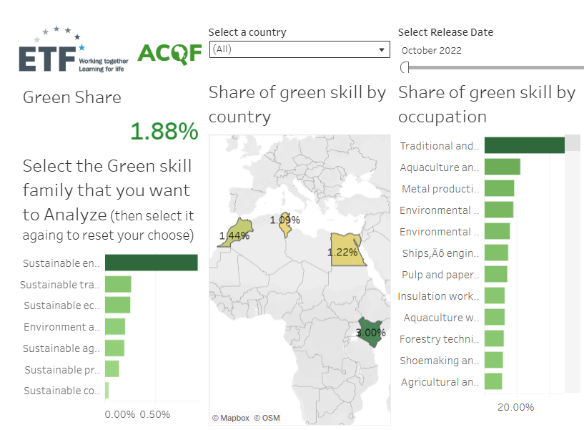
Common Skills Profiles:
Skills Data Focus
Online Job Adds Analysis: real-time labour market intelligence
Green skills dashboard: a new data visualisation tool focused on green skills and occupations
42 ooccupational profiles currently visible with skills and demand trends
    Kenya
    Morocco
    Tunisia
    Egypt

Slide 15
Opportunities - linking data on qualifications with data on skills profiles of occupations
What skills are appearing in the job vacancies and how well are they covered by the learning outcomes in existing qualifications?
What are the emerging occupations for which no training offer is available?
Coordination with other ongoing initiatives
Opportunity-driven Skills and VET in Africa, African Occupational Standards Framework

Slide 16
Governance – ACQF Network
Importance of an institutional home for the framework
Network’s Inception Document,
Workplan
Organisation of the Network, governance
Identifying donor organisations, initiate contacts
ACQF implementation – referencing
Promotion and awareness building
Enhancing digital presence
Undertake common research
Support organisation of annual conferences
4 Technical Clusters
Network Presidency Elected:
South African Qualificatoins Authority (SAQA)
Kenya Qualifications Authority (KNQA)
Zambia Qualifications Authority (ZAQA)
To join: acqfnetwork@saqa.org.za

Slide 17
ACQF-II project support available
Technical advice in development and operationalisation of qualifications framework (priority for NQFs) and related policies or in their review.
Capacity building and peer learning activities
Involvement in ACQF Network activities: acqfnetwork@saqa.org.za
Comparison tools: Qualifications and Credential Platform (support to countries to map and enter their data on qualifications)

Slide 18
Questions, comments, clarifications?

