Slide 2
The HAQAA initiative
The third phase for Harmonization, Accreditation and Quality Assurance in African Higher Education (HAQAA) – 2022-2027 – falls under the Joint Strategy between the AU and the EU
It is a strong response from two Unions to "provide African countries with the skilled workers, managers and administrators they need to foster sustainable development and encourage trade and investment, as well as to strengthen citizenship and democratic values".

Slide 3
VISION 2063
Harmonization
Free movement of professionals
Regional and continental integration
Academic mobility of students, teacher-researchers
Knowledge and skills transferability and recognition
HAQAA3

Slide 4


African Standards and Guidelines for Quality Assurance (ASG-QA)
AQRM for institutional evaluation
Quality Assurance capacity building trainings for National Quality Assurance Agencies
Pan-African Quality Assurance and Accreditation Agency (PAQAA)
African Academic Credit Transfer System
HAQAA
PAQAF
CESA 25/ First Ten-Year Implementation Plan for Agenda 2063
Addis Recognition Convention
African Continental Qualifications Framework (ACQF)
TUNING/HAQAA
UNESCO
SIFA
** Outils et lignes d'action pour la transparence entre les systèmes, les fiducies, un langage commun pour la qualité, la mobilité et les reconnaissances.

Slide 5
Work areas
Transversal work area- Regional integration policy and capacity
Work Area - African Credit Transfer System – ACTS
Work Area - Higher Education Data Capacity in Africa
Work Area PAQAA / PAQAA Technical Unit
Work Area IQA/EQA Training and Capacity Building

Slide 6
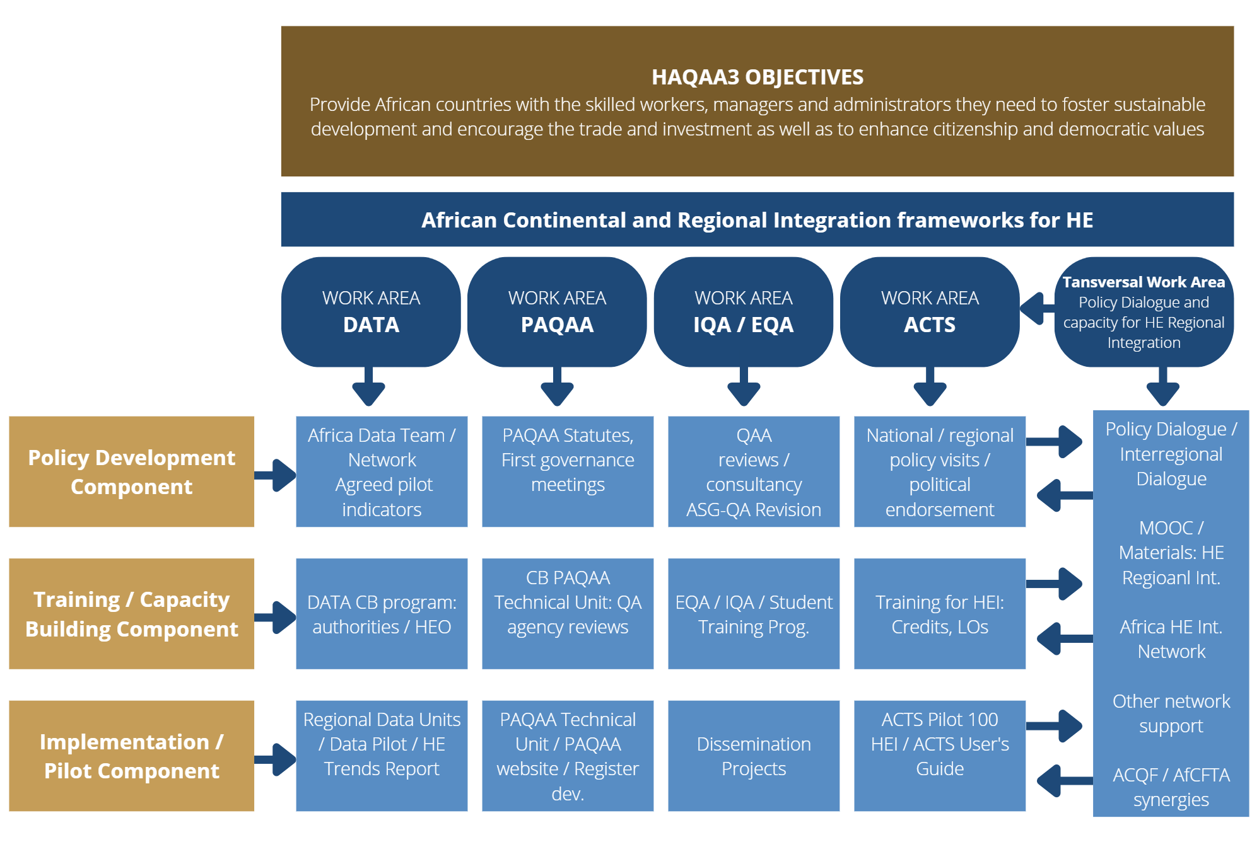

Slide 7

The ASG-QA
*A continental reference document: based on exisiting standards at different levels in Africa and
internationally, targeting both IQA and EQA
*New feature: National quality bodies assuring their own quality = transparency in QA procedures

Slide 8
Achievements
Common agreement on the definition and value of a credit in African higher education systems in order to promote transferability and comparability—key to harmonizing the African higher education space and promote mobility.
Consensus on the workload of a credit unit.
Consensus on the number of credit units for each year and for the different programs, i.e. Bachelors, Masters. The general trend is that 60 credits are equivalent to the workload of full-time student during one academic year: 1200-1500 hours.
Harmonized continental credit system that balances the different systems that span the continent: Anglophone, Arabophone, Francophone and Lusophone countries.

Slide 9
Piloting process and activities
Invitation and formal commitment from 15 national authorities and selection of 100 universities (5-10 per country)
Establishment of 4 ACTS Regional Clusters.
Online programme – 5 modules – 500 trainees (political frameworks and regional integration, intra African mobility, academic and professional recognition, LO, student workload estimation & credit allocation)
Regional Mobility and Recognition Roadmaps
ACTS Users Guide
ACTS Ambassadors Network
Synergies with Intra Africa Academic Mobility Scheme
Syerngies with ACQF and ACQF II Project
IAAMS

Slide 10
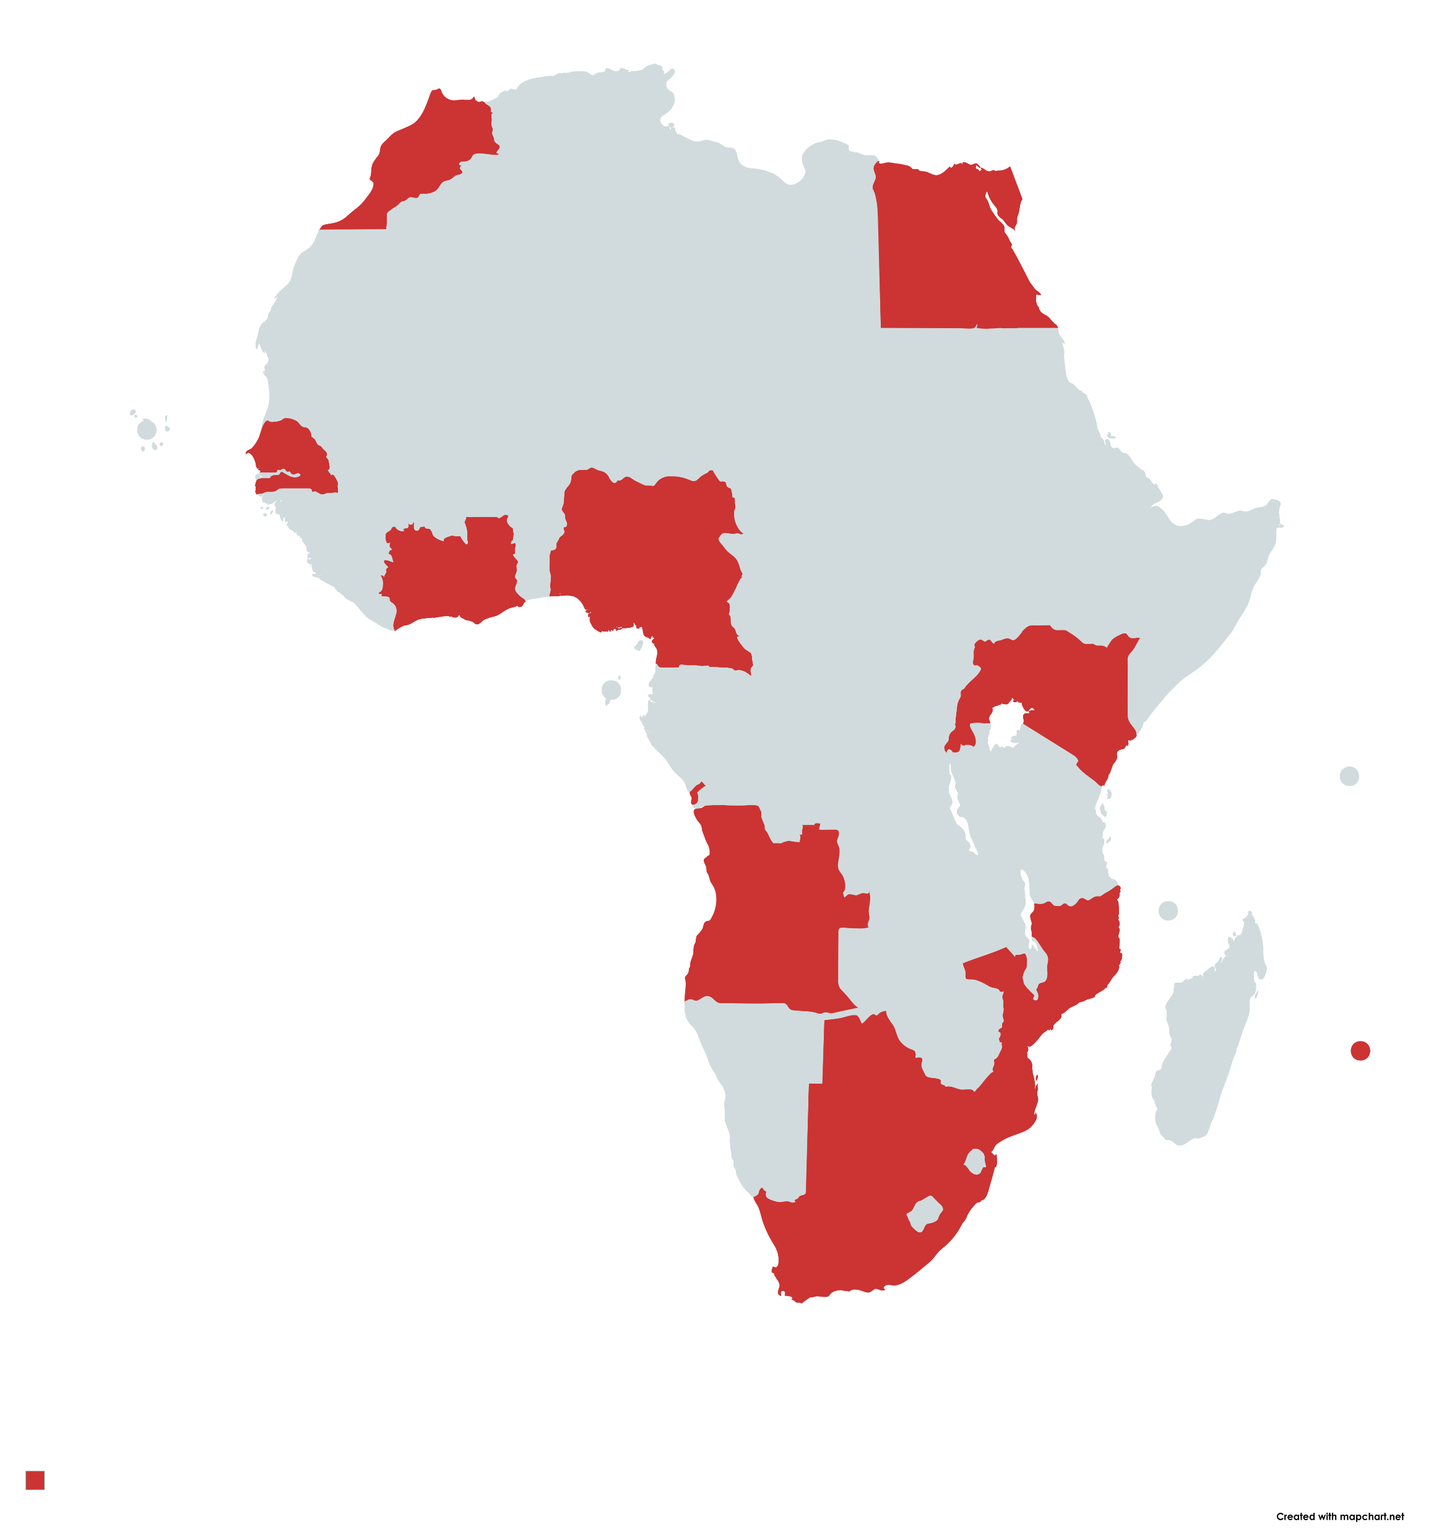
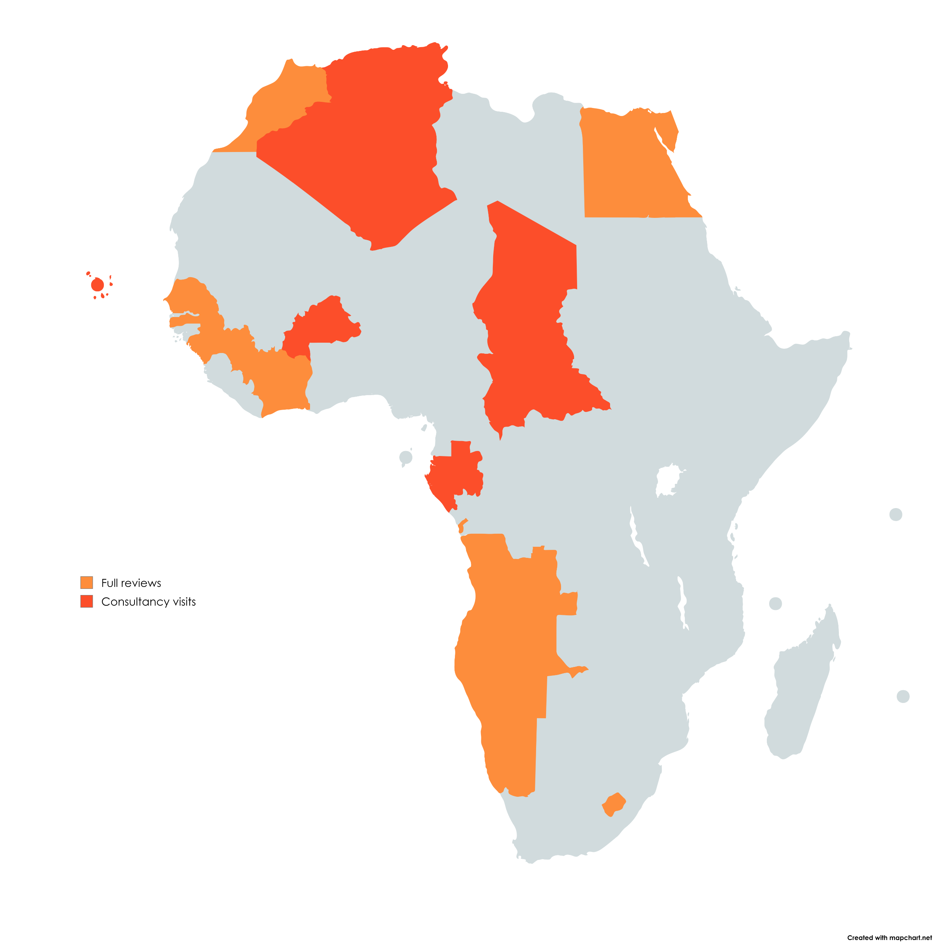
Participating countries

Slide 11
Guiding questions for reflection
In what ways can ACQF and HAQAA tools (like ACTS and ASG-QA) work together in your context?
What mobility and recognition challenges could be better addressed through this synergy?
What examples exist of practices that already link qualifications frameworks and academic credit accumulation and transfer systems?
Inputs collected to feed into ACTS pilot “mobility and recognition roadmaps” and ACQF national roadmaps

Slide 12

THANK YOU!
More information in
www.haqaa3.obreal.org

