Slide 1




Continental collaboration opportunities Bart Horemans, Team Leader Opportunity-Driven SKILLS and VET in AFRICA, ENabel THierry Foubert, Head of projects and partners unit, ETF
6th ACQF Forum
Mauritius
October 2025

Slide 2




European Training Foundation (ETF)
A key EU actor in human capital development
A bridge between EU policies and global partners, supporting the EU’s external relations
An EU agency with long-term impact and adaptability
Notes:
“The ETF is a key player in global human capital development, across the entire learning spectrum.
Its role is increasingly important as the EU positions itself as a global actor in skills development, supporting geopolitical and economic transitions.”
EU agency with focus on Skill for Global Europe
Working with 28 countries around EU, AfricanUnion and Global HCD community
3 decades of country relationships & HCDexpertise
Part of WU Implementing voluntarycontributions for EMPL, ENEST, INTPA, EIBand Germany

Slide 3
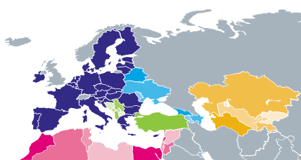


Where we work
Global knowledge hub via networks and partnerships: Skills lab, Vocational Excellence, Educational innovators …
Dialogue and Action for Resourceful Youth in Central Asia (DARYA)
Towards a global VET agenda (policy hub on Vocational Excellence), with Germany-BIBB, ILO, OECD, UNESCO-UNEVOC and Worldskills
Support to the implementation of the African Continental Qualifications Framework (ACQF II), with AUC
3
Notes:
The ETF works mainly in the countries neighbouring the EU, including the Southern and Eastern Mediterranean, the Western Balkans, Turkey, Eastern Europe and Central Asia. It also supports EU cooperation with the African Union in the area of skills.
3

Slide 4
What we work on
Data collection and analysis
Monitoring and system performance
Quality assurance of systems
Global education
AI and innovation
Social partners and CSOs
GLAD
Eastern Partnership
Teachers and trainers
Digital transition
Vocational excellence
Ukraine Task Force
Human capital development in fragile contexts
Work-based learning and career guidance
Curriculum development and key competences
Investments and financing of skills
EU assistance/EU requests
Adult learning
Green transition
Inclusion and equality
Qualifications and migration
Skills for future
Transition to work and employability
Youth guarantee

Slide 5







Knowledge, monitoring, policy advice
Education diagnoses in Armenia, Kosovo*, Lebanon, Moldova ...
Green economy: analysis of skills for green transition in five partner countries
Support to EU Delegations: e.g. Agri-VET in Rwanda
Task Force for Ukraine
Digital education: SELFIE in Ukraine and Azerbaijan
Peer learning & networks on Vocational Excellence, Skills Lab, Governance, Quality Assurance, etc.
5

Slide 6
perspective of 10-year continental frameworks
CESA: Harmonized education foundation
TVET: Relevant, portable, and employable skills
STISA: Innovation and research-driven mobility
Today approaching wider framework from the angle of the skills for private sector development:
1. Education continuum
2. Private sector involvement
3. Partnerships

Slide 7


#TeamEurope
Opportunity-driven Skills and VET in Africa
Your Global Gateway to Skills and Jobs
#TeamEurope
Opportunity-driven Skills and VET in Africa (TEI OP-VET)

Slide 8
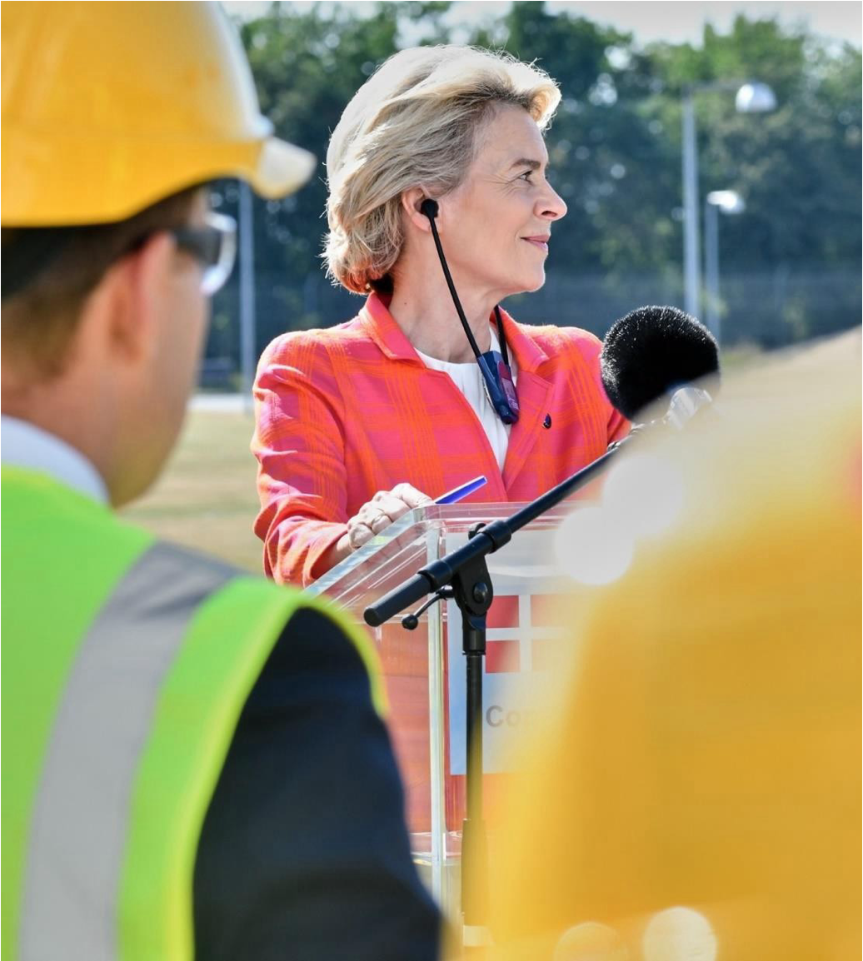
We will support smart investments in quality infrastructure, respecting the highest social and environmental standards, in line with the EU’s values and standards.
The Global Gateway strategy is a template for how Europe can build more resilient connections with the world.
Ursula von der Leyen
President of the European Commission
#TeamEurope
Opportunity-driven Skills and VET in Africa (TEI OP-VET)

Slide 9


Global Gateway – What is it?
The European strategy to boost smart, clean and secure links in digital, energy and transport sectors and to strengthen health, education and research systems across the world.
An EU principles and value-based offer to partner countries to position the EU more prominently in a competitive world.
The EU’s contribution to narrowing the global investment gap worldwide, fully aligned with the UN Sustainable Development Goals (SDGs) and the Paris Agreement.
#TeamEurope
Opportunity-driven Skills and VET in Africa (TEI OP-VET)

Slide 10






Global Gateway – Key areas of partnership
Digital
Climate & energy
Transport
Education & research
Health
Support open and secure internet
Support investments and rules paving the way to the clean energy transition
Support all modes of green, smart and safe transport
Invest in high quality education, with a focus on girls and women and vulnerable groups
Strengthen supply chains and local vaccines production
#TeamEurope
Opportunity-driven Skills and VET in Africa (TEI OP-VET)
Notes:
Note to presenter:
Education is one of the five central priorities of the Global Gateway, and is also an enabler of the other four pillars

Slide 11

Global Gateway – What is it?
Reflects a change in the way the EU approaches its external action, combining the needs of partner countries with a stronger assessment of the EU’s strategic priorities.
Implemented by Team Europe, mainly through Team Europe Initiatives.
Team Europe approach' means working together, along with the private sector and CSOs, pooling resources and expertise to deliver more effectiveness and greater impact.
#TeamEurope
Opportunity-driven Skills and VET in Africa (TEI OP-VET)

Slide 12
Global Gateway – Relevant stakeholders
Partner Countries Institutions
EU & MS Institutions
Private Sector
Development Finance Institutions (DFI’s)
Commercial Banks
Export Credit Agencies (ECA’s)
Civil Society Org.
Local Authorities
#TeamEurope
Opportunity-driven Skills and VET in Africa (TEI OP-VET)

Slide 13

The Africa-Europe Investment Package
Building more resilient connections between Africa and Europe
Mobilising at least EUR 150 billion in investments for Africa’s socio-economic, green and digital transformation
Supporting the priorities of the African Union’s Agenda 2063
Contributing to prosperity, innovation and transformation of sectors that create opportunities
150 billion
#TeamEurope
Opportunity-driven Skills and VET in Africa (TEI OP-VET)

Slide 14
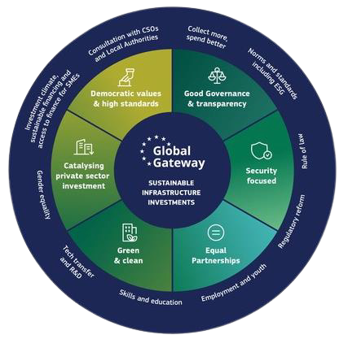

360° support to Global Gateway
#TeamEurope
Opportunity-driven Skills and VET in Africa (TEI OP-VET)

Slide 15





Global Gateway EU-Africa​
Africa-Europe Global Gateway Investment Package (GGIP)​
of EUR 150 billion between 2021-2027.​
​
Global Gateway priority areas for the TEI OP-VET:​
Digital
Health
Transport
Climate & Energy
The Global Gateway is partly funded through EFSD+ guarantee mechanism.​
TEI OP-VET launched as part of the GGIP in April 2024
#TeamEurope
Opportunity-driven Skills and VET in Africa (TEI OP-VET)

Slide 16




TEI OP-VET
A Team Europe Initiative (TEI) to support Opportunity-driven skills and vocational education and training (VET) in Sub-Saharan Africa
Co-funded by the European Union and the German Government (BMZ)
75 million (EU) + 1.050.000 (BMZ)
March 2024 - February 2029
#TeamEurope
Opportunity-driven Skills and VET in Africa (TEI OP-VET)

Slide 17




TEI OP-VET - 3 pillars
Request-based
Technical Assistance Facility
Regional exchange &
Public-Private Partnerships
OP-VET
Pilot Projects
Supporting VET (re-) orient them towards employment opportunities.​
Facilitating partnerships and promoting OP-VET.​
Funding and implementing OP-VET in SSA.​
PILLAR 1
PILLAR 2
PILLAR 3
Overall management
#TeamEurope
Opportunity-driven Skills and VET in Africa (TEI OP-VET)
Notes:
3 pillars with each pillar under the coordination of 1 agency, but the action is jointly implemented in a Team Europe Spirit.

Slide 18




Why Opportunity-driven Vocational Education and Training (OP-VET)? ​
A PARADIGM SHIFT
Employment as the leading perspective​​
Reverse-engineered VET starting from concrete employment opportunities​
Engaging the private sector to create a win-win for learners & business​​
#TeamEurope
Opportunity-driven Skills and VET in Africa (TEI OP-VET)
Notes:
Explain the name - opportunity-driven

Slide 19

Certification and Occupational Standards Why a continental approach matters?
Private companies are looking for graduates with internationally recognised qualifications, because it:
guarantees adequate skills levels
allows for comparability across countries and regions
is required by their clients
protects them against lawsuits
National certification and standards are not any longer sufficient in an increasingly regionalised / globalised economy
The need for an African continental wide approach has become not only pertinent but crucial
#TeamEurope
Opportunity-driven Skills and VET in Africa (TEI OP-VET)
Notes:
Private Sector Engagement
A key element is active collaboration with the private sector to ensure that VET programs meet the current and future needs of the labor market.
Youth and Women Focus
The project places a strong emphasis on enhancing employability for youth and women, ensuring that they have access to decent and sustainable jobs.

Slide 20

The Private Sector as Privileged Partner
Why is the close involvement of the private sector so essential?
Knows best which set of competences are needed at what qualification level
Is immediately concerned and have a vested interest as future employees / clients / providers
Is willing to invest in national / international initiatives in the field of certification and occupational standards
Is ideally placed to test the graduates/employers on acquired skills and competences
Is willing to engage in strategic and practical private public partnerships
#TeamEurope
Opportunity-driven Skills and VET in Africa (TEI OP-VET)

Slide 21
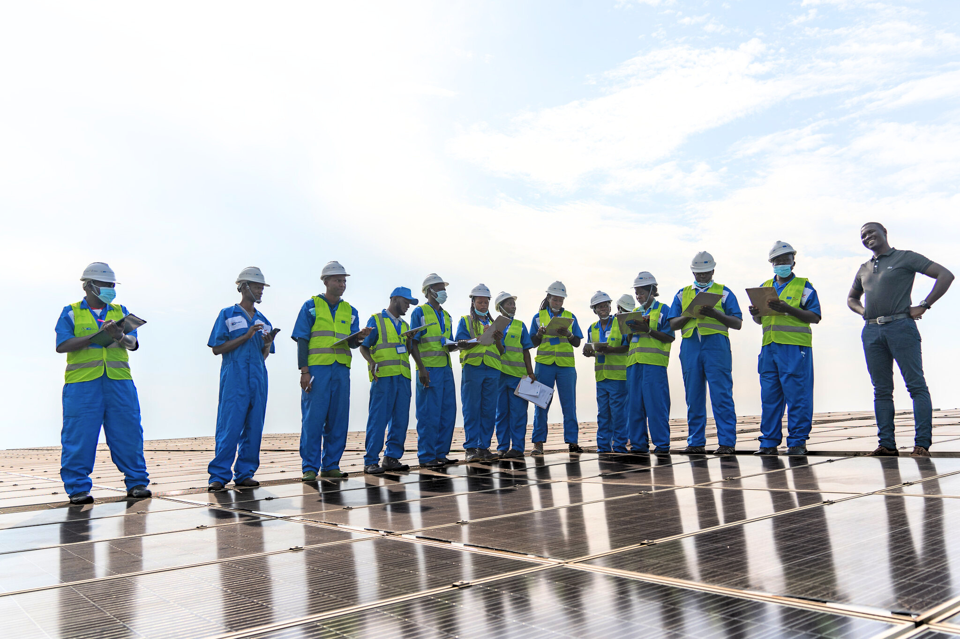
Join us
Support this transformative initiative and help shape Africa's future. Let's bridge skills with opportunities for sustainable development!
#TeamEurope
Opportunity-driven Skills and VET in Africa (TEI OP-VET)
Notes:
Info on the TA Facility? Email us at TA_FACILITY@TEI-OPVET.EU
All other questions email us at INFO@TEI-OPVET.EU

Slide 22
Way forward - From Data to Continental Recognition
Data
- How can the ACQF’s big data–driven occupational profiles be transformed into standards and certification schemes that are trusted and accepted across Africa?
- What mechanisms are needed to move from big data dashboards to agreed occupational standards?
Private sector
- What role should employers’ organisations and sectoral bodies play in validating these profiles?
Governance
- Which institutions at continental and regional levels should lead or coordinate this process?
- What would make a certification scheme “continental” in practice - who shall endorse it?

