Slide 1

Strengthening the international academic integrity community via the Global Academic Integrity Network (GAIN)
6th African Continental Qualifications Framework (ACQF) Continental Forum, 2nd October 2025
Laura Flynn, Head of Partnerships, lflynn@qqi.ie
Caoimhe Marshall, Manager, Partnerships, cmarshall@qqi.ie
Quality and Qualifications Ireland (QQI)
Notes:
1

Slide 2
Today we will talk about..
GAIN: a global response to a global issue
Establishing the Global Academic Integrity Network (GAIN)
The purpose and objectives of GAIN
Membership and criteria
How GAIN works
An invitation from GAIN to you

Slide 3
Academic integrity: a shared responsibility
“Maintaining academic integrity is critical to the reputation of higher education, and to the recognition of a graduate’s academic learning and resulting qualifications.“
(QQI, (2021), Academic Integrity: National Principles and Lexicon of Common Terms)

Slide 4
Common Ground among GAIN founders: Quality and Qualifications Ireland (QQI) & Tertiary Education Quality and Standards Agency (TEQSA)
Agencies with similar remits and functions
Legislative similarities
Memorandum of Understanding (2019)
Information sharing and engagement established
Shared concerns about the future of academic integrity
Shared challenges and a recognition that the issues were greater than any one jurisdiction could combat alone

Slide 5
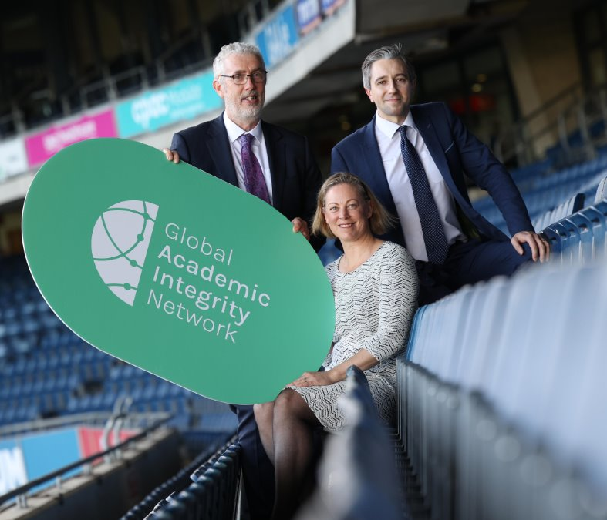
Establishing GAIN
Image taken from: International launch of the Global Academic Integrity Network | Quality and Qualifications Ireland
Notes:
Contract cheating and other forms of academic fraud have the potential to cause significant damage to our national qualifications systems. These are global issues that require a collaborative, cross-border approach to combat.
In recognition of this, the Global Academic Integrity Network (GAIN) was co-founded by Quality and Qualifications Ireland (QQI) and the Australian Tertiary Education Quality and Standards Agency (TEQSA) and launched by Simon Harris, Irish Minister for Further and Higher Education, Research, Innovation and Science in October 2022.
GAIN is a collective of regulators and quality and integrity agencies that aims to maintain existing connections between regulators and to establish new ones. Through the network, members disseminate new developments and research on contract cheating and academic fraud across jurisdictions; members also consider how common, global approaches to combatting these challenges can be developed and implemented.

Slide 6
“While individual jurisdictions are taking enormous strides in combatting cheating, many of these large operations are international and working together will give us the best chance of breaking their business models. GAIN will share intelligence on cheating operators and insights to help different jurisdictions tighten their anti-cheating detection, laws and penalties.”
TEQSA Chief Commissioner Peter Coaldrake (2022, International launch of the Global Academic Integrity Network | Quality and Qualifications Ireland)

Slide 7
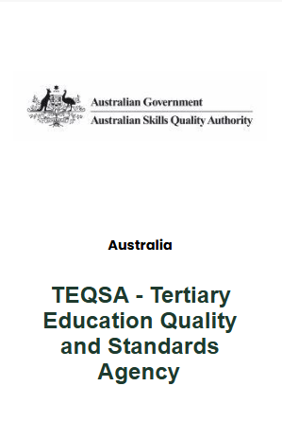
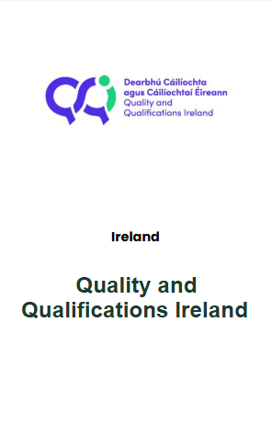


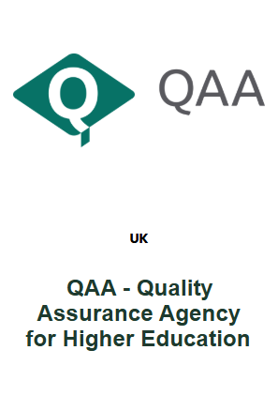

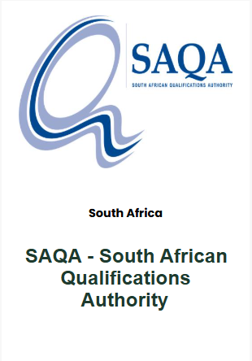
Founding members of GAIN

Slide 8
The role of GAIN in combatting threats to academic integrity
“The purpose of the Global Academic Integrity Network is to provide an international platform and coordinating structure for discussion, collaboration and information-sharing in relation to commercial contract cheating services and other threats to integrity. “
GAIN Terms of Reference, (2023)

Slide 9
GAIN’s Objectives
Sharing information about commercial contract cheating
Exploring approaches to disrupting and preventing commercial contract cheating services
Sharing information about emerging threats to academic integrity
Highlight the risks these services to stakeholders e.g. learners, education providers, enterprise, professional and regulatory bodies
Agree and publish joint collective statements to mitigate threats to academic integrity
Develop a shared communications strategy to expose threats and promote academic integrity
Disrupt contract cheating services’ business models
Encourage digital intermediary services e.g. social media platforms to support GAIN’s work
Share positive engagements with organisations responsive to legislative compliance
Highlight potential threats to the integrity of national education & qualifications systems
GAIN Terms of Reference, (2023)

Slide 10
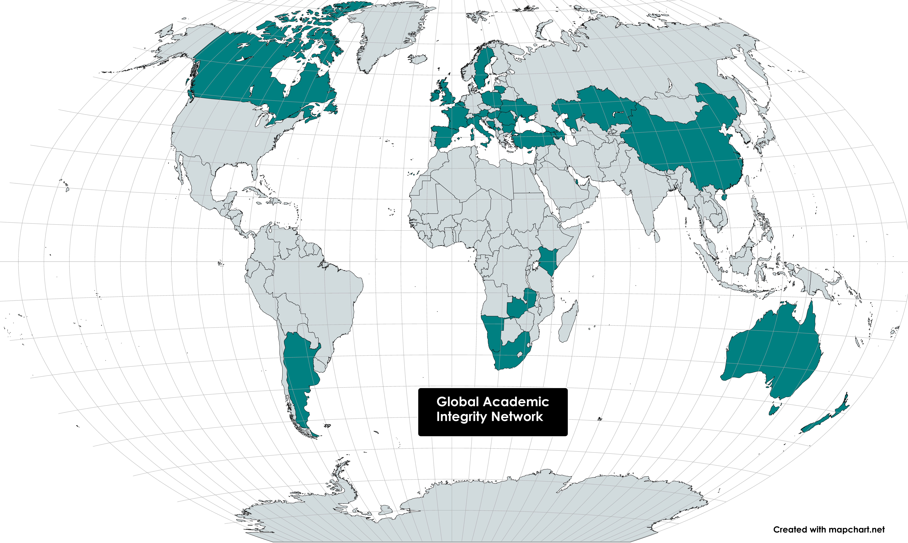

Membership today
47 members
36 countries
6 continents
www.globalacademicintegrity.network
Endorsed by European Association for Quality Assurance in Higher Education (ENQA), Council of Europe, European Network for Academic Integrity (ENAI), European Students Union (ESU)
Map created using World Map - Advanced | MapChart
Notes:
Among the founding members of GAIN were the South African Qualifications Authority (SAQA) and Zambia’s Higher Education Authority. Other African organisations which have joined GAIN include Kenya’s Commission for University Education and the Namibia Qualifications Authority.

Slide 11

Who can join GAIN?
Organisations* with an established legal basis,
which are formally recognised by the competent public authority, that have responsibility for external quality assurance, regulation AND/OR accreditation AND/OR qualifications systems or qualifications recognition across tertiary (higher and vocational/further) education
*We recognise the important role that professional standards bodies play in external QA and welcome endorsements from such bodies.
Any applicant organisations that do not fit within the green or the red lane will be asked to demonstrate relevant interest or role in academic integrity or related activities through a supporting statement and documentation
For profit entity OR
Entity unable to evidence a legitimate interest or role in academic integrity and related matters OR
Individual institution of higher education OR individuals OR
networks of education providers
​
Notes:
4
​‌OFFICIAL‌​

Slide 12
How GAIN works
Logistics:
Quarterly online meetings for members
QQI and TEQSA share secretariat
Chairing of meetings rotates between members
Members may suggest agenda items
Meetings recorded for sharing with members who are unavailable to attend
Meeting times alternated to suit time zones
Meeting content:
New members introduce their organisations
Members share updates
International academic integrity experts share research
Collective statements created, agreed and voted upon
GAIN communications:
Publication and promotion of collective statements on
GAIN website and other media
Members provide content for country pages on website
Members only LinkedIn page for sharing updates and
research

Slide 13
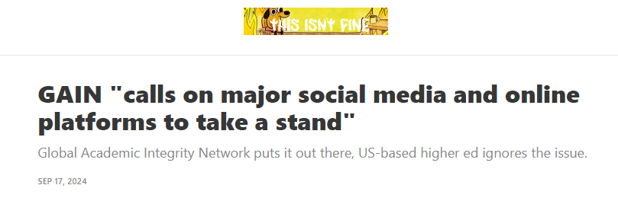
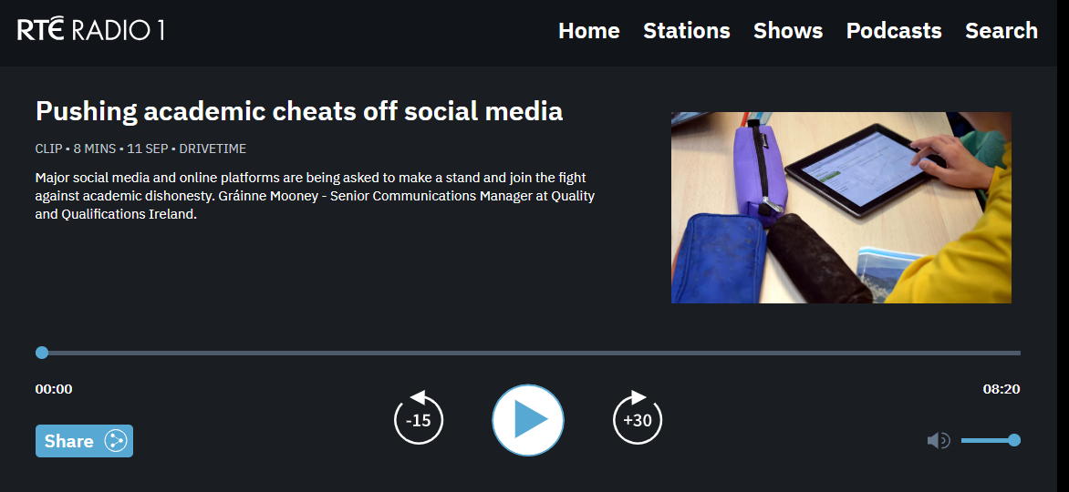
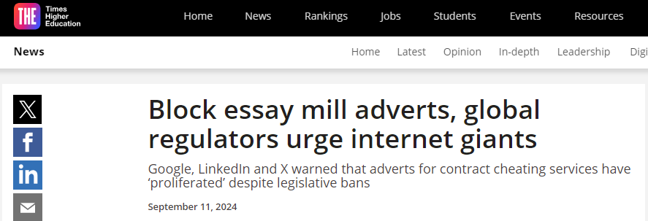
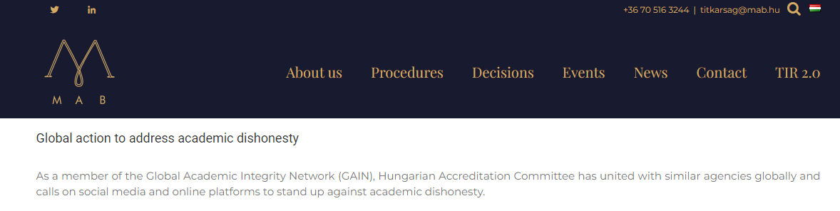
GAIN Collective Statement, September 2024
Open letter to social media and online platforms to take a stand against academic dishonesty and stop the advertisement of contract cheating services

Slide 14

Our invitation to you!
Please join us in collaborating to mitigate threats to academic integrity and continue to drive a positive culture of academic integrity that supports our education and qualifications systems, our graduates, employers and wider society!

Slide 15
Get involved
W: https://globalacademicintegrity.network/
E: gain@qqi.ie

Slide 16
References:
academic-integrity-national-principles-and-lexicon-of-common-terms.pdf
GAIN Terms of Reference (2023)
GAIN Collective Statement | Global Academic Integrity Network
International launch of the Global Academic Integrity Network | Quality and Qualifications Ireland
World Map - Advanced | MapChart

