Slide 1
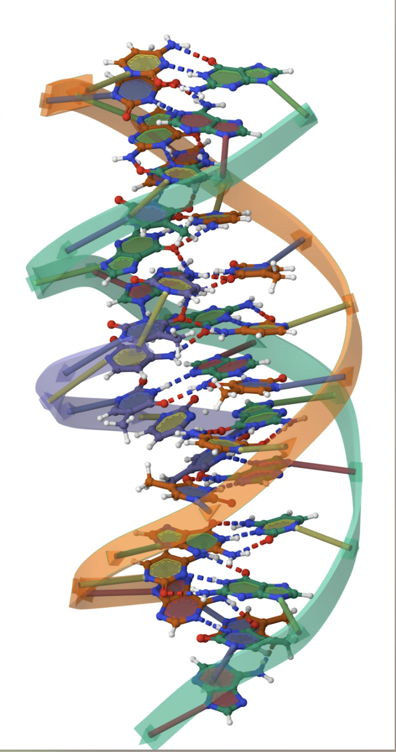

The UNESCO Higher Education Conventions:
A Triple Helix of Recognition, Cooperation and Quality
6th ACQF Continental Forum, October 2025
Peter J. Wells
Head of Education
Regional Officer for Southern Africa

Slide 2
RECOGNITION: The Basis for international collaboration
Lisbon Convention (1997)
Tokyo Convention (2011)
Addis Convention (2014)
Buenos Aires Convention (2019)
Arab States Convention (Paris, 2022)
A Second Generation of Updated Regional Recognition Conventions
6th ACQF Continental Forum, October 2025

Slide 3
Why revised Regional Conventions and Global Convention?
International coherence in recognition processes
Normative framework for the sharing of information on higher education systems
Intra- and inter-regional university collaboration and academic mobility
Facilitate intra- and inter-regional good practices in quality assurance mechanisms in higher education
6th ACQF Continental Forum, October 2025

Slide 4

Addis Convention
Revised Convention on the Recognition of Studies, Certificates, Diplomas, Degrees, and Other Academic Qualifications in Higher Education in African States
Entry into Force: 15 December 2019
14 State Parties:
Burkina Faso, Cabo Verde, Congo, Djibouti, Gambia, Guinea, Holy See, Mauritania, Mauritius, Senegal, Seychelles, South Africa, Togo, Zambia.
6th ACQF Continental Forum, October 2025

Slide 5

Global Convention on the Recognition of Qualifications concerning Higher Education
Entry into Force: 5 March 2023
States Parties (38 as of April 2025, of which 6 in Africa):
Andorra, Armenia, Australia, Bosnia and Herzegovina, Cabo Verde, Côte d'Ivoire, Croatia, Cuba, Djibouti, Ecuador, Estonia, Finland, France, Georgia, Guinea, Holy See, Hungary, Iceland, Japan, Lithuania, Luxembourg, Mongolia, New Zealand, Nicaragua, Norway, Republic of Korea, Republic of Moldova, Romania, San Marino, Senegal, Slovakia, South Africa, State of Palestine, Sweden, Tunisia, United Kingdom of Great Britain and Northern Ireland, Uruguay, Yemen

Slide 6
Principles of the Conventions
Facilitate mobility through international cooperation
Provide an inclusive framework for fair recognition
Respect for domestic laws and institutional autonomy
Does not
-mean automatic recognition
-specify how to recognise
6th ACQF Continental Forum, October 2025

Slide 7
Recognition
Transparent, fair, non-discriminatory and timely assessment
Decisions based on quality information from competent authorities
Appeal mechanisms
Individual has right to assessment
Recognition may lead to further study, use of academic title, and employment
6th ACQF Continental Forum, October 2025

Slide 8
Implementation of the Conventions
Does not replace or modify regional conventions
Do not have to be party to regional conventions to be party to the Global Convention
Open to UN members and specific territories
6th ACQF Continental Forum, October 2025

Slide 9

COOPERATION: The DNA of international HE
Study Abroad Programmes
Student Exchange Initiatives
Faculty Exchange / Visiting Scholars
Joint or Dual/Double Degrees/Courses
Scholarship Programmes
Joint Research/collaboration
6th ACQF Continental Forum, October 2025

Slide 10

COOPERATION: The DNA of international HE
1000 Chairs and 45 networks across 125 countries. This network of universities around the world supports UNESCO’s work in education, the natural and social sciences, culture and communication, to help address pressing challenges and contribute to the development of their societies. They also bring together partners in academia, civil society, local communities and policy-makers in dialogue for project implementation.
6th ACQF Continental Forum, October 2025

Slide 11
QUALITY: The Foundations of Cooperation and Trust
Establishment of QA Agencies/bodies
External and Peer Review Processes for HEIs and study Programmes
Reliable/Publicly available Information on QA Procedures and Outcomes
Reliable/Publicly available information on Recognized HEIs operating in the territory (competent authorities)
Robust Internal QA Procedures at the institutional level
6th ACQF Continental Forum, October 2025

Slide 12
QUALITY: Developing an Internal QA Culture
UNESCO Capacity-building Workshops
• Module 1 Foundations of QA in Higher Education introduces key QA dimensions, functions and principles.
• Module 2 National, Regional, and International QA Frameworks and Standards stresses the need to harmonize QA standards for better student mobility and qualification recognition.
• Module 3 QA in Digital Transformation focuses on how digital tools and AI can enhance learning and QA processes.
• Module 4 QA of Assessment Methods stresses the importance of data collection and effective assessment strategies.
• Module 5 QA in Curriculum Design, Development and Evaluation highlights the need for aligning curricula with industry demands
• Module 6 Internationalization and QA explores the role of internationalization in improving education quality, focusing on university-industry partnerships, and student mobility.
6th ACQF Continental Forum, October 2025

Slide 13

QUALITY: UNESCO WORKSHOPS
6th ACQF Continental Forum, October 2025

Slide 14

Questions?
Comments?
Reflections?
Peter J. Wells: p.wells@unesco.org

