Slide 1
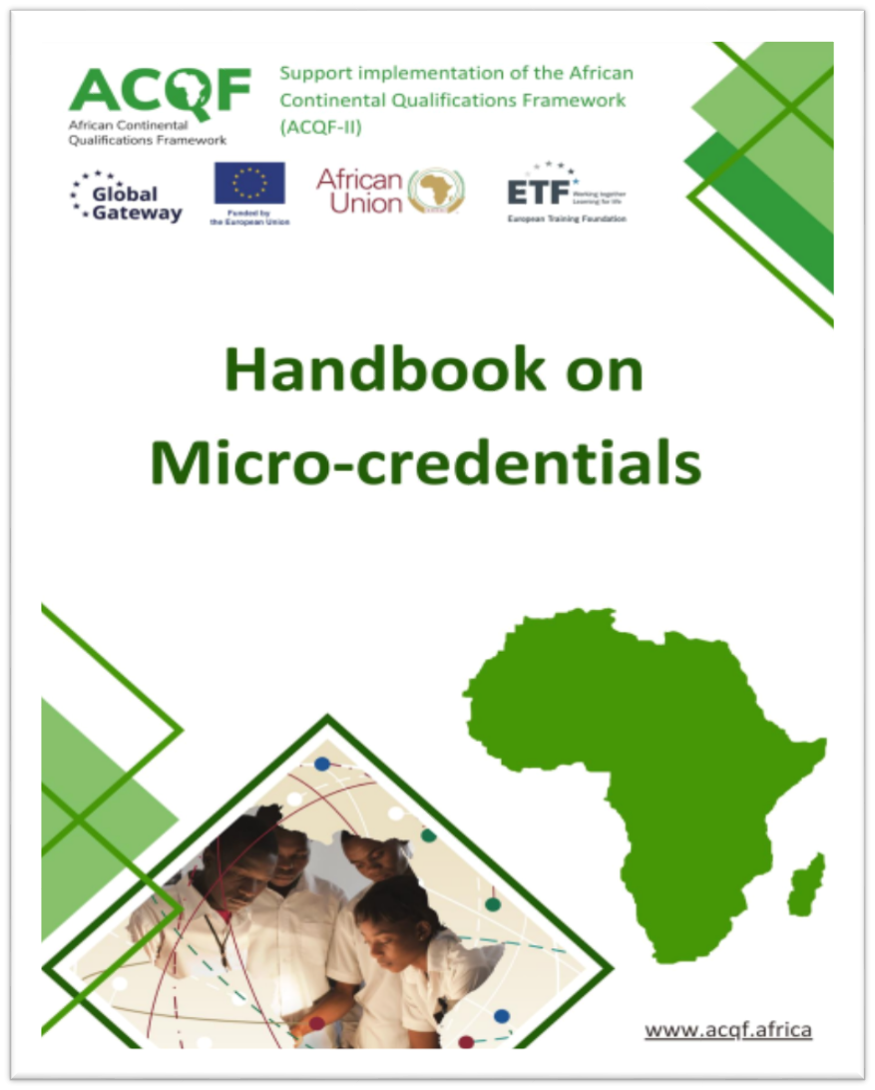


The 6th ACQF Continental Forum - Mauritius
Session 6:
Unpacking National Micro-credentials Frameworks
Presented by: James Mwewa
30th September 2025

Slide 2
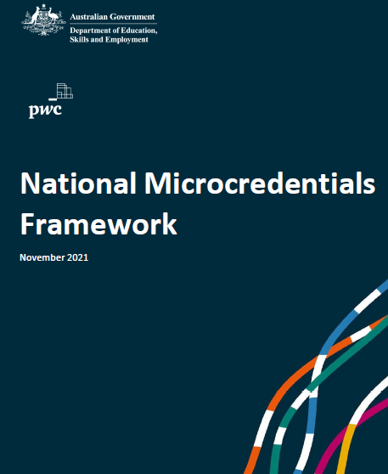

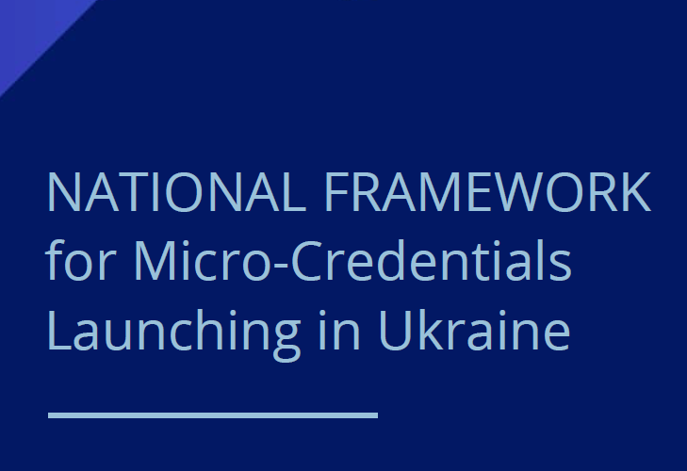

Topics
Introduction
Key Components and Options
Open Discussion
Micro-credentials Handbook: https://acqf.africa/capacity-development-programme/training-modules/micro-credentials-handbook/@@display-file/file/Micro-Credentials%20Handbook%20ACQF_FINAL%20Version_23.12.2024_WEB_EN.pdf

Slide 3
Introduction

Slide 4
MCs – subject of ongoing studies
National governments, and regional and international organisations have intensified debate and research with the aim to define the role and place of Micro-credentials (MCs) in national education systems and qualifications frameworks, enhancing their benefits for lifelong learning and employability – UNESCO, COMMONWEALTH, EU, AU (ACQF), SADC, New Zealand, Malaysia, Portugal, Australia, MAURITIUS, SEYCHELLES...
In 2022 UNESCO proposed a common definition of micro-credentials, based on a
process of experts’ consultation of global scope.
  UNESCO (2022). Towards a common definition of micro-credentials.
  https://unesdoc.unesco.org/ark:/48223/pf0000381668
In June 2022 the European Union approved the Council Recommendation on a
European Approach to Micro-credentials for lifelong learning and employability.
  Council Recommendation of 16 June 2022 on a European approach to micro-credentials for lifelong learning and employability 2022/C 243/02 ST/9790/2022/INIT https://eur-lex.europa.eu/legal- content/DE/TXT/?uri=uriserv:OJ.C_.2022.243.01.0010.01.ENG

Slide 5


Micro-credentials: elements of a definition
Existing definitions (from OECD, European Commission, UNESCO, Australian Government) point to key characteristics of micro-credentials:
  Referring to learning over a limited time and/or in a specific area
  May form part of or add to full qualifications
  Potentially ‘stackable’ over time, adding to individual learning careers
  Given their limited size and focus, more flexible than traditional qualifications
  Based on assessed learning
  Frequently delivered in a digital form.
Page 15

Slide 6
Micro-credentials: UNESCO proposed definition
Focused on a specific set of learning outcomes in a narrow field of learning and achieved over a shorter period of time.
Micro-credentials are offered by commercial entities, private providers and professional bodies, traditional education and training providers, community organisations and other organisations.
While many micro-credentials represent the outcomes of more traditional learning experiences,
others verify demonstration of achievements acquired elsewhere, such as in the workplace,
through volunteering, or through personal interest learning
. Micro-credentials are often promoted
as an efficient way to upskill workers across the lifespan.
The proposed definition (Oliver, 2021) states that a micro-credential:
1. Is a record of focused learning achievement verifying what the learner knows,
understands or can do;
2. Includes assessment based on clearly defined standards and is awarded by a
trusted provider;
3. Has stand-alone value and may also contribute to or complement other micro-
credentials or macro-credentials, including through recognition of prior
learning; and
4. Meets the standards required by relevant quality assurance agencies.

Slide 7
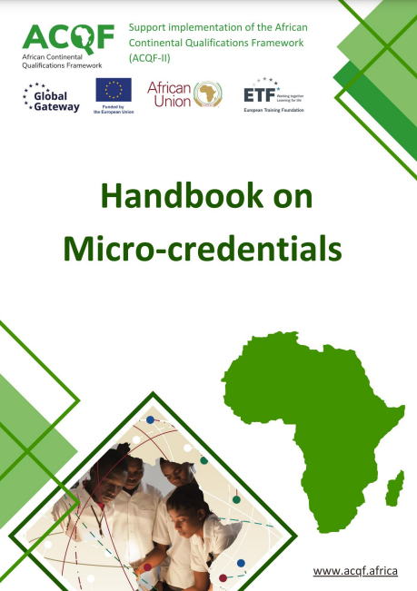
Micro-credential definition in the ACQF Policy document
Micro-credential means the record of the learning outcomes that a learner has acquired following a small volume of learning. These learning outcomes will have been assessed against transparent and clearly defined criteria. Learning experiences leading to micro-credentials are designed to provide the learner with specific knowledge, skills and competences that respond to societal, personal, cultural or labour market needs. Micro-credentials are owned by the learner, can be shared and are portable. They may be stand-alone or stackable / combined into larger credentials. They are underpinned by quality assurance following agreed standards in the relevant sector or area of activity.

Slide 8
Micro-credentials: definitions in selected countries
Country | Definition
New Zealand | Micro-credentials are small, stand-alone awards with set learning outcomes. Micro-credentials recognise learners' skills, experience or knowledge, while meeting demand from employers, industry and communities. Micro-credentials are: • Listed on the New Zealand Qualifications and Credentials Framework (NZQCF). • 5 to 40 credits in size (although in exceptional circumstance may be less than 5 credits); Taught at all levels of the NZQCF. • Delivered by accredited education providers. • Developed because there is evidence they are needed.
Australia | Micro-credentials are a certification of assessed learning or competency, with a minimum volume of learning of one hour and less than an AQF award qualification, that is additional, alternate, complementary to or a component part of an AQF award qualification.

Slide 9
Micro-credentials: definitions in selected countries… Cont’d
Country | Definition
Seychelles | A record of focused learning achievement verifying what the learner knows, understands or can do, and includes assessment based on clearly defined criteria, and is awarded by an accredited or registered provider.
Malaysia | Micro-credential is a certification of assessed learning of a single or a set of courses which are intended to provide learners with knowledge, skills, values and competencies in a narrow area of study and/or practice.
Canada | A micro-credential is a certification of assessed competencies that is additional, alternate, complementary to, or a component of a formal qualification.

Slide 10

Micro-credentials – an inevitable way forward
Given the accelerating and dynamic changes in the national and global economies, the graduates and others in the workplace must acquire new knowledge and learn new technologies and skills throughout their careers to remain productive.
Micro-credentials make possible the targeted, flexible acquisition of knowledge, skills and competences to meet new and emerging needs in society and the labour market and make it possible for individuals to fill the skill gaps they need to succeed in a dynamic environment, while not replacing traditional qualifications.
The shorter, personalised, demand-driven and stackable micro-credentials are, thus, expand opportunities for reskilling and upskilling of the workforce in tandem with changes in the workplace and also offer new pathways to full qualifications.
https://www.weforum.org
/agenda/2023/05/future- of-jobs-2023-skills

Slide 11

Challenges
Stakeholders are still unsure or unaware of micro-credentials and their benefits
Lack of trust – transparency, QA
Complexity and variety of micro-credentials offerings
Recognition of micro-credentials
Limited funding – cost implications
Evidence gaps, lack of systematic data collection – hence the ongoing intensified studies
Balancing between regulation and flexibility.

Slide 12
National MCs Frameworks-
Key Components and
Options

Slide 13
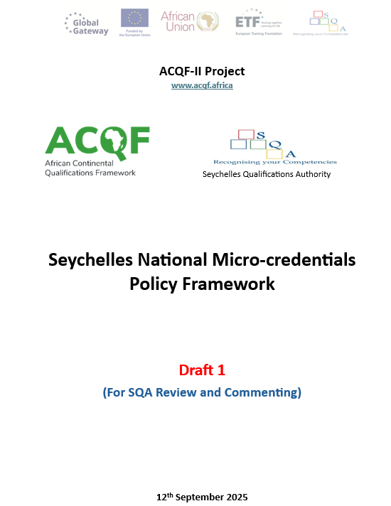
Importance of a national MCs framework?
An enabling framework for the development, QA, uptake and recognition of MCs, making them trustworthy for stakeholders and maximising their impact.
A critical national instrument to supporting:
Learning/ Skilling
Upskilling
Reskilling.
Facilitates the recognition of skills/ learning outcomes:
  Lifelong learning - throughout life
  Lifewide learning - in different contexts and situations within life.

Slide 14
Background and national policy context
Prevailing or predicted national context – education completion rates, employment rates, skills gaps, ease of access to quality, relevant and equitable education and training, technological advancements, etc.
National policies and legal instruments in favour of MCs

Slide 15
Purpose and objectives of the MCs framework
Provide stakeholders with guiding principles on the development, delivery, issuance and recognition of micro-credentials in the country
National definition for micro-credentials
Principles for good quality micro-credentials
Critical elements to describe micro-credentials
Minimum criteria for the inclusion of micro-credentials in the NQF
Modalities for quality assuring micro-credentials
Approaches for recognition of micro-credentials
Use of micro-credentials for credit accumulation and recognition, and recognition of prior learning.

Slide 16
National definition of micro-credentials
Make reference to existing international, regional and national definitions
Always contextualise
Consider learning outcomes, volume of learning, duration and credits, QA, assessment, etc.
Examples: refer to the slides on Micro-credentials: definitions in selected countries

Slide 17
Purposes of micro-credentials
Addressing skills mismatches and skills in demand, promoting lifelong learning
Serving as a vital tool for upskilling and reskilling workers helping address skills gaps by providing targeted training
Enhancing employability
Providing flexible learning pathways

Slide 18
Target groups/ beneficiaries of micro-credentials
Lifelong learners and professionals seeking career progression and personal development
Job seekers and NEET youth
Low-qualified/ skilled individuals
Learners in formal and non-formal education and training
Out-of-school youths
Disadvantaged groups (household income-wise, girls, women, refugees)

Slide 19
Providers of micro-credentials
Offered and awarded by providers accredited or registered/ recognised according to relevant national legislation.
In the absence of the accreditation or registration/ recognition status, an organisation or institution wishing to offer or award micro-credentials can collaborate with an accredited or registered/ recognised provider for the purposes of quality assurance and recognition of such micro-credentials.

Slide 20

Roles of stakeholders
Govt./ Policy Makers
NQF Agencies/ Bodies
QA/ Regulatory Agencies
Education and Training Institutions/ Providers
Employers/ Industry
Students/ Learners/ Applicants
Professional/ industry bodies/ associations.

Slide 21
Micro-credentials value chain
Design & Development
Part of existing LP (modularisation)?
Stand-alone?
Delivery
Delivery modes (in-person, online, blended)
Tools
Assessment
Types of assessments
Tools
Issuance/ awarding
Co-design and development
Physical or digital
Features and details
Portability and security
CAT and stacking options
What about RPL?
Credit-bearing and non credit-bearing

Slide 22
Recognition pathways for micro-credentials
    Education and training providers: credit recognition and accumulation towards a qualification, and admission into a learning programme or a course.
    Employers, professional or industry bodies, public institutions: seeking to recognise skills and competencies of employees may recognise micro-credentials for continuous professional development, recruitment process or advancement within the career structure, or towards licencing professional services/ practise, or other licensable activities.
    Registration of micro-credentials on the NQF and their inclusion into the national database support the transparency of micro-credentials and enhance trust in their quality, which can further facilitate recognition of micro-credentials at national and international levels.

Slide 23
Micro-credentials and recognition of prior learning (RPL)
Typical RPL Process
Micro-credentials can be awarded through recognition of prior learning (RPL): as a result of RPL and as a tool for RPL.
Providers of MCs should design or integrate micro-credentials into their institutional RPL policies and procedures in accordance with national policies and guidelines on RPL.
Providers of MCs are responsible for internal/ institutional quality assurance of the RPL process for micro-credentials; NQF agencies / bodies: external QA.
No distinction in recognition of MCs awarded through RPL (non-formal and informal) and through formal learning.
1.
Identification
2.
Documentation
3.
Assessment
4.
Certification

Slide 24
Micro-credentials and credit systems
Providers of MCs can assign credits for micro-credentials that are:
part of a qualification listed on the NQF;
based on a unit/ competence standards;
component of an accredited learning programme;
based on an accredited short course.
Credits should be assigned to micro-credentials in line with existing nation CAT policies and guidelines.

Slide 25
Inclusion of micro-credentials in the NQF
Most resent (new and revised) NQFs are now open to inclusion of micro-credentials that meet the principles for the good quality micro-credentials.
Only credit-bearing micro-credentials are registered on the NQFs.
Micro-credentials should be mapped to appropriate NQF levels based on complexity of their learning outcomes.
The level assigned must provide a best match between the level descriptors (for a specific NQF level) and the learning outcomes and assessment criteria of the micro-credential.

Slide 26
Critical information to describe micro-credentials
Title
Provider/awarding institution
Purpose/ rationale
Workload (in credits or notional hours)
Level on the NQF (if applicable)
Field and subfield
Entry requirements (including via other micro-credentials)
Learning outcomes
Assessment methods and criteria
Quality assurance
Modes of Delivery (if applicable)
Recognition of prior learning opportunities (if applicable)
Integration and stackability

Slide 27
Inclusion of micro-credentials in national databases
Information on MCs registered on NQFs should be included in national databases.
The information on micro-credentials in the database should contain the critical information listed on the previous slide.
Where a micro-credential is recognised by a professional or industry body or within the public sector, aligns with an industry standard, standards for recruitment, training or other professional development requirement or scheme of service, or constitutes recognition towards professional services or other licensable activities, this should be indicated.

Slide 28
Stackability of micro-credentials
Ability to combine or "stack" individual micro-credentials into larger (macro) credentials or qualifications.
Providers should design micro-credentials that allow combinations with other micro-credentials, parts of qualifications or qualifications, providing learners with progressive and flexible learning pathways.
recognising micro-credentials for credit towards a qualification, use inter-institutional agreements to allow different pathways for stacking micro-credentials and credit accumulation.
Decisions to “stack” or combine micro-credentials lie with the education and training provider recognising micro-credentials from other learning programmes, short courses or other providers.

Slide 29
Collaboration between stakeholders
Traditional providers of MCs should collaborate with companies, professional or industry bodies to ensure the relevance of micro-credentials and courses leading to micro-credentials for the labour market
In the absence of the accreditation or registration/ recognition status, companies, professional or industry bodies wishing to offer or award micro-credentials can collaborate with an accredited or registered/ recognised provider for the purposes of quality assurance and recognition of such micro-credentials.

Slide 30
Quality assurance (QA) of micro-credentials
QA essential for recognition of MCs - supports the credibility and trustworthiness of micro-credentials.
QA ensures that MCs are ‘fit for purpose’, that is, they meet the specific skill and knowledge needs of the learners and the labour market.
MCs should be an integral part of internal quality assurance processes of providers as for other awards or qualifications.
QA of MCs should cover: the overall quality of the MC itself, including its design and assessment of learning outcomes, and the quality of the course leading to the MC, where applicable; certification through RPL process, where applicable.
MCs should be subject to external QA. External QA of MCs can be based on the principles for good quality MCs.
External QA of credit-bearing MCs can be conducted in line with: institutional accreditation, accreditation of learning programme, accreditation of short courses.

Slide 31
Principles of good quality micro-credentials
Outcome-based
Skill or competency focused
Standard-based assessment
Quality
Learning pathways
Learner-centred
Relevance
Transparency
Information and guidance
Portability and authenticity
Recognition

Slide 32
Open Discussion

Slide 33
Questions for open discussion
1. Should all MCs be included in the NQF? What parameters/ criteria do you see critical to the inclusion of MCs in NQFs?
2. It is not uncommon for providers to offer and award non-credit bearing MCs. How, in your view, can such MCs be best quality assured to enhance their recognition?

Slide 34
Thank you!
Merci!
Obrigado!

