Slide 1



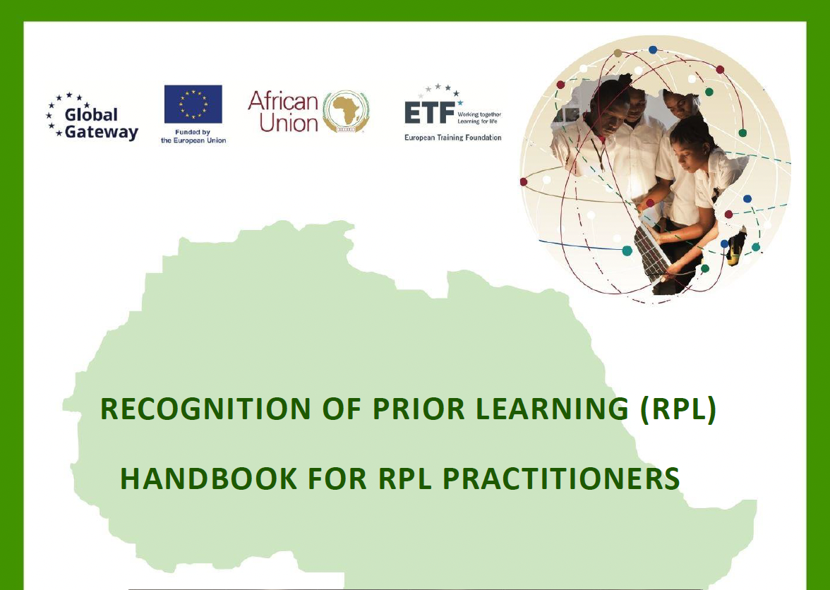
6th ACQF Network Forum 30 September – 2 October 2025 Assessment in the Context of RPL, with a Focus on Portfolios
Patrick Werquin, ETF expert
Mona Pielorz, DIE, Germany

Slide 2
Agenda for this Session on RPL
Building on previous presentations
Not RPL in general: assessment only (concrete, with some secrets ☺)
Focus on portfolios (Mona Pielorz, DIE, Germany)
Patrick Werquin, “Assessment in the Context of RPL with a Focus on Portfolio”, 6th ACQF Forum, Mauritius, 30 September – 2 October 2025

Slide 3
Quick Quick Quick Reminders
RPL is a process
RPL is a second chance of qualification (certification in French)
RPL is about recognising all learning outcomes (whether formal, non-formal or informal context)
Key issue is societal recognition
A qualification is a piece of currency in the labour market
RPL is a key companion to microcredentials (not a secret anymore)
Patrick Werquin, “Assessment in the Context of RPL with a Focus on Portfolio”, 6th ACQF Forum, Mauritius, 30 September – 2 October 2025

Slide 4
Key Reminder
RPL focuses on what learners/applicants know and can do, not on where or how they have learnt it
Patrick Werquin, “Assessment in the Context of RPL with a Focus on Portfolio”, 6th ACQF Forum, Mauritius, 30 September – 2 October 2025

Slide 5
Assessment in the Context of RPL
All this means assessment is key
For trust
It means quality assurance
Therefore, some principles have to be respected
Conclusion: assessment in RPL is no different in essence to assessment in the formal education and training system (FETS)
Patrick Werquin, “Assessment in the Context of RPL with a Focus on Portfolio”, 6th ACQF Forum, Mauritius, 30 September – 2 October 2025

Slide 6
Assessment in RPL vs. in Formal ET
Let’s be very concrete, you will hear, RPL is:
Fast? Faster?
Random? More random?
Easy? Easier?
… than formal education and training
Patrick Werquin, “Assessment in the Context of RPL with a Focus on Portfolio”, 6th ACQF Forum, Mauritius, 30 September – 2 October 2025

Slide 7
Assessment in RPL vs. in Formal ET
Fast? Faster? NO
Random? More random? NO
Easy? Easier? NO
Patrick Werquin, “Assessment in the Context of RPL with a Focus on Portfolio”, 6th ACQF Forum, Mauritius, 30 September – 2 October 2025

Slide 8
Assessment in RPL vs. in Formal ET
Fast? Faster? NO: the learning process is a ‘loooooooooot’ longer°, assessment too
Random? More random? NO: mixed approaches allow to cover all learning outcomes ☺☺☺ Secret #1
Easy? Easier? NO: same standards (assessment process different)
Key Rules:
. Qualifications standards: must be the same than for the education and training formal system (parity of esteem)
. Principles: must be the same
. Process: can be different
Patrick Werquin, “Assessment in the Context of RPL with a Focus on Portfolio”, 6th ACQF Forum, Mauritius, 30 September – 2 October 2025
Notes:
PhD in Djibouti

Slide 9
Principles: you will read this ☹☹☹
Validity
Authenticity
Fitness for purpose
Reliability
Fairness
Sufficiency
Currency
Transparency
☹☹☹ Conflation ☹☹☹
Patrick Werquin, “Association: Evidence reflects up-to-date competence.
essment in the Context of RPL with a Focus on Portfolio”, 6th ACQF Forum, Mauritius, 30 September – 2 October 2025

Slide 10
Principles ☺☺☺☺ The Right Way
Authenticity
Validity
Sufficiency
Currency
Fitness for purpose/authenticity
Reliability
Fairness
Transparency
Patrick Werquin, “Association: Evidence reflects up-to-date competence.
essment in the Context of RPL with a Focus on Portfolio”, 6th ACQF Forum, Mauritius, 30 September – 2 October 2025

Slide 11
Principles ☺☺☺☺ The Right Way
Evidence
Assessment Process
Authenticity
Validity
Sufficiency
Currency
Fitness for purpose/authenticity
Reliability
Fairness
Transparency
No Conflation
☺ Secret #2 ☺
Patrick Werquin, “Association: Evidence reflects up-to-date competence.
essment in the Context of RPL with a Focus on Portfolio”, 6th ACQF Forum, Mauritius, 30 September – 2 October 2025

Slide 12
Principles
Authenticity: Ensures the evidence genuinely belongs to the learner
Validity: Evidence must align with required learning outcomes
Sufficiency: Enough evidence to make a robust judgement
Currency: Evidence reflects up-to-date knowledge, skills and competences
Fitness for purpose/authenticity: The method must match the outcome
Reliability: Consistency of judgements across assessors and contexts (regions)
Fairness: Equitable treatment of all applicants
Transparency: Clarity of criteria, procedures, and feedback
Patrick Werquin, “Association: Evidence reflects up-to-date competence.
essment in the Context of RPL with a Focus on Portfolio”, 6th ACQF Forum, Mauritius, 30 September – 2 October 2025

Slide 13
Assessment Methods (selection)
Portfolio assessment (evidence of experience, reflection, artefacts).
(Smart) portfolios Secret #3: for eligibility and for final assessment
Challenge examinations (written or online tests).
Practical demonstrations (skills in real or simulated contexts).
Oral or written tests (short-answer, case-based).
Interviews and questioning (structured, criterion-based).
Combination of methods for triangulation and fairness.
Patrick Werquin, “Assessment in the Context of RPL with a Focus on Portfolio”, 6th ACQF Forum, Mauritius, 30 September – 2 October 2025

Slide 14
My Advice
Mixed approaches… so randomness is minimised (absent)…
… and detractors speechless ☺ ☺ ☺
In this context, portfolios are key tools (again for eligibility and full assessment): floor to Mona Pielorz
Patrick Werquin, “Assessment in the Context of RPL with a Focus on Portfolio”, 6th ACQF Forum, Mauritius, 30 September – 2 October 2025

Slide 15
M e r c i
D a n k e

