Slide 1
Portfolio – Shapes, Structures and Design
Mona Pielorz 02.10.2025

Slide 2
Definitions
General education / assessment
“A purposeful collection of student work that exhibits the student’s efforts, progress, and achievements in one or more areas. The collection must include student participation in selecting contents, the criteria for judging merit, and evidence of student self-reflection.” — Paulson, Paulson & Meyer (1991), widely cited in portfolio assessment literature.
OECD (Recognition of Prior Learning)
“A portfolio is a structured collection of documents and other evidence that demonstrates an individual’s learning outcomes, competences and achievements, compiled for the purpose of recognition.” — OECD, Recognition of Non-formal and Informal Learning: Outcomes, Policies and Practices (2010).
European Training Foundation (ETF)
“The portfolio method requires the individual to compile a file of evidence of competences and learning outcomes, accompanied by reflective statements, which is assessed against established standards.” — ETF (2022), Validation of non-formal and informal learning in practice.
Notes:
Purposeful: not ‘everything’, but specifically collected.
Evidence-based: evidence of learning outcomes and competences.
Reflective: explanation by the candidates themselves of how their experiences demonstrate competences.
Assessment-oriented: suitable for assessment against standards (especially in the RPL context).

Slide 3
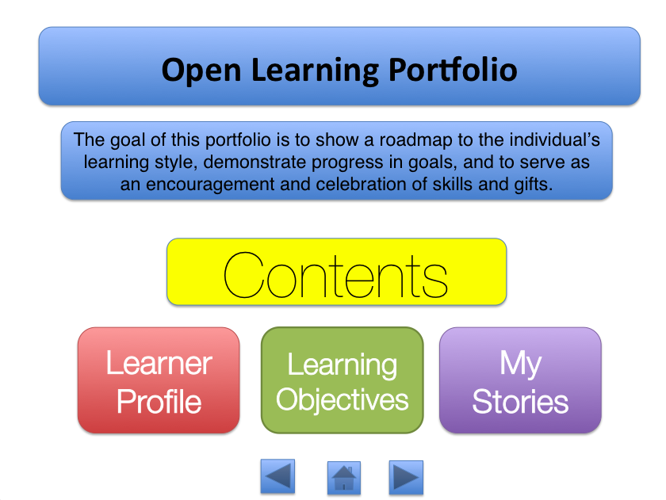
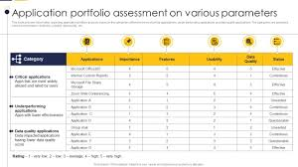
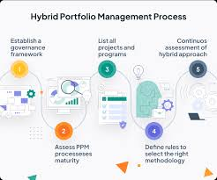
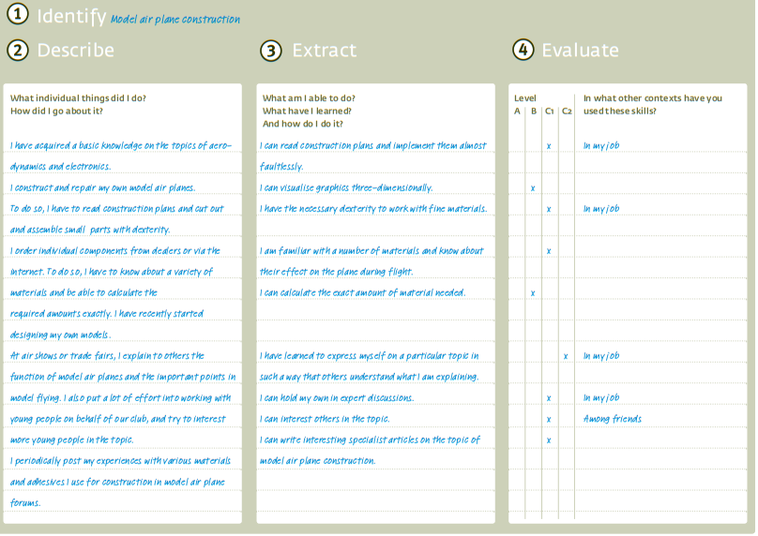

The five „main“ versions od portfolios

Slide 4
Process/Learning/Development Portfolio
Advantages and challenges (in recognition contexts)
+ Good to show learning trajectories and depth of growth. + Facilitates self‐reflection and metacognition. – May include “messy” artefacts; less polished. – Harder to map directly to fixed external criteria.
Purpose / emphasis:
To document ongoing learning, development, and growth over time
Key features / characteristics
Contains drafts, intermediate work, reflections, revisions, “works in progress”
Notes:
Process documentation: Steps, methods and procedures used to work on a task or project.
Learning experiences: Reflection on what was learned during the project or course, including difficulties, solutions and moments of insight.
Evidence of development: Progress in building your own skills, e.g. new knowledge, abilities or personal development.
Supporting documents: Work samples, sketches, drafts, feedback, reflective texts.
Outlook: What next steps are planned and how what you have learned can be applied in the future.
Sample table of contents
Introduction
Aim of the portfolio
Context (project, course, professional situation)
Starting point
Personal previous experience and expectations
Initial ideas and questions
Process documentation
Work steps and approach
Methods and tools used
Challenges and solution strategies
Learning experiences
Technical insights
Personal learning moments (e.g. ‘aha’ moments, change of perspective)
Feedback from others
Development and skills
What new knowledge/skills were acquired?
Reflection: Change in own thinking and behaviour
Evidence (e.g. work samples, intermediate products, screenshots)
Results and interim results
Presentation of partial results
Comparison: Initial situation vs. current status
Outlook
Next steps or further development
Transfer to other contexts (e.g. studies, career, other projects)
Appendix
Documents, sketches, photos, feedback forms
Literature or sources

Slide 5
Showcase/Presentation/Professional Portfolio
Advantages and challenges (in recognition contexts)
+ Efficient for external reviewers: highlights strongest evidence. + Easier to “sell” skills/competences succinctly. – Risk of selection bias (only successes). – Potential to hide gaps or developmental challenges.
Purpose / emphasis:
To present one’s strongest work, achievements, successes
Key features / characteristics
Select “best-of” artefacts; structured for an external audience (assessors, employers)
Notes:
Key elements of a Showcase/Presentation/Professional Portfolio
Selected achievements: Best projects or results presented clearly and visually.
Professional competences: Evidence of core skills and strengths.
Supporting materials: Certificates, references, testimonials, work samples.
Presentation quality: Structured, concise and visually appealing format.
Future orientation: Career goals, opportunities and application of expertise.
Typical contents of a showcase/presentation/professional portfolio:
Introduction/profile
Brief overview of yourself, your role or your professional context
Professional statement or short biography
Best-of works/showcases
Selection of your best projects, products or results
Images, screenshots, videos or reports that demonstrate quality
Brief descriptions: goals, methods, results, impact
Skills and strengths
Overview of key skills (technical, methodological, social)
Certificates or evidence, if applicable
References
Feedback from clients, employers, colleagues
Testimonials or letters of recommendation, if applicable
Presentation format
Visually appealing design (e.g. with graphics, layout, storytelling)
Often intended for job applications, career development or project acquisition
Contact / profile
Contact details, professional networks (LinkedIn, website, portfolio page)

Slide 6
Assessment/Performance Portfolio
Advantages and challenges (in recognition contexts)
+ Most directly usable for credentialing / recognition. + Easier to validate alignment with outcomes. – Requires that the candidate understand the assessment criteria well. – May limit inclusion of other dimensions of learning (e.g. “hidden” competences).
Purpose / emphasis:
Designed explicitly for assessment — to demonstrate alignment with predefined criteria, outcomes or standards
Key features / characteristics
Artefacts are chosen or structured to map to the assessment framework; often includes direct evidence, rubrics, reflective commentary
Notes:
Key elements of an Assessment/Performance Portfolio
Evidence of competence: Demonstration of knowledge, skills and attitudes against defined standards.
Assessment criteria: Clear link to benchmarks, rubrics or qualification frameworks.
Authentic work samples: Assignments, projects, tests or practical demonstrations.
Evaluator feedback: Comments, grades, peer or supervisor assessments.
Progress record: Documentation of achievements and areas for improvement.
Example table of contents
Introduction
Purpose of the assessment portfolio
Context (course, programme, qualification)
Assessment framework
Standards, criteria or learning outcomes
Explanation of evaluation method
Collected evidence
Work samples, assignments, projects
Documentation of practical performance
Assessment results
Feedback from teachers, peers or supervisors
Grading, rubrics, scoring sheets
Performance reflection
Self-assessment of strengths and weaknesses
Lessons learned
Development plan
Identified gaps
Next steps for improvement
Appendices
Certificates, transcripts, supplementary documents

Slide 7
Hybrid/Mixed Portfolio
Advantages and challenges (in recognition contexts)
+ Offers a balance: shows trajectory and meets external criterion. – More complex to design and guide. – Risk of overloading the candidate or assessor.
Purpose / emphasis:
Combines features of process, showcase, and assessment portfolios
Key features / characteristics
Contains both developmental artefacts (process) and polished pieces (showcase), plus alignment / commentary to criteria
Notes:
Key elements of a Hybrid/Mixed Portfolio
Combination of purposes: Integrates elements of process, showcase and assessment portfolios.
Multiple audiences: Designed for self-reflection, professional presentation and external evaluation.
Diverse evidence: Mix of reflections, work samples, feedback, certificates and achievements.
Flexible structure: Adaptable to context, course or career goals.
Holistic view: Demonstrates both learning journey and final performance.
Example table of contents
Introduction
Aim of the hybrid portfolio
Target audiences (self, peers, employers, assessors)
Learning and process
Documentation of steps, methods and experiences
Reflection on challenges and insights
Showcase of achievements
Selected highlights, best work, outcomes
Professional presentation of competences
Assessment and evidence
Work samples matched to standards
Feedback and evaluation results
Personal development
Skills acquired and growth over time
Self-assessment and reflection
Future perspective
Career or learning goals
Application of competences in new contexts
Annexes
Certificates, transcripts, references, supplementary documents

Slide 8
Biographical - Systematic Portfolio
Advantages and challenges (in recognition contexts)
+ Makes tacit competences visible + Strong bridge between biography and recognition – Requires careful guidance and support
Purpose / emphasis:
Map life and career history to competences
Key features / characteristics
Timeline, turning points, clusters of experience, reflection, evidence
Notes:
Key elements of a Biographical – Systematic Portfolio
Life-course orientation: Structured around personal and professional stages of life.
Holistic documentation: Captures formal, non-formal and informal learning experiences.
Systematic approach: Follows a guided process with questions, prompts and categories.
Self-reflection: Focus on individual strengths, motivations and competences.
Transferability: Outcomes can be linked to qualification frameworks, career planning or counselling.
Example table of contents (inspired by ProfilPASS structure)
Introduction
Purpose of the portfolio
How to work with it
Personal background
Biographical data
Key life experiences
Learning biography
Formal learning: School, vocational education, higher education
Non-formal learning: Courses, training, workshops
Informal learning: Voluntary work, hobbies, family responsibilities, everyday learning
Competence identification
Skills, knowledge and abilities from all life areas
Reflection prompts: “What did I do? What did I learn? How did I use it?”
Systematic documentation
Tables or matrices to record evidence of competences
Linking experiences to competence areas or frameworks
Personal strengths profile
Summary of competences and motivations
Self-assessment and feedback integration
Outlook and planning
Next steps in career, education or personal development
Goals and action plan
Appendices
Certificates, references, documents, work samples

Slide 9
Portfolio types in recognition procedures
Portfolio type | Reflection (self- and learning experiences) | Evidence (standards, documentation) | Presentation (for employers/public) | Guidance (counselling, orientation) | Assessment/Evaluation (formal recognition)
Process/Learning/ Development | high – focus on learning paths, challenges, insights | medium – evidence often unsystematic | low – not primarily intended for external presentation | high – useful for counselling within recognition procedures | low – only indirectly applicable
Showcase/ Professional | low – little systematic reflection | medium – highlights results but not always standard-based | very high – strong for external presentation and best work | low – not primarily counselling-oriented | medium – may serve as work sample in assessments
Assessment/ Performance | low – reflection not central | very high – explicit alignment with standards/criteria | medium – formal presentation possible | medium – can be embedded in counselling | very high – core instrument for formal recognition
Hybrid/Mixed | high – includes reflective elements | high – integrates evidence and standards | high – also allows for external presentation | high – adaptable for counselling and orientation | high – supports assess-ment and standards-based recognition
Biographical/ Systematic | very high – life course, experiences, competences | high – systematic documentation of learning and evidence | medium – can be adapted for presentation purposes | very high – strong role in counselling | medium – supportive in assessments but not usually sufficient on its own

Slide 10
Key for RPL: Reflection
More than collecting documents: Reflection explains the significance of each piece of evidence, showing how it demonstrates learning.
Making tacit learning visible: Reflection helps individuals connect life and work experiences with competences that are otherwise hidden.
Giving the candidate a voice: Through reflection, candidates describe their own learning journey in their own words.
Ensuring assessment relevance: Reflection links artefacts directly to learning outcomes and standards, making the assessor’s task clearer.
Empowering learners: Reflection strengthens confidence, as candidates recognise the value of their experiences and achievements.
A new skill for many: Many candidates have little or no prior experience in reflecting on their own learning, which is why guidance and facilitation are essential..
Notes:
More than collecting documents: Reflection explains the significance of each piece of evidence, showing how it demonstrates learning.
Making tacit learning visible: Reflection helps individuals connect life and work experiences with competences that are otherwise hidden.
Giving the candidate a voice: Through reflection, candidates describe their own learning journey in their own words.
Ensuring assessment relevance: Reflection links artefacts directly to learning outcomes and standards, making the assessor’s task clearer.
Empowering learners: Reflection strengthens confidence, as candidates recognise the value of their experiences and achievements.
A new skill for many: Many candidates have little or no prior experience in reflecting on their own learning, which is why guidance and facilitation are essential.

Slide 11
Designing portfolios: considering the target group
Start with the learner, not the template: Portfolio design must begin with a clear understanding of who will use it.
Literacy and numeracy levels: Some candidates may have limited writing or numeracy skills; design should therefore include oral, visual or practical ways of documenting competences.
Accessibility and inclusiveness: Portfolios must allow for different languages, digital skills, and cultural backgrounds.
Alternative forms of evidence: Audio recordings, photos, demonstrations or storytelling can substitute for written texts.
Support structures: Guidance, facilitation and peer exchange are critical for candidates with fewer formal skills.
Respecting dignity: The process should empower learners by recognising strengths rather than highlighting deficits.

Slide 12

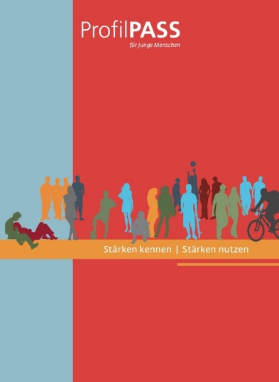

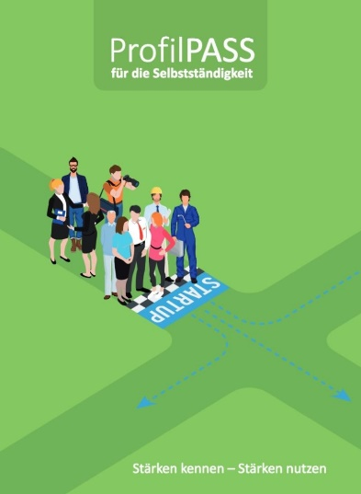
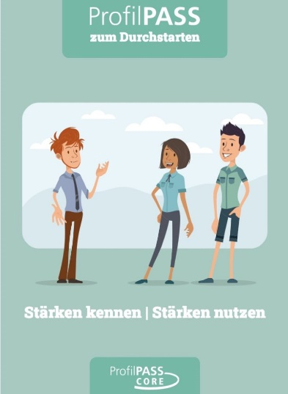
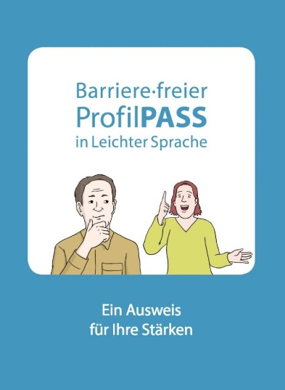
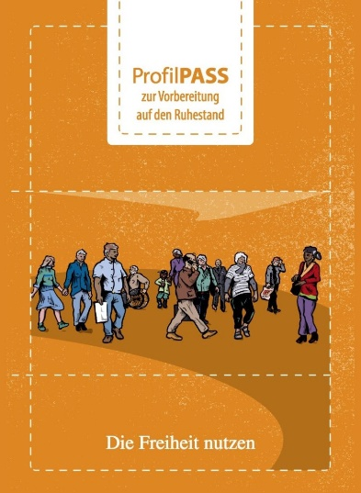



ProfilPASS – one idea, many target groups, many languages
Adults
English/French +
Young people
(12-18 y)
English/French +
Newly immigrated adults
English +
Aspiring entrepreneurs
English +
NEET young adults
English/French +
Learners with difficulties
English +
Adults nearing retirement
English +
Returning aid workers
English +
Women
English +
Female migrants
English/French +

Slide 13
Assessment Portfolio – Designerperspektive
Define assessment purpose
Establish a clear function: verification of learning outcomes for RPL or formal qualification.
Delimitation – validatable evidence
Align with standards
Determine reference framework
Each portfolio category must be aligned with these standards.
Specify evidence requirements
Define what types of evidence will be accepted
Operationalise criteria: authenticity, validity, sufficiency, currency.
Design structure and templates
Specify a uniform structure
Provide templates or checklists
Develop reflective prompts
Incorporate standardised questions that highlight the link between experience and competence.
Integrate facilitation model
Define roles
Guidelines for facilitators
Assessment procedure
Regulate the process
Develop assessment grids to ensure consistency
Quality assurance
Moderation, second marking, peer review, calibration of assessors
Documentation and archiving of portfolios
Notes:
Define assessment purpose
Establish a clear function: verification of learning outcomes for RPL or formal qualification.
Delimitation: it is not just about self-reflection, but about validatable evidence.
Align with standards
Determine reference framework (e.g. national qualification standards, job profiles, learning outcomes).
Each portfolio category must be aligned with these standards.
Specify evidence requirements
Define what types of evidence will be accepted (documents, work samples, testimonials, digital media).
Operationalise criteria: authenticity, validity, sufficiency, currency.
Design structure and templates
Specify a uniform structure (e.g. one section per standard: Outcome – Evidence – Reflection).
Provide templates or checklists so that candidates know how to assign evidence.
Develop reflective prompts
Incorporate standardised questions that highlight the link between experience and competence.
Example: “What did you learn? How does this demonstrate the required standard?”
Integrate facilitation model
Define roles: Who advises, who accompanies, who assesses?
Guidelines for facilitators: how to support collection, structuring and reflection.
Assessment procedure
Regulate the process: submission, preliminary assessment, portfolio review, possibly validation interview.
Develop assessment grids to ensure consistency.
Quality assurance
Moderation, second marking, peer review, calibration of assessors.
Documentation and archiving of portfolios.

Slide 14
Design perspective: Biographical - Systematic Portfolio
Define the purpose
Main function: competence biography that reveals learning across all life domains.
Delimitation: evidence against standards and narrative connections and hidden competences.
Align with recognition context
Decide how life experiences will be linked to competence frameworks or qualification standards.
Ensure flexibility: representation of diverse
Specify evidence and narrative requirements
Accept traditional documents and alternative forms
Encourage narrative explanations that accompany evidence.
Design structure and templates
Provide a biographical framework
Use worksheets or guiding questions to help participants capture experiences systematically.
Develop reflective prompts
Include questions that link experiences → competences Integrate facilitation model
Assign facilitators to support candidates
Provide alternatives (audio recording, video interviews)
Portfolio development procedure
Sequence: life history → competence mapping → evidence collection → reflection → compilation.
Allow iterative development: feedback and guidance.
Quality assurance
Train assessors to value both narrative and evidence.
Use moderation to ensure fairness where portfolios differ strongly in format
Document how biographical evidence is judged against standards.
Notes:
“Whereas the assessment portfolio focuses on evidence against standards, the biographical-systematic portfolio begins with the person’s life story. It is especially powerful in RPL, because it brings forward competences that would otherwise remain hidden.”
Define the purpose
Establish the main function: to reconstruct a competence biography that reveals learning across life domains.
Delimitation: not only evidence against standards, but also narrative connections and hidden competences.
Align with recognition context
Decide how life experiences will be linked to competence frameworks or qualification standards.
Ensure flexibility so that diverse trajectories (work, family, volunteering, community) can be represented.
Specify evidence and narrative requirements
Accept both traditional documents (certificates, references) and alternative forms (photos, audio, storytelling).
Encourage narrative explanations that accompany evidence.
Design structure and templates
Provide a biographical framework: timeline, life phases, turning points, competence clusters.
Use worksheets or guiding questions to help participants capture experiences systematically.
Develop reflective prompts
Include questions that link experiences to competences: “What did you learn from this event?” “Which competences were strengthened?” “How does this connect to your current work or life?”
Integrate facilitation model
Assign facilitators to support candidates in telling their stories, especially those with limited literacy.
Provide alternatives (audio recording, video interviews) where writing is difficult.
Portfolio development procedure
Sequence: life history → competence mapping → evidence collection → reflection → compilation.
Allow iterative development with feedback and guidance.
Quality assurance
Train assessors to value both narrative and evidence.
Use moderation to ensure fairness where portfolios differ strongly in format (e.g. written vs. oral).
Document how biographical evidence is judged against standards.

Slide 15
Making portfolios accessible and relevant
Use target-group examples: Exercises should draw on familiar situations, roles and contexts from participants’ daily lives.
Storytelling and lived experience: Examples from peers or community members make reflection easier and more meaningful.
Multimodal evidence: Videos, photos or audio recordings can replace or complement written texts.
Role models on video: Short clips of people from the same background telling their competence stories provide orientation and encouragement.
Practice through guided exercises: Step-by-step activities help participants learn reflection, even without strong literacy skills.
Building confidence: Seeing and hearing stories “like my own” motivates participants to share and document their experiences.

Slide 16
Guidance and counselling in connection with portfolios
Role of guidance
- Portfolios are not self-explanatory.
- Counsellors or facilitators lower the
threshold to participation and reduce the risk of candidates giving up.
Forms of support
- Orientation sessions
- Individual counselling
- Workshops
- Feedback loops
Facilitator’s role in RPL
- Bridge between the candidate’s biographical narrative and the assessor’s formal criteria.
- Encouraging reflection, not just collection.
Ensuring authenticity and coherence of the portfolio.
Added value
Increases quality of portfolios
Strengthens fairness in assessment
Promotes empowerment
Notes:
Role of guidance
Portfolios are not self-explanatory. Candidates often need advice on what counts as evidence, how to organise it, and how to connect it to standards.
Orientation sessions: explaining the purpose and process of the portfolio.
Individual counselling: helping candidates identify competences and select relevant evidence.
Workshops: group settings to exchange experiences and demystify the portfolio task.
Feedback loops: iterative reviews before submission.
Facilitator’s role in RPL
Acting as a bridge between the candidate’s biographical narrative and the assessor’s formal criteria.
Encouraging reflection, not just collection.
Ensuring authenticity and coherence of the portfolio.
Added value
Increases quality of portfolios (clearer, more relevant evidence).
Strengthens fairness in assessment, since not all candidates have the same literacy or documentation skills.
Promotes empowerment, as candidates see their own competences more clearly.

Slide 17
Results of Portfolios
Making competences visible → Experiences and skills are documented in a structured and verifiable way.
Strengthening reflection and self-confidence → The process encourages self-reflection and increases confidence in one’s abilities.
Evidence and recognition → Recognition requires verifiable evidence. The portfolio provides this, but – depending on the context – may be complemented by further procedures (e.g. professional interview, practical demonstration).
Dialogue and guidance → Portfolios serve as a basis for dialogue with assessors, employers or counsellors and open up learning and career pathways.

Slide 18




Thank you very much for your attention.

