Slide 1


ACQF CLUSTER 4: COLLABORATION, COMMUNICATION & KNOWLEDGE SHARING
PRESENTED BY : Ms. Ivey Koin
DATE : 1st October, 2025
Copyright © KNQA

Slide 2
Role of Cluster 4
Cluster 4 enhances the effectiveness and visibility of the ACQF by strengthening communication, knowledge sharing, and collaboration among stakeholders. It ensures timely information flow, promotes good practices through platforms like webinars and newsletters, and fosters partnerships to advance ACQF goals.
1
Copyright © KNQA

Slide 3
Objectives of Cluster 4
Enhance visibility and advocacy for ACQF
Promote mutual learning
Strengthen communication & coordination among ACQF stakeholders
1
Copyright © KNQA

Slide 4
Membership of Cluster 4
Cluster 4 membership is as follows:
Seychelles (2)
South Africa (1)
Mozambique (1)
Malawi (1)
Bukina Faso (1)
Kenya (2)
Copyright © KNQA

Slide 5
What we have been upto:
ToR review
Workplan Development
Website review
Stakeholder mapping
ACQF Newsletter development
Copyright © KNQA

Slide 6
TOR REVIEW:
Requesting for increase in membership of the cluster for Cluster 4 to cover all regions
Requesting for approval and financing of the part Action Plan with an aim to allow the cluster to commence activity on the ground.
Copyright © KNQA

Slide 7
WORKPLAN DEVELOPMENT:
Its main aim is to:
Structure the communication value chain for the ACQF operationalization. Institution of the communication value chain through stakeholder mapping is part of the Workplan implementation process.
Copyright © KNQA

Slide 8
Workplan Development
Objective | Activities | Timeline
Strengthen Internal Communication | Develop a communication calendar (meetings, newsletters, updates) | September – October (2025)
External Communication & Media | Create social media content plan (Twitter/X, LinkedIn, ACQF platforms) Build media relations: identify journalists and prepare press kit | October – November (2025) November 2025 – December 2026
Strengthen Internal Communication | Establish standardised reporting templates. | October – November (2025)
Enhance Stakeholder Engagement & Visibility | Develop stakeholder briefs (FAQs, one-pagers, policy briefs) | November – December 2025
Enhance Stakeholder Engagement & Visibility | Map and update stakeholder database (ministries, RECs, HEIs, TVET, private sector) | January – March 2026
Enhance Stakeholder Engagement & Visibility | Disseminate stakeholder newsletters | First Edition: October – November 2025 February – March 2026 and adjusted accordingly moving forward

Slide 9
Workplan Development Cont’
Enhance Stakeholder Engagement & Visibility | Host stakeholder webinars | January – March 2026
Promote Knowledge Products | Review ACQF knowledge products (guidelines, toolkits, reports) Produce simplified summaries of 2 major ACQF guidelines. | April – July 2027
External Communication & Media | Develop branding and communication guidelines. | August – September 2027
External Communication & Media | Publish success stories / case studies from member states. | October – November 2027
Monitor & Report Progress | Conduct mid-term progress review. | TBC
Monitor & Report Progress | End-term review and final report. | TBC
Monitor & Report Progress | Develop indicators for monitoring communication and engagement. | TBC

Slide 10
Website Review
Cluster 4 in collaboration with Cluster 2 came up with the following:
Get bot/language plug in to translate languages on Website
Up to date Publications/Newletters – translated to languages
Interactive/user friendly website (less technical language)
Need for Media/gallery section

Slide 11
Stakeholder Mapping
Mapping of stakeholders is intended to:
Identify communication focal point persons for countries and regions
Work with respective countries/institutions to develop a value chain of comms transmission
Enhance public awareness via existing comms value chains
Monitor and evaluate effectiveness of the comms value chains

Slide 12
Stakeholder Mapping Cont’
 | Stakeholder type | List | Remarks
1. | Continental | AU secretariat | Oversight
2. | Regional | Regional Economic communities Governments (55) countries | Six Regional Economic Communities (RECs) in Africa, recognized by AU eg. EAC, ECOWAS, SADC and COMESA
3. | National | Ministries of Labour/Education/NQAs Regulators, Private sector, Public, CBOs, Education and Training Institutions | Cascade communication to the general public within the Country
4. | Development and Technical Partners | EU through ETF Worlf Bank and AfDB UNESCO, ILO GiZ, British Council | Support the institution of the ACQF

Slide 13
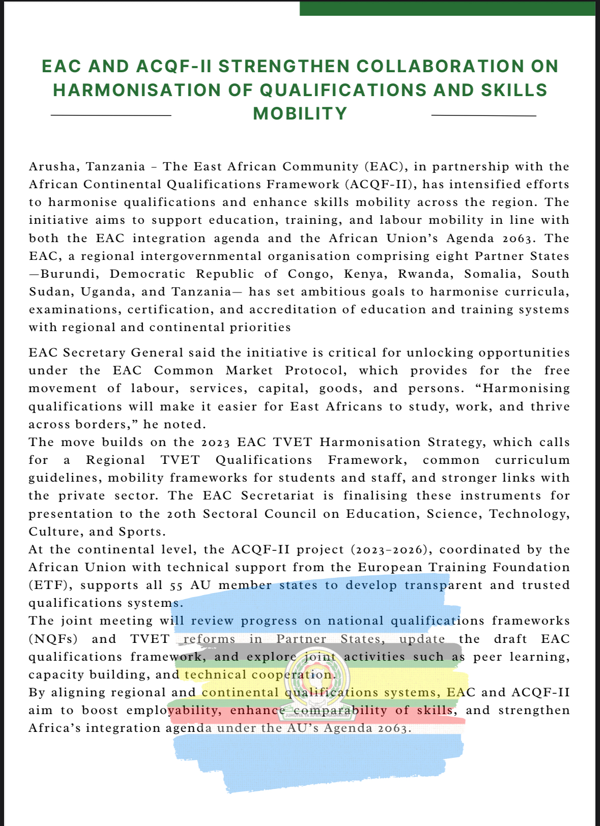
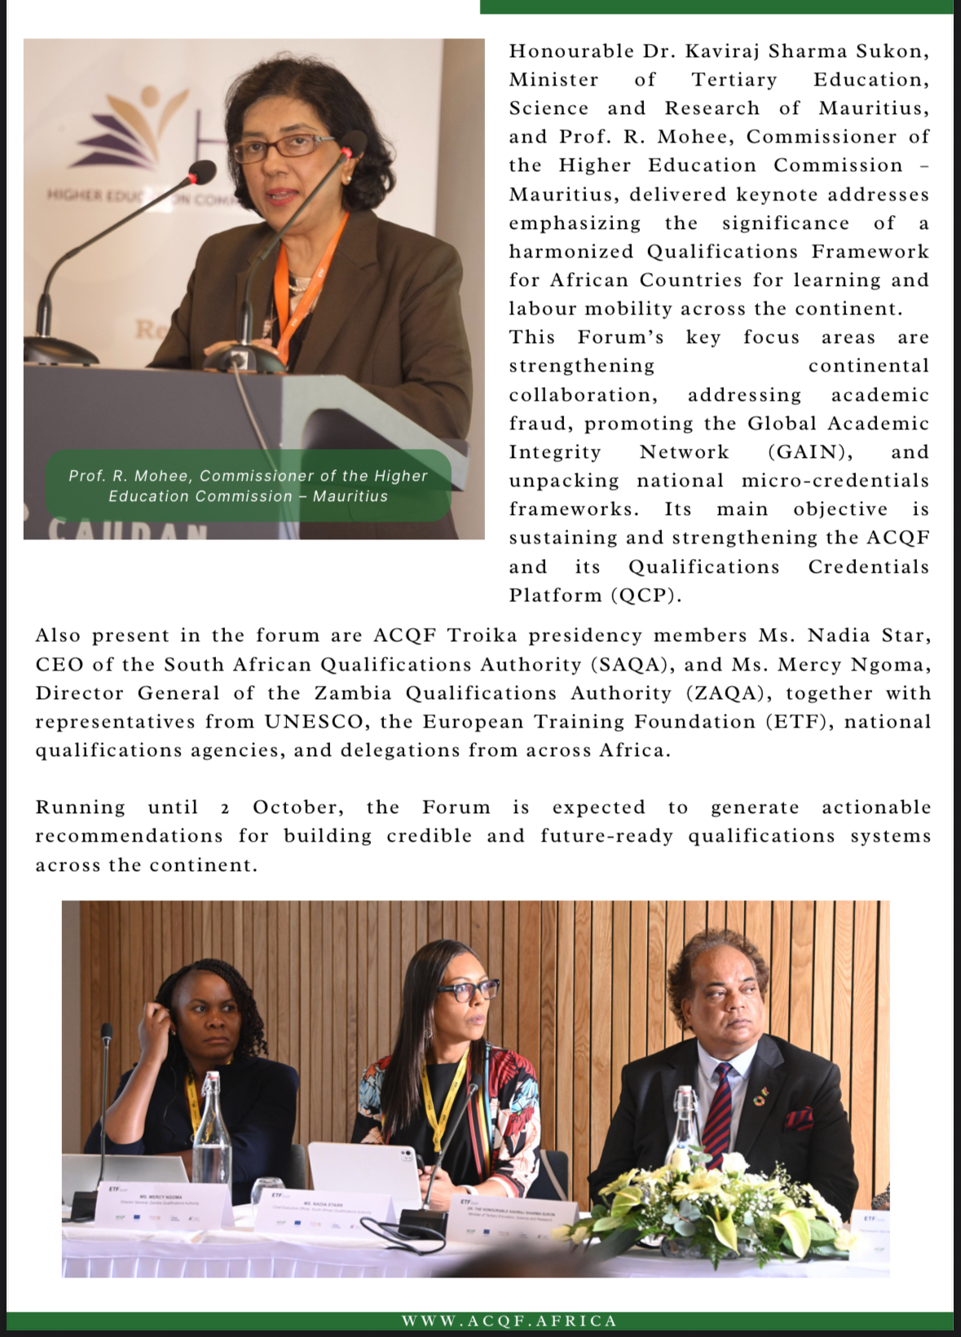

Slide 14
What else are we working on?
Cluster 4 is working on:
A high- level Advocacy Plan for 2026 outlining the proposed annual meeting and webinar schedule, key themes, and other recommended advocacy activities for the year.
Dissemination of research findings from recent surveys.

Slide 15
Feedback
Cluster 4 notes the following:
Translation and coordination services have been availed spectacularly
Teamwork has enabled the progress made by team
That current members (NQA, QA authorities, policy makers etc.) provide their contact details for compilation into a formal database to streamline communications value chains.

Slide 16
THANK YOU!
Q & A

