Slide 1



Green and digital
skills in Africa
The 6th ACQF Continental Forum
"Building Future-Ready Qualifications Systems for Africa"
Mauro Pelucchi
Head of Global Data Science Lightcast

Slide 2

Agenda – today’s topic
Green and digital trends
What is an occupational profile?
What does it mean for policy makers and education providers?

Slide 3
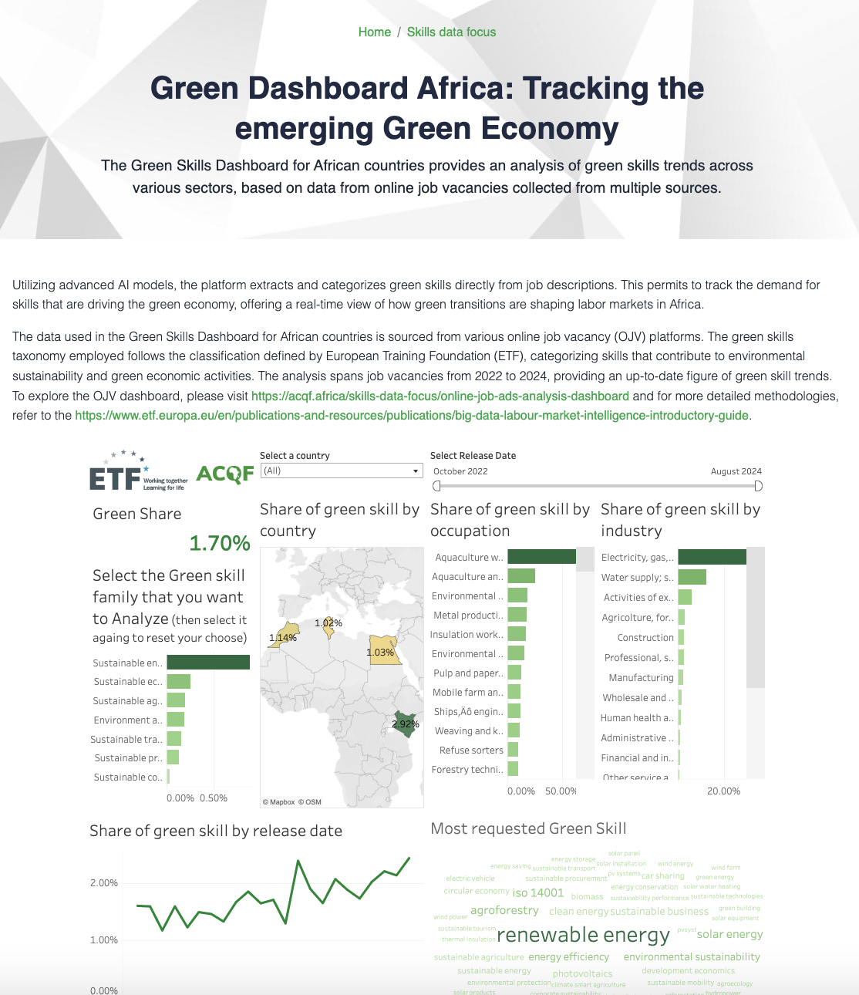

Green skills dashboard for African countries
https://acqf.africa/skills-data-focus/big-data-lmi-green-dashboard-africa

Slide 4



What do we need to prepare the green revolution?
Analyze the jobs and the skills for a green future
Create programs to disseminate green skills
Elaborate career paths and transition for new and old jobs

Slide 5

Green Skills clusters
Environment and Sustainable Tourism | This cluster encompasses skills related to managing natural ecosystems, such as forests and maritime areas, and includes competencies for promoting sustainable tourism.
Sustainable Agriculture | These skills focus on enhancing agricultural practices that are environmentally sustainable and beneficial for producers, consumers, and ecosystems.
Sustainable Construction | Skills under this cluster involve improving energy efficiency in buildings and aligning construction practices with the principles of a circular economy.
Sustainable Economy | This group refers to skills that support the broader concept of a circular economy, including resource efficiency and waste minimisation.
Sustainable Energy | Skills related to transforming energy production by integrating renewable sources, such as solar, wind, or hydro energy.
Sustainable Production | These skills are relevant for modifying existing production methods to reduce environmental impact and increase sustainability.
Sustainable Transport | This cluster involves competencies aimed at reducing emissions from transport, using alternative fuels and promoting mobility-sharing systems.

Slide 6
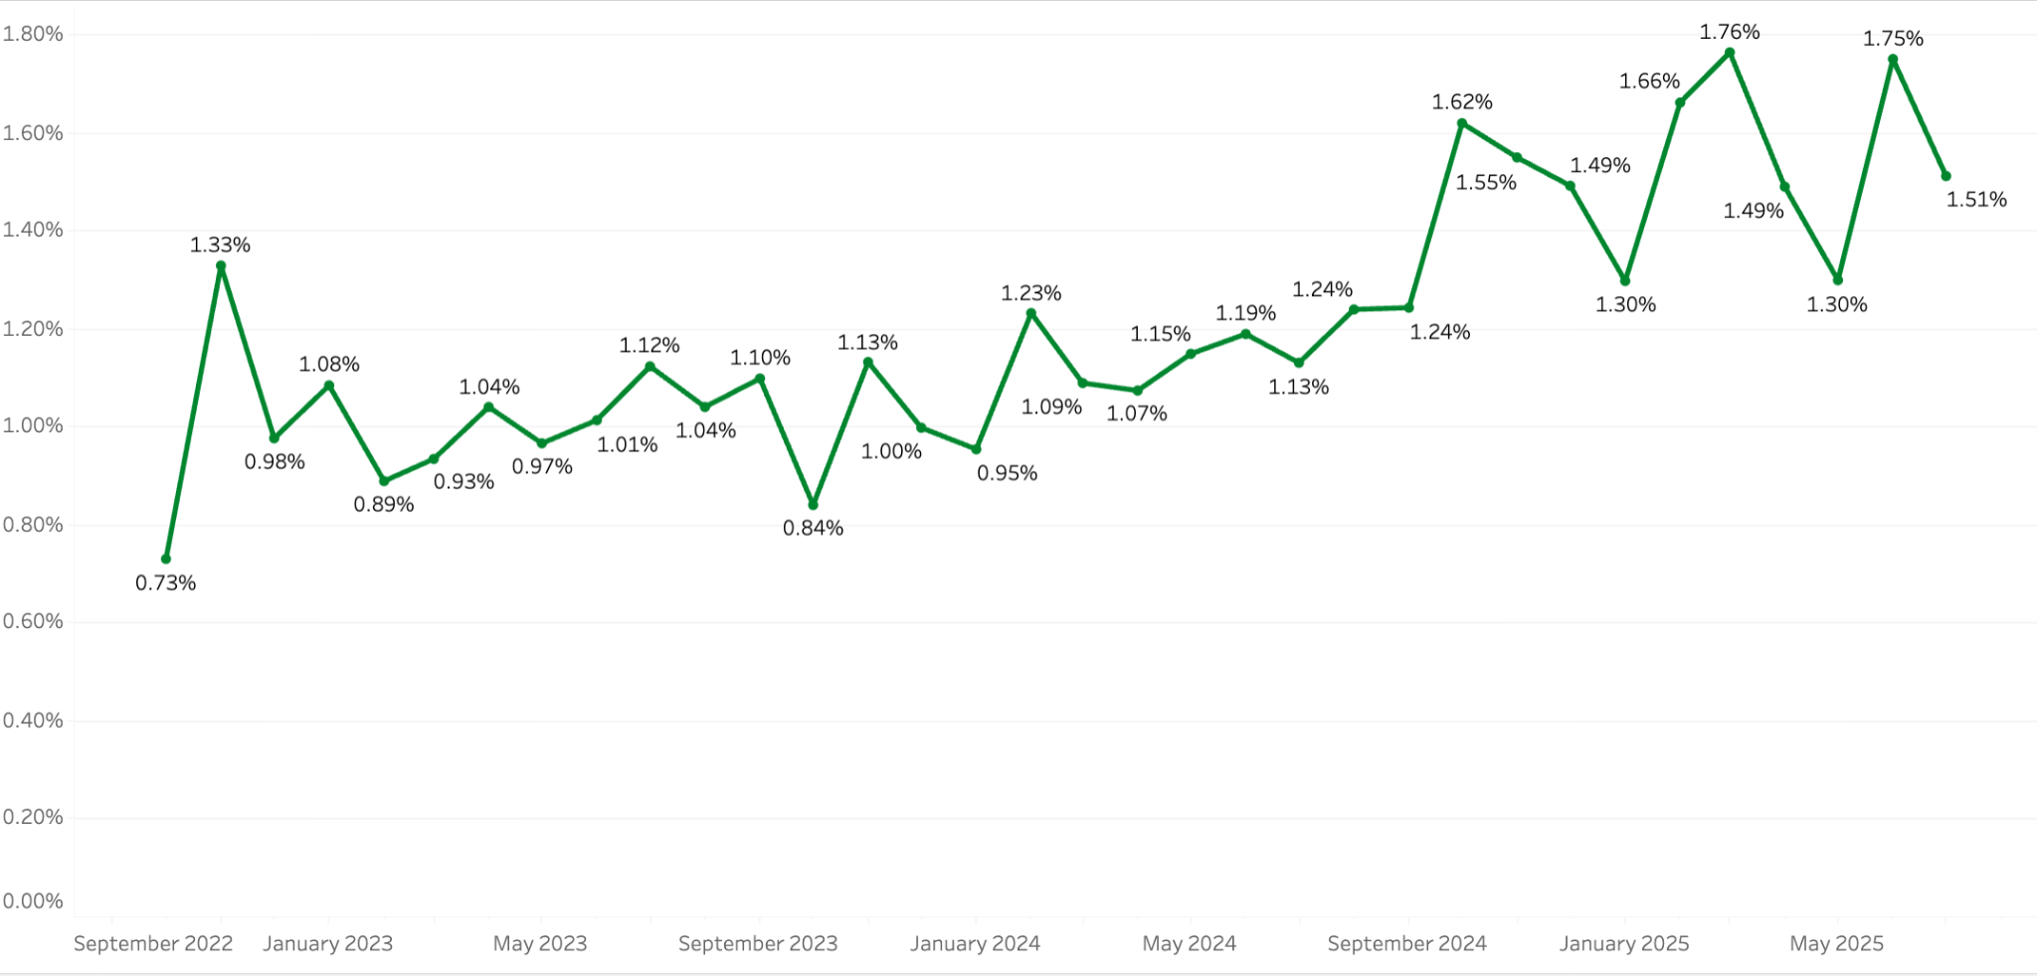
Green job postings collected in 4th African countries
Green Skills Presence: 1.17% of postings reference at least one green skill.
Leading Green Skill Families:
Sustainable Energy
Sustainable Economy
Environment & Sustainable Tourism
Sustainable Agriculture
Signals expanding relevance of green competencies across occupations, industries, and countries, aligned with global shifts toward renewable energy and efficiency.
Source: ETF & Lightcast Global Job Postings

Slide 7
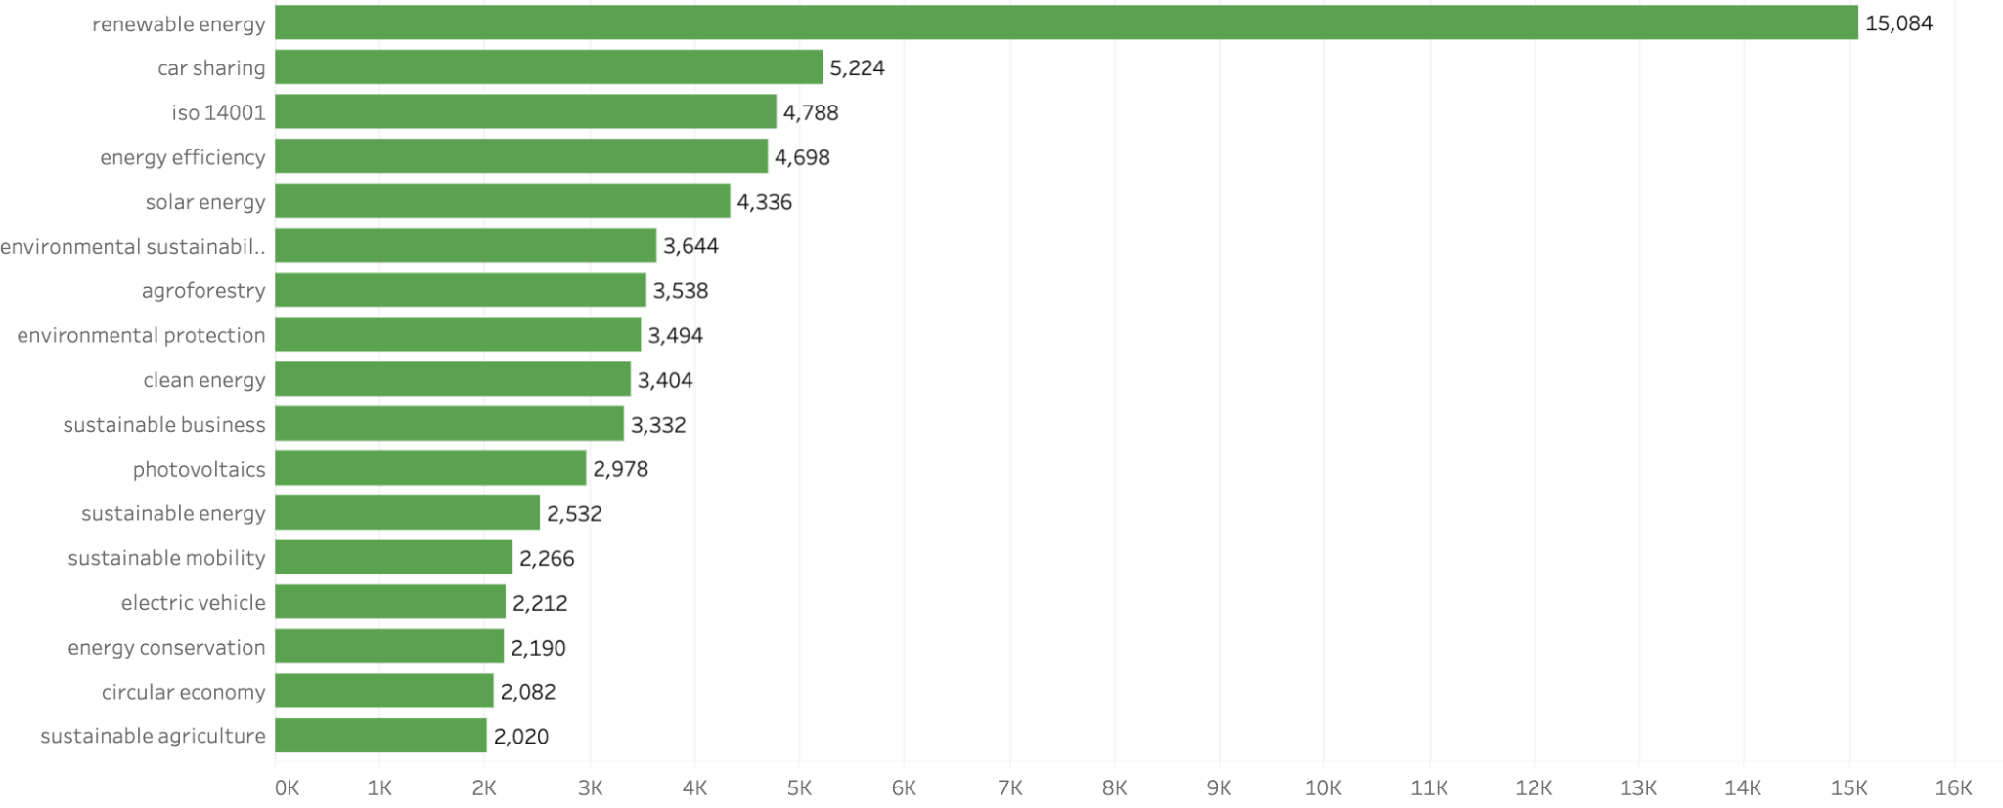
Green Skills - 279 unique skills
Green transition demand is driven by renewable energy, energy efficiency, and environmental protection, yet workforce supply is not keeping pace (22.4% vs. 12.3% growth in 2022–23, WEF 2024).
This widening gap highlights the need for targeted policies and workforce development to equip workers with green competencies.

Slide 8
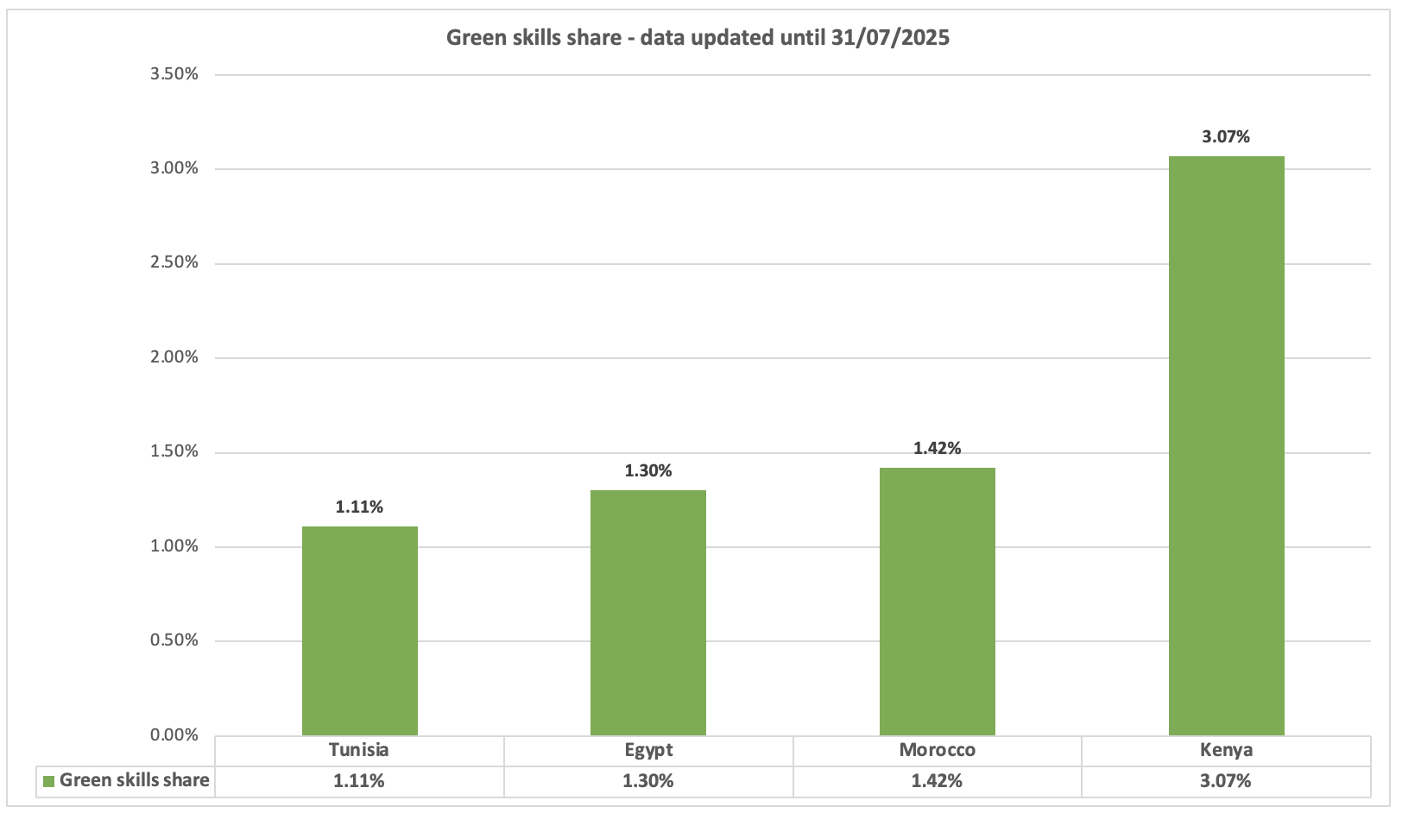
Green Jobs are on the rise, but magnitude is different in different countries
Kenya and Morocco stand out with the highest relative demand for green skills, reflecting stronger momentum in their green transition.
Their progress highlights the potential of targeted investment in education, supportive policies, and the growth of green industries.
Strengthening these efforts can accelerate the development of a skilled, sustainable workforce and position both countries as regional leaders in the green economy.
Source: ETF & Lightcast Global Job Postings

Slide 9
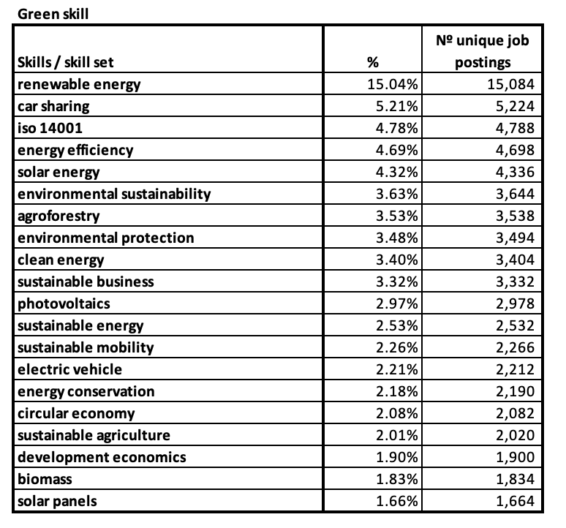
Demand for ‘green’ skills in Africa:
Green Skills Across the Value Chain of the Green Economy
The demand for green skills reflects the entire value chain of the green economy. At the core are energy-related skills such as renewable energy, energy efficiency, solar energy, and photovoltaics, which drive the transition to clean energy systems.
Surrounding this core, skills linked to standards and management (ISO 14001, environmental sustainability, sustainable business) ensure that sustainability is embedded into corporate practices.
Further along the chain, applied and sectoral skills, from agroforestry and sustainable agriculture to circular economy and sustainable mobility, extend green practices into production, land use, and transport. This distribution shows how green competencies are not isolated but interconnected, supporting a systemic transformation toward a sustainable economy.
Source: ETF & Lightcast Global Job Postings

Slide 10
Defining skill sets: bridging green skills demand with training and policy.
A framework skill set is a combination of abilities, knowledge, and expertise needed for specific tasks or roles. It helps align workforce skills with job demands and training needs.
Top skill categories
Top skill
electricity and energy
energy sector policies
solar energy
energy efficiency
electricity
carry out energy management of facilities
renewable energy technologies
Sustainable energy
Top job titles used for recruitment related to Sustainable energy
include: Renewable Energy Engineer, Energy Systems Analyst, Solar PV Installer and Wind Turbine Technician
engineering
engineering principles
maintenance operations
design prototypes
management and administration
customer relationship management
cost management
identify suppliers
define quality standards
manage budgets
business processes
software and applications development
computer programming
database
accessing and analysing digital data
have computer literacy
business ICT systems
use spreadsheets software
perform data analysis
Source: ETF & Lightcast Global Job Postings
Skill Categories and Skills: ESCO Taxonomy
adapt to change
developing solutions
Other categories
work in teams
teamwork principles
working efficiently

Slide 11
Defining skill sets: bridging green skills demand with training and policy.
A framework skill set is a combination of abilities, knowledge, and expertise needed for specific tasks or roles. It helps align workforce skills with job demands and training needs.
Top skill categories
Top skill
environment
adapt to different weather conditions
conserve forests
climate change impact
engineering
conserve water resource
waste management
Sustainable agriculture
Top job titles used for recruitment related to Sustainable agriculture
include: Sustainable Agriculture Specialist, Agroecologist and Organic Farm Manager
economics & law
develop environmental policy
ensure compliance with environmental legislation
management and administration
project management
conduct reforestation surveys
identify suppliers
wildlife projects
manage budgets
software and applications development
computer programming
database
accessing and analysing digital data
have computer literacy
use microsoft office
office software
perform data analysis
Source: ETF & Lightcast Global Job Postings
Skill Categories and Skills: ESCO Taxonomy
adapt to change
taking a proactive approach
Other categories
work in teams
communication
teamwork principles

Slide 12
Defining skill sets: bridging green skills demand with training and policy.
A framework skill set is a combination of abilities, knowledge, and expertise needed for specific tasks or roles. It helps align workforce skills with job demands and training needs.
Top skill categories
Top skill
engineering
install photovoltaic systems
biodiesel
energy transformation
maintain concentrated solar power systems
analyse energy consumption
Sustainable production
Top job titles used for recruitment related to Sustainable production
include: Sustainable Production Manager, Green Manufacturing Engineer and Sustainable Supply Chain Manager
economics
climate change impact
environmental legislation
management and administration
planning and organising
project management
identify suppliers
complying with operational procedures
manage budgets
software and applications development
computer programming
database
accessing and analysing digital data
have computer literacy
use microsoft office
business ICT systems
perform data analysis
Source: ETF & Lightcast Global Job Postings
Skill Categories and Skills: ESCO Taxonomy
communication
developing solutions
Other categories
work in teams
manage time
assume responsibility

Slide 13
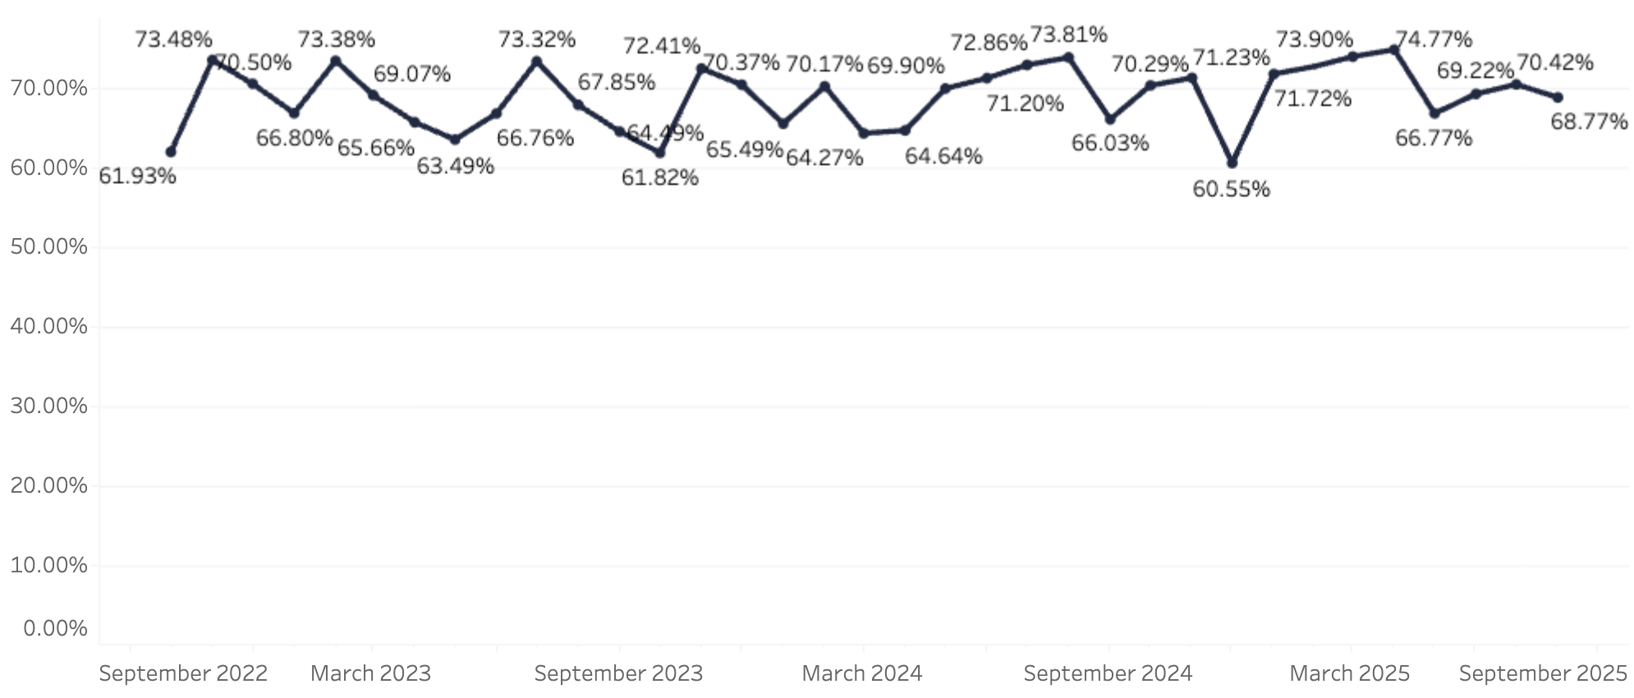
Digital Skills Trends in African Labour Markets
Analysis of job postings across four African countries shows that nearly 7 in 10 vacancies (68.9%) require digital skills.
The strongest demand is concentrated in ICT-related occupations (such as programmers, software developers, and network professionals) where digital literacy is nearly universal (above 95%).
At the sector level, digital requirements extend well beyond ICT, with high shares observed in professional services, finance, energy, and retail.
Core skills in demand include computer literacy, office software, data analysis, and programming, highlighting the foundation needed for participation in the digital economy.
Source: ETF & Lightcast Global Job Postings

Slide 14
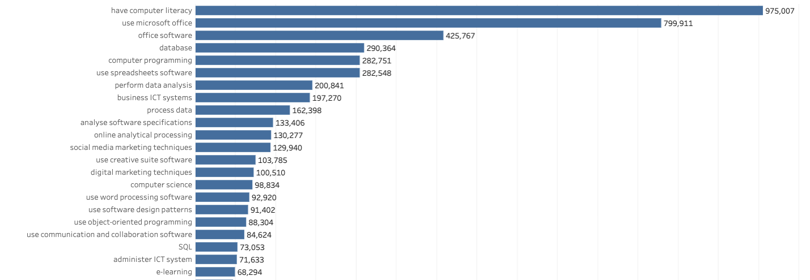
Digital Skills Trends in African Labour Markets
Employers primarily seek foundational digital skills: computer literacy (975k), Microsoft Office (800k), and ERP\office systems (426k). Beyond basics, demand extends to databases, programming, and data analysis, showing the need for advanced capabilities.
Skills like digital marketing, social media, and e-learning illustrate the spread of digitalisation across industries.
This mix highlights the importance of both universal digital literacy and specialised technical expertise
Source: ETF & Lightcast Global Job Postings

Slide 15
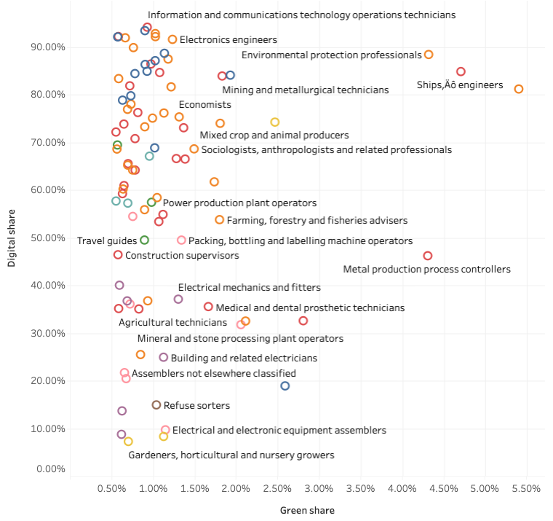
Where Digital Meets Green in the Labour Market
The twin transition is not evenly spread across occupations.
At the top, ICT roles show near-universal digital adoption but only modest links to green skills.
Occupations like environmental professionals, power plant operators, and agricultural producers sit at the intersection, requiring both green and digital expertise, critical for the future workforce.
Yet many technical and manual roles remain on the margins, with low uptake in both areas, signalling where reskilling and policy action will be most urgent.
Digital share and green share – ETF database – African countries – Lightcast
Source: ETF & Lightcast Global Job Postings

Slide 16

Bridging qualifications and occupations: a Data-Driven approach
1
Connecting education with Labour Market Needs: the Occupational Profiles dashboard aims to seamlessly connect educational achievements (qualifications) with labour market demands (occupations)
3
Guided standards for qualifications: these data-driven common occupation profiles can guide and inform the design of qualification standards, making them more relevant and aligned with actual job market needs.
2
Data-Driven insights: utilizing big labour market data, the approach is grounded in real-world demands and trends
4
Educational alignment with market demands: ensures that educational institutions can prepare students with the competencies and skills that are truly sought after in the workforce, enhancing employability and career success.

Slide 17
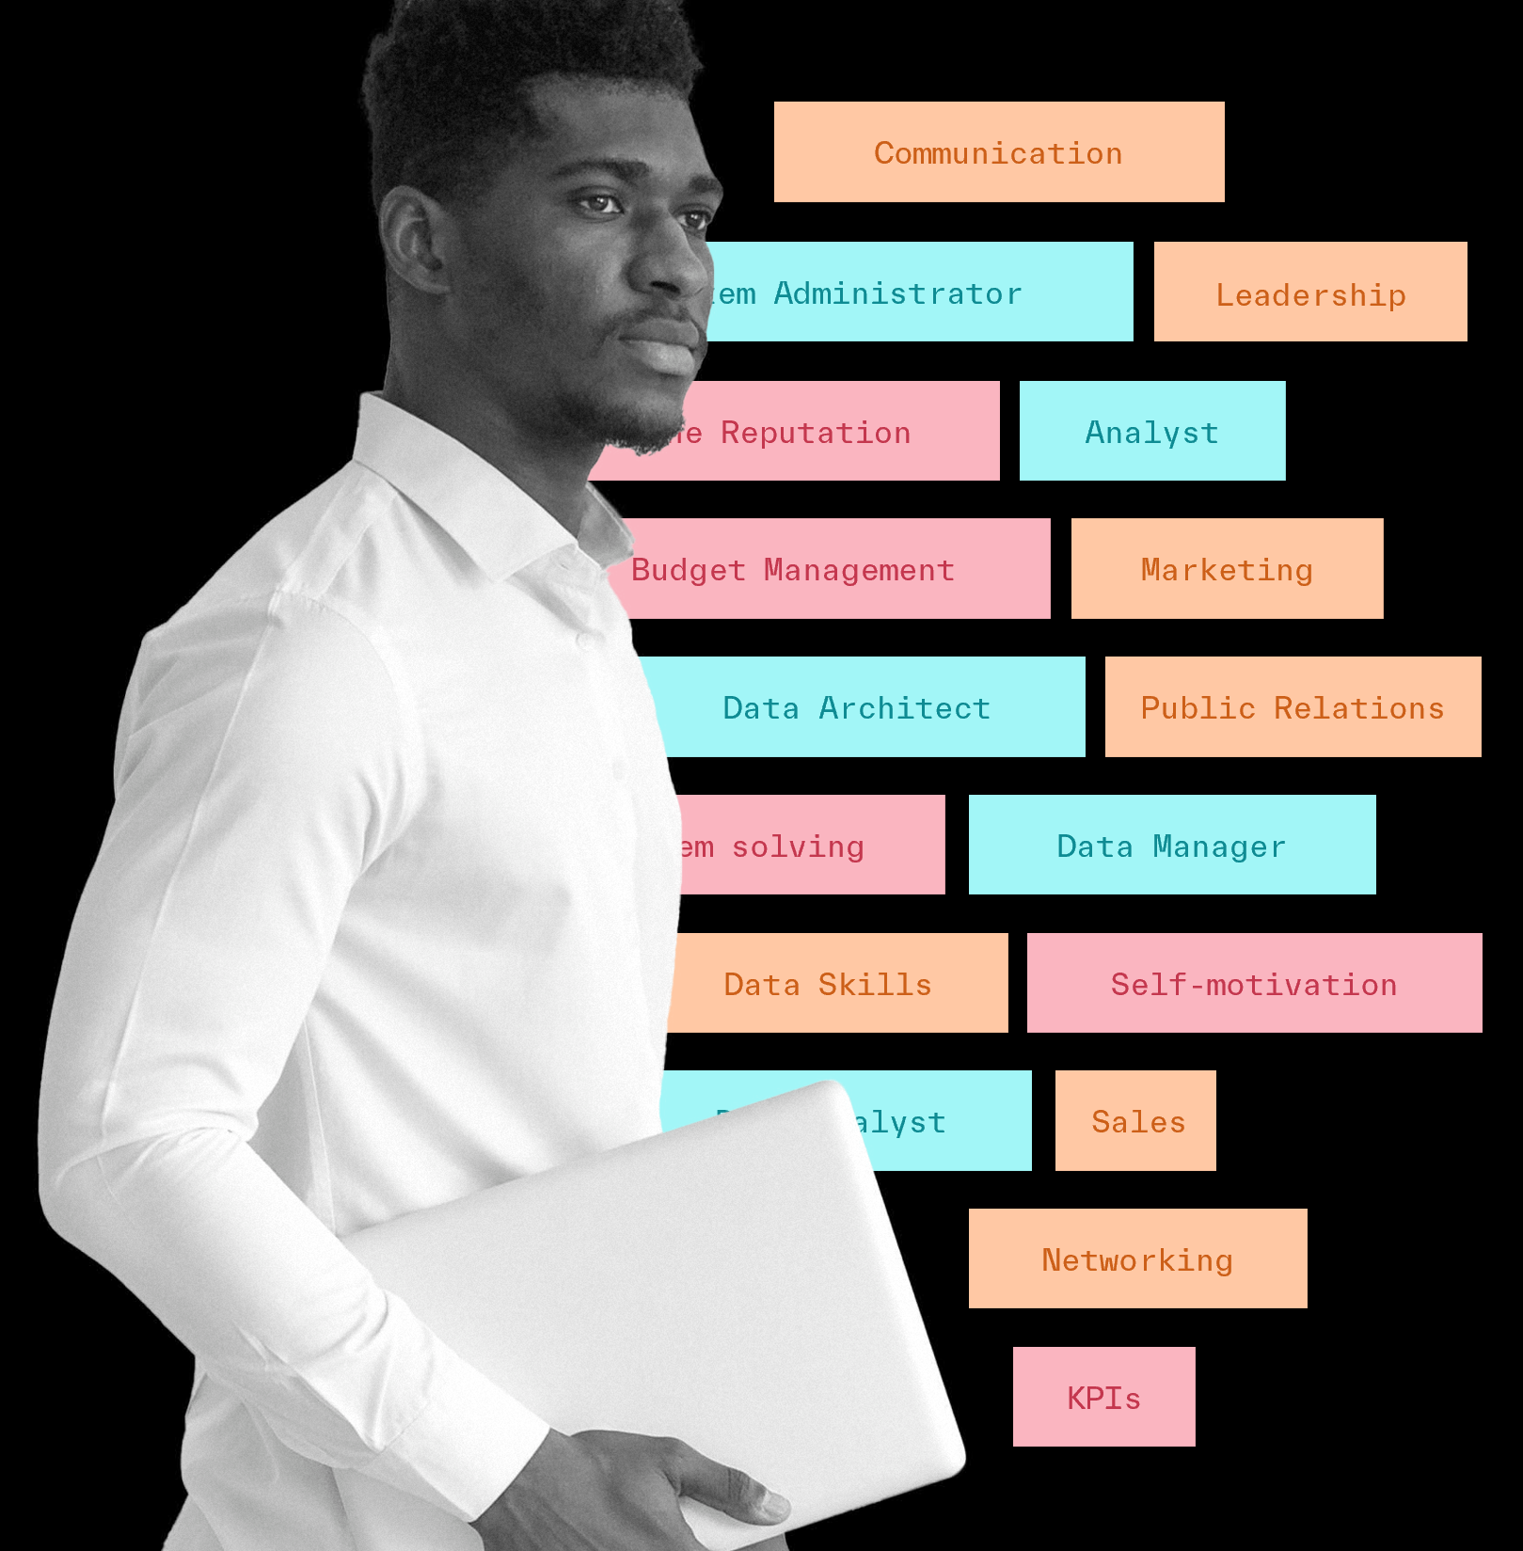
Common Occupational Profiles
A data-driven definition of a job, with the focus on skills insights.
They mix conventional data and new metrics to inform
about the demand and the possible study pathways to an occupation (qualification).

Slide 18
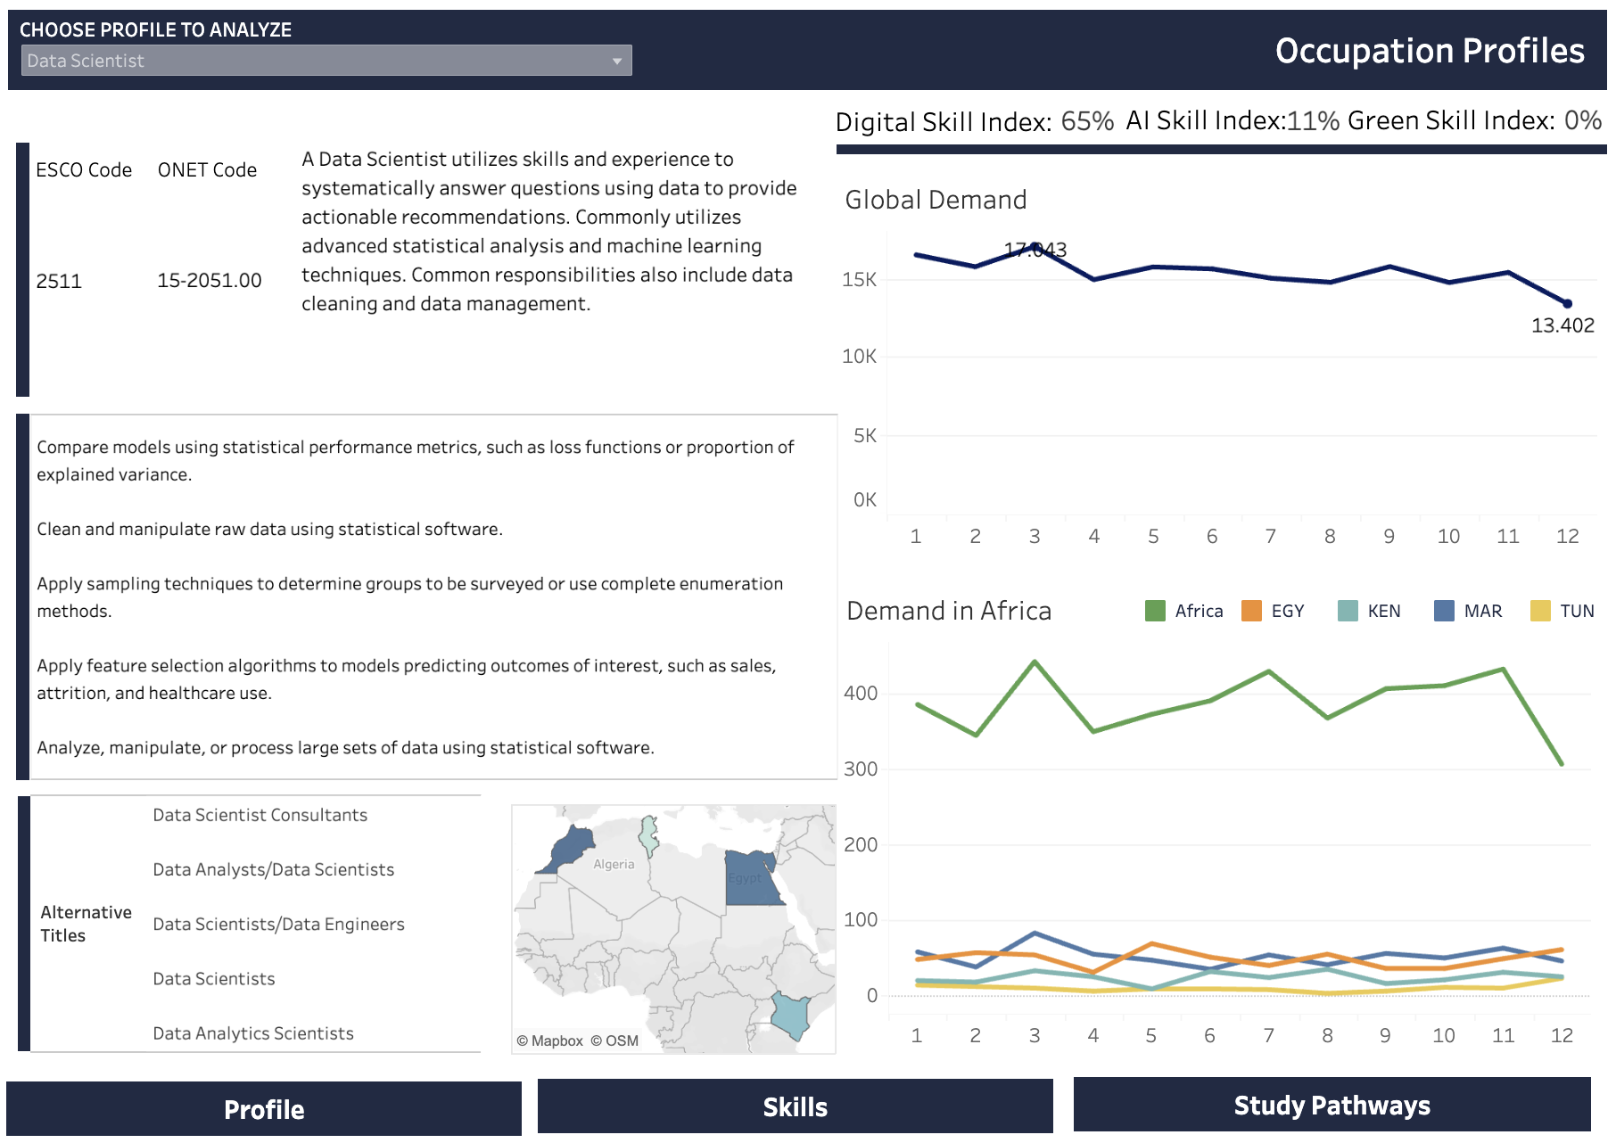
From skills data to common occupational profiles
Skills frequency and international taxonomies are the starting point…
The dashboard introduces the user with the possibility to choose a specific profile and get the following information regarding it:
Description of the chosen profile
Correspondence of chosen profile with profiles from ESCO and ONET taxonomies
Task Description provided by ONET
Alternative job titles the profile is presented on the market
Global Demand (number of job postings) for the job profile
Demand within all the African countries and 4 countries Egypt, Kenya, Morocco and Tunisia specifically

Slide 19
How to inform on skills trends?
Defining, distinguishing and necessary skills
1. Defining Skills represent the day-to-day tasks and responsibilities of the job. An employee needs these skills to qualify for and perform successfully in this occupation.
2. Distinguishing Skills are advanced skills that are called for occasionally. An employee with these skills is likely more specialised and able to differentiate themselves from others in the same role.
3. Necessary Skills are specialised skills required for that job and relevant across other similar jobs. An employee needs these skills as building blocks to perform the more complex Defining Skills.

Slide 20
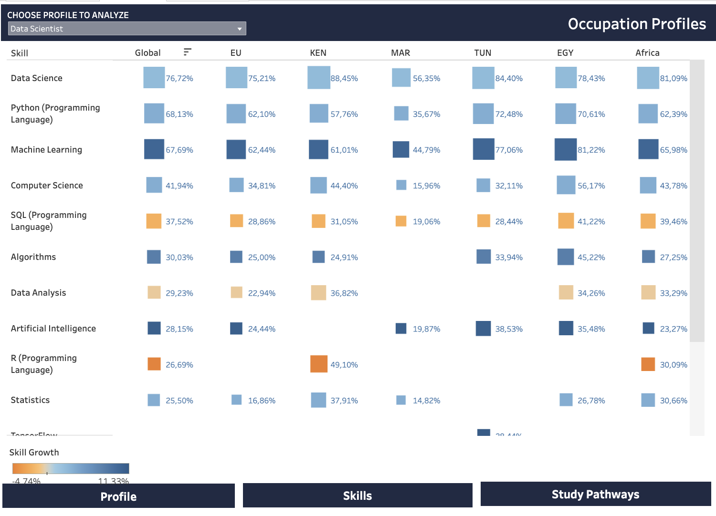
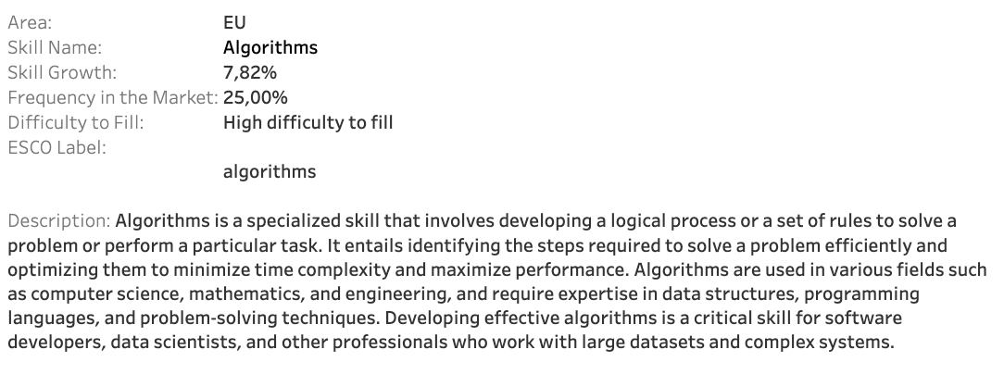
From skills data to common occupational profiles
Capture and compare emerging trends
The Skills section in the dashboard analyzes skills for the selected job profile:
Top Specialized skills by recall of skills within the available job postings Globally, within EU and among job postings of specific 4 countries in Africa. Recall is shown as a % share of available skills
The data is color coded by the projected skill growth on the market. The exact value of the projected growth can be seen upon hovering on the skill in the skill Tooltip
Tooltip also demonstrates the detailed description of the skill

Slide 21
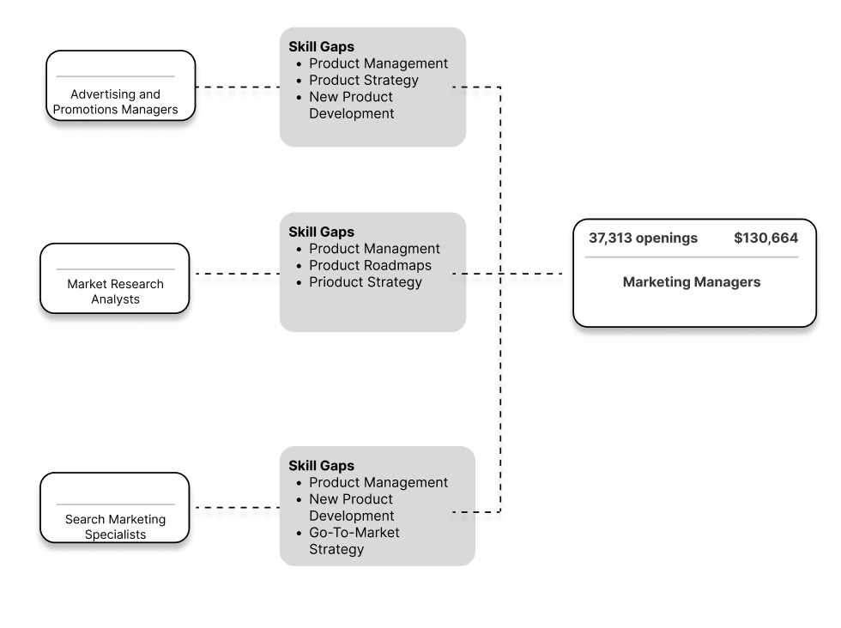
Next-Step Jobs: Career and Study Pathways
Career Pathways enables education providers to identify common skills requirements to advance the local workforce into a need-to-fill role.
Pathways are built between roles with strong skill adjacencies, and specify the last-mile skill gaps that can be addressed with targeted training.
Career Pathways Analysis:
Marketing Managers

Slide 22
From skills data to common occupational profiles
Identifying career and study pathways
Advancement: Jobs that pay more and are within the same occupation group as the source occupation.
Lateral Advancement: Jobs that pay more but require transition to a new occupational group as opposed to the source occupation.
Similar: Jobs that pay a comparable salary and are within the same occupation group as the source occupation.
Lateral Transition: Jobs that pay a comparable salary but require transition to a new occupation group as opposed to the source occupation.

Slide 23
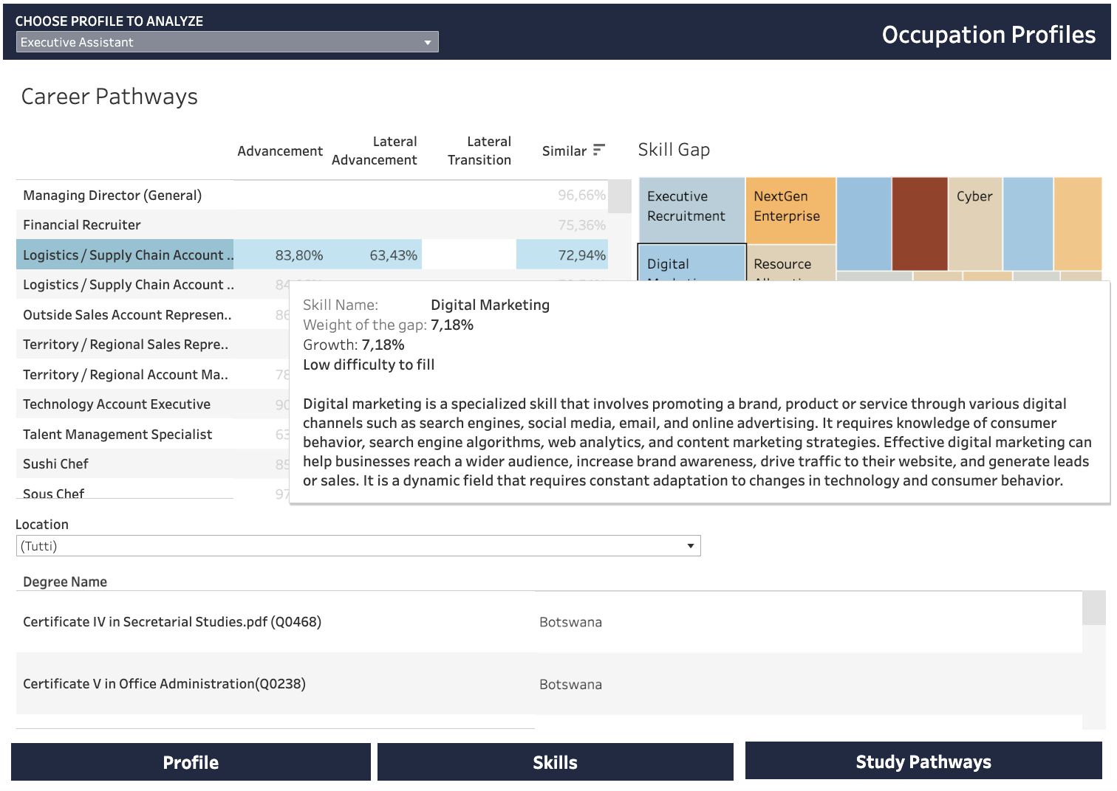
From skills data to common occupational profiles
Identifying career and study pathways
The section analyzes the pathways for the selected profile: career pathways related to the specific profile and educational pathways leading to them.
For the selected profile, list of occupations are presented, distributed by 4 different hierarchical categories: Advancement, Lateral Advancement, Lateral Transition or Similar level. For each of them, the index of similarity is given.
Upon selecting specific career, user can also see the skill gap existing from the chosen profile and the original profile of the analysis. The skills are color coded by the skill weight to analyze the gap.
User is also presented with the list of the degrees connected to the profile of analysis at various locations in African countries.

Slide 24
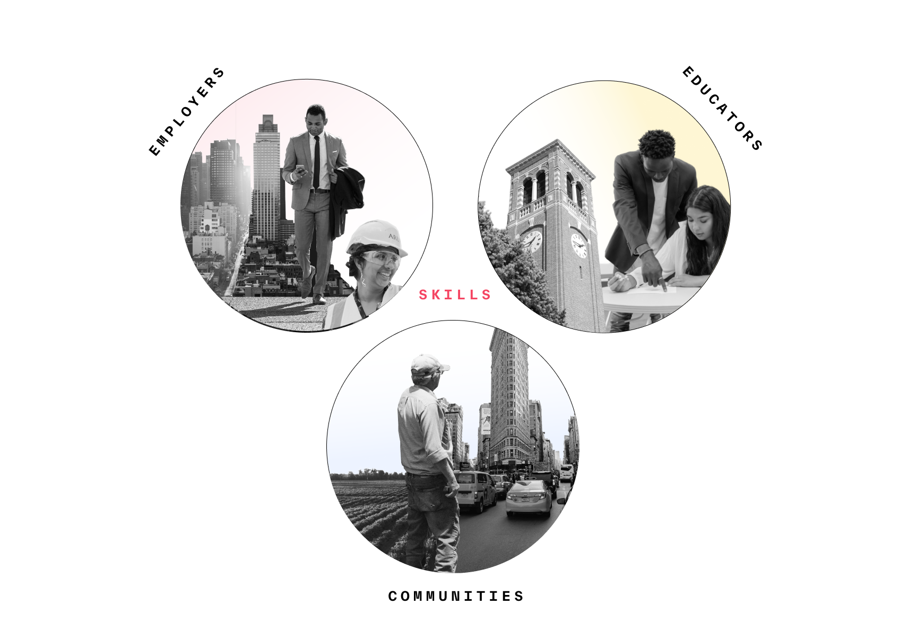
What does this mean for policy-makers and education providers?
Policy-makers and education providers need to work together to link qualifications and demanded skills to respond to a rapidly changing labour market.
Planning and development: which courses are more likely to provide students a strong career outcome?
Inform students: communicate to students how your courses will prepare them for their future.
Course design: what knowledge, competencies and attributes does a course need to develop to prepare students for the world of work?
Careers advice: empower careers advisors with detailed insights to enrich their guidance, unlocking new possibilities for students.
Civic engagement: engage with wider stakeholders with a common language of data.

Slide 25


4 main points to take-away
The building blocks of work
It’s a complex world
Skills describe the competencies and experiences workers need to complete key tasks in their role
Often described by employers in their job adverts
Macro-economic trends are affecting different parts of the labour market in different ways (mix of skills supply and demand)
It is critical to use a data-driven approach.

Slide 26

Thank you. Any questions?
Contact details:
Mauro Pelucchi – Head of Global Data Science – mauro.pelucchi@lightcast.io

