Slide 1



Transforming higher education through innovative projects (HEC)
6th ACQF Continental Forum
Building Future-ready qualifications systems for Africa
Professor (Dr) R. Mohee, CSK
Commissioner
and
Dr Noshmee Baguant,
Acting Head, Regulatory Affairs and Accreditation Division
01 October 2025

Slide 2

Higher Education Ecosystem in Mauritius
Institutions Falling Under The Purview of HEC
Ministry of Tertiary Education, Science and Research
Policy on Tertiary Education
Regulatory Body
Licensing of HEIs
Institutional Accreditation
Financing Public HEIs
National Credit Value And Transfer System
Recognition and Approval of Micro-Credentials
Higher Education Commission
9
Public Higher Education Institutions
4
Branch Campuses
Quality Assurance Authority
Institutional Audit
Qualification Standards
Register of Qualifications
34
Private Higher Education Institutions
Overseas institutions with degree awarding powers
4
Public and Private HEIs

Slide 3
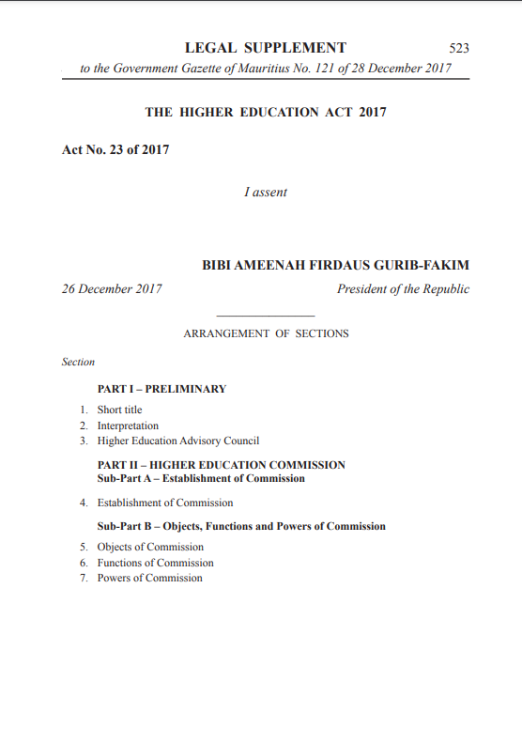
The Higher Education Commission- HE Act 2017
Objects of Commission
The Commission shall –
(a) monitor and oversee the higher education sector;
(b) ensure –
(i) the availability of adequate human resources, physical, infrastructure and other material resources;
(ii) the rationalisation of teaching programmes in public higher education institutions; and
(iii) the planning and implementation of research in higher education institutions;
(c) promote the development of higher education, academic research and training facilities through equity of access, high quality learning and research outcomes, the efficient use of national resources and innovation;
(d) foster the achievement of international standards of scholarship through a diversity of teaching and research;
(e) identify and enhance good practice in higher education;
(f) support and facilitate the implementation of the national higher education strategy of the Government; and
(g) support the development of cultural life.
https://hec.mu/pdf_downloads/our_act/bill2017_heact.pdf

Slide 4
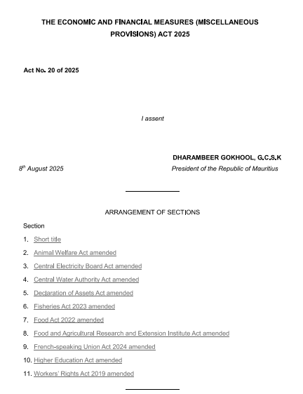
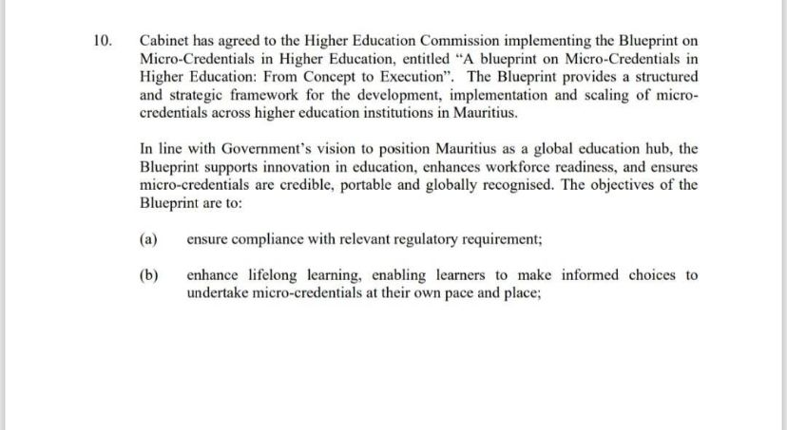

Amendment to Higher Education Act 2017
Enacted as part of the Economic and Financial Measures (Miscellaneous Provisions) Act 2025, introduced via the Finance Act No. XVIII/2025 and gazetted in early August 2025
These reforms aim to enhance flexibility, promote innovation, and position Mauritius as a regional hub for knowledge, research, and skills development
Key Reform Areas | Amendments briefly explained
Recognition and approval of Micro-credential | HEC empowered to approve and recognise micro-credentials.
Research Governance | Academic Research Committee to oversee national excellence framework.
Reforms in the Processes for Accreditation of Programmes | Revised procedures for accreditation of programmes, local adaptation for internationally accredited programmes by 25%.
National Credit Transfer System | Institutional use of both national and international credit system permitted.
National Quality Code | Mandatory adoption of Mauritius Quality Code in legal framework.

Slide 5







HEC Transformative Projects
National Credit Value & Transfer System
Micro-Credential Framework
COL Skills For Work
4,000 +
Scholarships
(2021- 2023)
Access to more than
14,000 courses
AI Guidelines for Higher Education
National OER Repository
Technology Enabled Learning

Slide 6
National Credit Value Transfer system

Slide 7
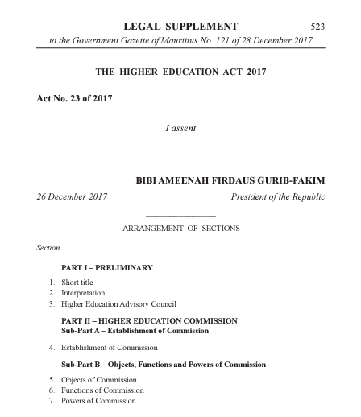
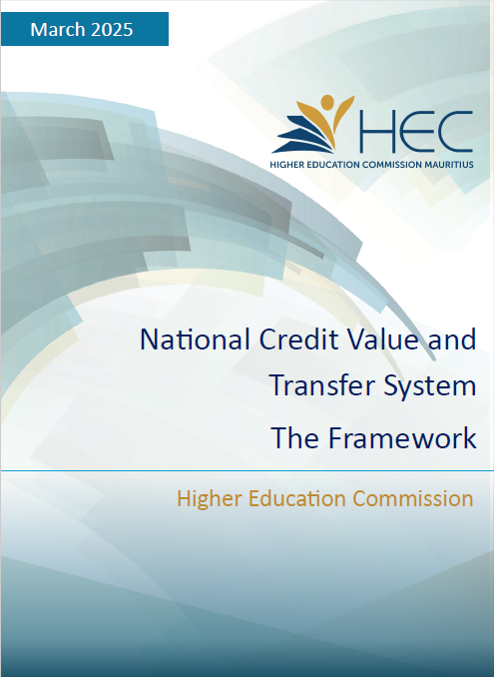

NCVTS for Higher Education in Mauritius
HE Act 2017
Objective
Enhance accessibility, flexibility, and quality of post-secondary education through a robust credit accumulation and transfer system.
Goal
Promote lifelong learning, student mobility, and support national development.
Section 18. National Credit Value and Transfer System
1. The Commission shall develop and issue a National Credit Value and Transfer System in order to recognise qualifications and units by awarding credits.
Framework
Basis: Implemented under HE Act 2017.
Alignment: National Qualifications Framework (NQF) by Mauritius Qualifications Authority.
Process: Transfer and accumulation of credits within and across NQF levels.
Legislative Framework
HE Act 2017
HEC’s Framework and Guidelines for NCVTS
Ministry documents

Slide 8
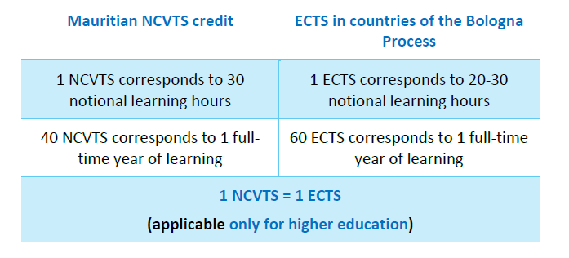
NCVTS Key Components
NCVTS Credit
NCVTS Credit Value
Definition: A value assigned to qualifications, units and modules that represents the estimated notional learning time required for achievement of related learning outcomes. NCVTS credits confirm that a qualifications, units and modules, consisting of a coherent set of learning outcomes has been assessed validated and awarded by a competent educational institution, according to agreed standards.
One NCVTS credit (1 NCVTS) corresponds to the learner’s workload of 30 hours of estimated notional learning time, which includes all learning activities under relevant and decided learning conditions for the specified learning outcomes.
One NCVTS Credit represents 30 Notional Hours of Learning
Aligning with ECTS
The learning outcomes and associated notional learning time for a full-time year are equivalent to a minimum 40 NCVTS credits in the NCVTS Framework.

Slide 9
Microcredential journey

Slide 10
Micro Credentials Journey in Mauritius
Baseline Study
Baseline Study on Micro Credentials
November 2022 /January 2023
Phase 1- Surveys
Surveys at national and institutional level (Aug – December 2023)
Phase 2
Consultations
Validation Webinar
April 2024
Micro Credentials National Framework
National Consultation Workshop on Micro Credentials Framework for Mauritius
January 2024
Drafting of National Micro Credentials Framework (2024)
Phase 3
Framework Development
Drafting of A Blueprint For Micro-credentials In Higher Education: From Concept To Execution
(January 2025)
Validation Workshop on MC Blueprint
14 May 2025
Blueprint on Microcredentials (2025)
Implementation

Slide 11
Baseline Study- Survey Findings
In 2023: 2 surveys on microcredentials, policies and practices, perceptions for future development in both TVET institutions and HEIs
Survey Findings (470 responses)
Key Opportunities Perceived
Lifelong learning objectives is the opportunity most agreed with by both HEIs (91%) and TVETs (87%)
Collaboration with industry/society, would enhance employability, and increase alignment between curricula and work-based learning (87% HEIs and TVET)
Major Challenges Identified
Recognition of micro-credentials is seen as the most significant challenge by 83% of HEIs and 74% of TVET institutions
Integrating micro-credentials within the wider accreditation system is a concern for both sectors (74% HEIs, 68% TVETs)
Lack of awareness among prospective learners (74% HEIs, 69% TVETs) and employers (65% HEIs, 67% TVETs) is also a significant challenge

Slide 12

MC Guidelines ( UNESCO IIEP /HEC/MQA)
Micro-credentials in Mauritius: towards a national framework for TVET and higher education
Guideline 1: Objectives for MC framework, coverage, principles, actors
Guideline 2: Definition of MC – information requirements for increased transparency
Guideline 3: Credit award and stackability
Guideline 4: Inclusion and levelling of MC against NQF, quality assurance
Guideline 5: National register, credit bank and open badge options
https://hec.mu/pdf_downloads/recent_posts/unesco_07022025.pdf

Slide 13



Alignment with existing frameworks
ACQF
UNESCO
Commonwealth of Learning
PoMiSA

Slide 14



PoMiSA Project
POTENTIAL OF MICRO CREDENTIALS IN SOUTHERN AFRICA (PoMiSA)
The POMISA project seeks to establish a robust framework for the recognition, quality assurance, and regulation of micro-credentials, ultimately fostering innovation, mobility, and economic growth in the region ( 18 institutions and 7 countries)
Project Partners

Slide 15

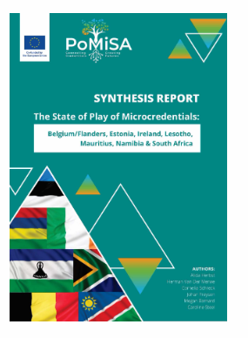
State of Play Report- PoMiSA
Available at pomisa.hec.mu
The synthesis report draws on the "state of play" reports developed using a shared analytical framework. Through a comparative analysis of these reports, this synthesis provides insights to inform subsequent project activities and broader regional collaboration.

Slide 16

Mauritius Micro Credentials Blueprint
Elements
Defining Micro Credentials
Principles of Micro Credentials
Regulatory Framework for Quality Assurance
Recognising Micro-Credentials
Approval Micro Credentials
Certifying Micro Credentials
The Blueprint for Micro-Credentials in Higher Education (2024–2025) sets the long-term policy direction, with guiding principles for Mauritius and a strategic roadmap for phased implementation for embedding micro-credentials into higher education.
Developing a register
Piloting Micro Credentials
Implementation Plan

Slide 17
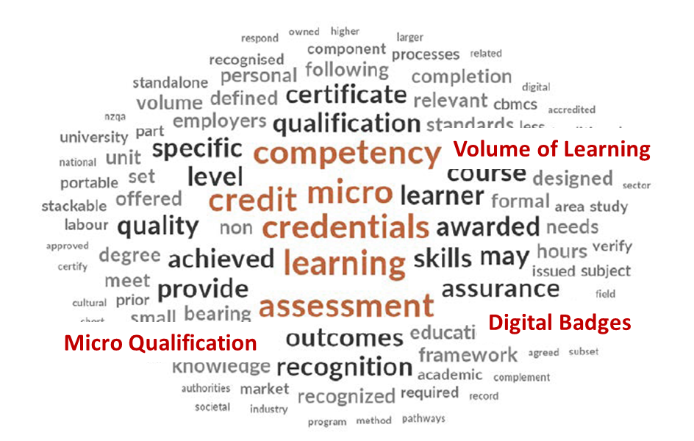
Definition Micro Credentials
Micro Credentials
Definition
(UNESCO and adapted from NCVTS)
Micro-credentials are a record of learning outcomes acquired following a smaller volume of learning, assessed against transparent and clearly defined criteria. They provide learners with specific knowledge, skills, and competences addressing social, personal, cultural, and labour market needs. They are supported by agreed quality assurance standards.

Slide 18
Micro Credentials Blueprint
Principles
Quality
Ensure all micro-credentials meet high-quality standards.
Transparency
Promote clear communication about micro-credentials, including objectives, outcomes, and pathways
Relevance
Align micro-credentials with societal, cultural, and labour market needs.
Valid Assessment
Incorporate robust and fair assessment methods.
Recognition
Establish mechanisms for academic and industry recognition.
Learning Pathways
Facilitate flexible and stackable learning journeys for learners.
Authentic
Develop credentials rooted in real-world applications and competencies.
Portability
Ensure credentials can be easily transferred across institutions and sectors.
Learner-Centred
Focus on the needs, goals, and progression of learners.
Harmonisation with Industry
Foster collaboration with industries to enhance relevance
Information and Guidance
Provide learners and stakeholders with clear guidance about micro-credentials.
Outcomes-Based
Define measurable learning outcomes for all credentials.
Lifelong Learning
Support ongoing education and upskilling for all individuals.

Slide 19
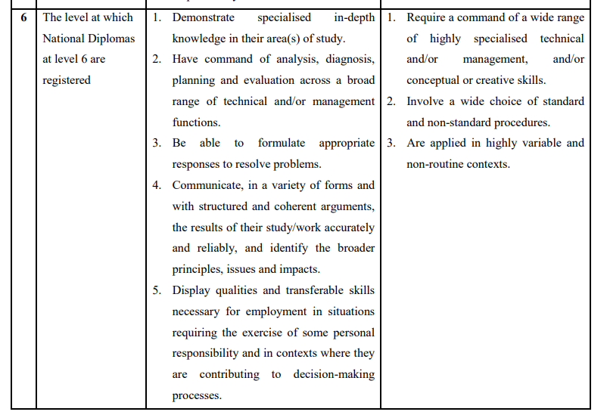

Alignment with the NQF
For the successful implementation of Micro Credentials, there is a need to align Micro Credentials with the NQF Levels
For example, for a micro credentials to align with the NQF Level 6, it should be in line the following:

Slide 20
Pilot Project- Certificate in Special and Inclusive Education
INPUT
OUTPUT
OUTCOME
Courses
6 micro-credential courses per educator
Managing ADHD, Autism, Learning Disabilities, and Concussion in School
Diversity and Inclusion in Education
Teaching Children with Visual Impairment
Disability Awareness and Support
Severe to Profound Intellectual Disability
Disability Inclusion in Education
Certificate in Special and Inclusive Education
UTM offered certificate program to the SEN educator.
Exemptions: Participants received credit for 2 of the 10 modules, those mapped directly from their micro-credentials upon certificate entry.
Qualified SEN Educators
All 447 participants now hold a nationally recognized certificate.
Minimum Wage Eligibility & Pay Raise
Having attained the formal qualification, educators became eligible for the minimum-qualified-teacher salary bracket and received corresponding pay increases.

Slide 21
The way forward- Industry led microcredentials

Slide 22

Industry Led Micro Credential
What Are Industry-Led Microcredentials?
Short, targeted certifications co-designed by industry and higher education to address specific workforce skill gaps in Mauritius.
Collaboration is Key
Industry identifies needs and shapes content.
Higher education institutions ensure quality teaching and assessment.
Partnership formalized through agreements.
Approval Process
Higher Education Commission (HEC) accredits microcredentials for quality and national recognition.
Only accredited institutions can award them.
Recognition and Benefits
Certificates are nationally recognized, stackable toward qualifications, and usable for Recognition of Prior Learning (RPL).
Valued by employers due to industry input.
Flexibility and Innovation
Delivered online or hybrid for accessibility.
Encourages pilot projects and continuous improvement.

Slide 23
Conclusion
The development and uptake of microcredentials are shaped by a range of enabling factors
Political
Economic
Social
Technological
Legal
Policy alignment with NQFs and skills strategies.
Government and donor funding.
Regional/continental recognition frameworks.
Demand for job-ready, flexible skills.
Lower cost compared to full degrees.
Employer uptake and partnerships with industry.
Lifelong learning culture.
Wider access for diverse groups.
Learner demand for flexible, career-oriented study.
Recognition by society and employers.
Digital platforms and online delivery.
Innovative assessment and digital badges.
Data-driven learning outcomes.
Recognition in NQFs and QA frameworks.
Approval and recognition .

Slide 24
Enabling Factors
Policy alignment with NQFs and skills strategies.
Government and donor funding.
Regional/continental recognition frameworks.
Demand for job-ready, flexible skills.
Lower cost compared to full degrees.
Employer uptake and partnerships with industry.
POLITICAL
ECONOMIC
Lifelong learning culture.
Wider access for diverse groups.
Learner demand for flexible, career-oriented study.
Recognition by society and employers.
LEGAL
Enabling Factors
SOCIAL
Recognition in NQFs and QA frameworks.
Approval and recognition .
TECHNOLOGICAL
Digital platforms and online delivery.
Innovative assessment and digital badges.
Data-driven learning outcomes.

Slide 25
Quality Assurance

Slide 26
Quality Assurance
To ensure the credibility, portability and recognition of micro-credentials, higher education institutions must adhere to specific quality assurance standards as set by the HEC.

Slide 27
Providers of Micro Credentials
.
The provider is a public higher education institution having a collaboration with a local or foreign awarding body/ a public higher education institution with awarding powers
The provider is a private registered higher education institution with the HEC having a collaboration with a local or foreign awarding body/ a registered private higher education institution with awarding powers

Slide 28
Roles of Stakeholders
Collaboration between industries/professional bodies and educational providers ensures that micro-credentials remain dynamic, meeting the ever-evolving demands of the labour market.

Slide 29
Approval of Micro-credentials
Approval refers to the formal process by which the HEC evaluates whether a micro-credential meets established standards in terms of learning outcomes, content, delivery, assessment, and relevance.

Slide 30
Application for Approval of Micro Credentials
1
Submission of an application to HEC for the approval of a Micro Credential in accordance with the established 9 criteria including all required documentation
2
Prescribed payment effected to the HEC
Assessment Process
-Reviewing of submitted materials
- Consultation with experts in the field
- Site visit and further evaluation (If required)
3
After successful completion of this process, the Micro Credential is officially approved
4

Slide 31

Criteria for Approving Micro-credentials
Collaboration with Industry/Professional Body
Review
Title and Learning Outcome
Delivery
Need and Acceptability
Resources
Entry Requirement
Assessment and Moderation
Design and Credits
HEC’s Approval Guidelines
Review
The shelf-life of a micro-credential is set for a duration of three years
Micro-credentials should not form part of the core modules of an academic programme.
A micro-credential is no more than 20 credits (NCVTS)

Slide 32

Alignment of Micro Credential in NCVTS
Credit Allocation
Credit allocation for micro-credentials typically follows a structured approach where credits are assigned based on the notional learning hours required to complete a course.
In the NCVTS, 1 NCVTS Credit = 30 Notional Hour
Can use the same system to adapt to Micro Credential by determining the total learning hours for each credential.
Volume of learning: workload | Learning outcomes | Align with NQF | Number of Credits | Assessed by
✓ | ✓ | ✓ | ✓ | ✓
https://learning.unison.org.uk/events/open-university-ou-microcredentials/#:~:text=On%20completing%20the%20microcredential%20you,for%20flexibility%20around%20busy%20schedules.

Slide 33
Recognition of Micro-credentials
Recognition involves the acceptance and value attributed to a micro-credential by a third party, such as the HEC.
A micro-credential may be recognised for purposes such as employment, career advancement, admission into further study, or credit transfer.

Slide 34
Process for recognition of micro-credentials
Submission of Micro-Credential to HEC for recognition
Initial review of application which includes:
Title of the Micro-Credentials
Name of Provider
Country of Issuer
Date of Issue
Awarding Body
Learning Outcomes description
Course structure and duration
Notional Workload needed to achieve learning outcomes as per NCVTS
Types of Assessment
Level of learning experience (aligning to NQF)
QA mechanisms
Assessment of Micro-Credential
Not Complete
Complete
Approval by HEC

Slide 35
Certifying Micro-credentials
Formal certificates or digital badges
Issued by recognised and registered institutions, including both public and private higher education providers

Slide 36
Register of Micro-credentials
Title: The name of the micro-credential.
Credits: The number of credits assigned, reflecting the learning required to complete it.
Classification: The category or field based on ISCED, the qualification belongs to, outlining its focus.
Approval Period: The timeframe for which the micro-credential remains approved.
Provider: A registered/recognised higher education institution.
Awarding Body: The institution which awards/issues the micro-credential.

Slide 37
Thank you

