Slide 1



CONCERTATION FRAMEWORK FOR MINISTERS RESPONSIBLE FOR EMPLOYMENT AND VOCATIONAL TRAINING
OF THE UEMOA SPACE (CCMEFP-UEMOA)
Presentation of the CCMEFP-UEMOA platform for pooling resources and tools for vocational training and employment
6th ACQF Continental Forum, 30 September to 02 October 2025, Port Louis/Maurice
BANCE Amidou
Permanent Secretary of the CCMEFP-UEMOA
E-Mail: bance2070@gmail.com
Telephone: (00223) 75 38 08 70
WhatsApp: (00226) 71 05 87 90

Slide 2
PRESENATION PLAN
INTRODUCTION
I- PRESENTATION OF THE CCMEFP-UEMOA
Organs and functioning
Results achieved
II-PLATEFORM OF MUTUALIZATION
Findings
Objectives
Principles and criteria of the Platform
Roles/Responsibilities of actors
Resource typology
Platform Digital Portal
Interests and benefits of pooling
III-PERSPECTIVES
CONCLUSION

Slide 3
INTRODUCTION (1/1)
Meeting of the Heads of State and Government of the African Union held in Ouagadougou, Burkina Faso, in September 2004: to place job creation at the centre of economic and social policy objectives at national, regional and continental levels for the sustainable reduction of poverty and the improvement of people’s living conditions, to combat poverty and underemployment in Africa, and to reduce youth and women’s unemployment.
WAEMU organised the first sectoral meeting of the Ministers responsible for Employment and/or Vocational Training of the WAEMU Area in Abidjan, Côte d’Ivoire, in October 2009.
Decision on a dynamic of annual meetings of Ministers
Establishment of a formal consultation framework known as the Framework for Consultation of Ministers responsible for Employment and Vocational Training in the WAEMU Area at the 2nd meeting supported by WAEMU on 28 April 2010 in Bamako, Mali.
Mission: Strengthen consultation and cooperation among its members with a view to making national and sub-regional employment and vocational training policies more efficient.

Slide 4
I- PRESENTATION OF THE CCMEFP-UEMOA (1/2)
1-BODIES AND FUNCTIONING
the Conference of Ministers: supreme body, composed of the ministers responsible for employment and vocational training from the 8 WAEMU member countries and the ministers who are members of the pooling platform. It shall meet in ordinary session each year at the invitation of the President and with funding from the WAEMU Commission and the WAEMU-VECMC.
Chair: Mr N’Guessan KOFFI, Minister for Technical Education, Vocational Training and Learning of Côte d’Ivoire;
Vice-President: Ms Oumou SALL SECK, Minister for National Entrepreneurship, Employment and Vocational Training of Mali;
UEMOA/DDH Commissioner: Mamadu Sérifu JAQUITE from Guinea-Bissau.
the Bureau of the Conference of Ministers: body responsible for monitoring the implementation of decisions, resolutions and recommendations of the Conference of Ministers. The Bureau of the Conference of Ministers shall comprise the President, the Vice-President and the Permanent Secretary;
the Permanent Secretariat of the Framework for Consultation: administrative body responsible for monitoring the implementation of the recommendations and decisions of the Conference of Ministers and facilitating centres of expertise. The SP: Mr Amidou BANCE, from Burkina Faso, Specialist in training engineering and professional integration.
Commissions for the preparation and follow-up of the Conference of Ministers (8 countries)

Slide 5
I- PRESENTATION OF THE CCMEFP-UEMOA (1/2)
2-SOME ACHIEVED RESULTS
the existence of a functioning Permanent Secretariat. Headquarters inaugurated in Bamako in November 2019;
the regular organisation of the Conference of Ministers since 2010.
Advocacy for the creation and empowerment of National Employment and Training Observatories in the 8 WAEMU countries: 5 stand-alone ONEFs, 2 non-stand-alone and 1 NC
the establishment of a Commission for the preparation and follow-up of the Conference of Ministers in each of the eight (8) countries in 2019.
the creation of a platform for pooling vocational training resources and tools in 2018 /National Mutualisation Entities (ENM)
advocating for the effectiveness of the payment of the Patronal Learning Tax (TPA) to the vocational training funding funds.
setting up the Community colleagues’ initiative;
Implementation of the Regional Vocational Training Programme (PROFOR): 24 priority occupations identified, a harmonised framework document for the development and adaptation of training curricula adopted in 2023, inventory of NQFs and VAEs and adoption of a roadmap (2025-2030)

Slide 6
II- MUTUALISATION PLATFORM (1/6)
1- FINDINGS:
poor performance of the education system, one of the consequences of which is the low employability and productivity of young people in the labour market;
lag in the supply of training in relation to the challenges to be met for economic and social development, resulting in the inadequacy of vocational training systems to meet the needs of the professional world;
TVET plays a minor role in relation to general secondary education, one of the consequences of which is the lack of a skilled workforce in many occupations;
the gap between the skills acquired through the training schemes in place and those required by undertakings.
2- OBJECTIVES REFERRED
Create a dynamic of dialogue at the subregional level and inter-country cooperation;
Pooling policies and strategies, sharing experiences, tools and resources in the field of employment and vocational training: adopt common approaches which can efficiently combat unemployment and underemployment and reduce poverty in each of the Member States or acceding countries;
structure the development of vocational training provision based on the adaptation and contextualisation of existing tools and resources

Slide 7
II-PLATEFORM OF MUTUALIZATION (2/6)
Definition of mutualisation: Comprehensive programme on the sharing and use of resources with normative and pedagogical content with a view to developing and strengthening vocational training provision and facilities in the countries involved
3-Principles and criteria of mutualisation
Four (04) general principles of mutualisation
P1 - Lifting of the right to property
P2 - Free of platform resources
P3 - Revolving shared resources
P4 – Formality of the Platform’s resources
The 4 criteria for selecting a resource
C1.Resource developed and implemented in a partnership approach / economic actors;
C2.News resource up to 10 years old;
C3.Resource is applied/used in the country of origin;
C4.A resource validated (tech.and/or admin) by a competent authority in the country of origin.

Slide 8

II-PLATEFORM OF MUTUALIZATION (3/6)
4-Roles and responsibilities of the actors of mutualization
Coordination of any pooling action at national level:
Collect tools and resources that meet the principles and rules of pooling
Checks standards at national level
Fills in a FIR and submits the resource on the platform
Supports the process of updating and appropriation of a resource
Promotion of the Platform at national level
1
DIGITAL PORTAL
Regional Animation Unit
Admin Portal
National entity
Technical checks on the ergonomic aspects selected for the platform
Publication of articles submitted by the URA
Updates
Site maintenance
Moral and legal manager of the platform:
Follows and accompanies the actions of mutualization
receives the resources and tools and the IRF that accompanies them
Verifies compliance with the selection criteria and validates the publication of the resource.
Accounts for the development/functioning of the Platform to the authorities of the Consultative Framework
Carries out proactive work to identify poolable resources
Develops, if necessary, arrangements to support the accession of non-national structures
3
2
Digital portal
8

Slide 9
5-Typology of platform resources and tools
II-PLATEFORM OF MUTUALIZATION (4/6)
1 – Resources/tools requiring adaptation
Six (06) categories of resources and tools from the traditional PCA process:
Directory of Trades,
Study report,
Curricula or training programs / referentials,
Curricula or training programs / guides,
tools for setting up training programmes,
tools for monitoring/evaluation of training programmes and teaching/learning.
2 – Information resources/tools
A series of documents of an informative nature that can be exchanged in order to collectively strengthen national vocational training systems, classified into five (05) categories:
1 - Policy and Strategy Documents
2 – Governance
3 – Monitoring-Evaluation / Certification
4 - Insertion support devices/tools
5 – Methodological approaches

Slide 10
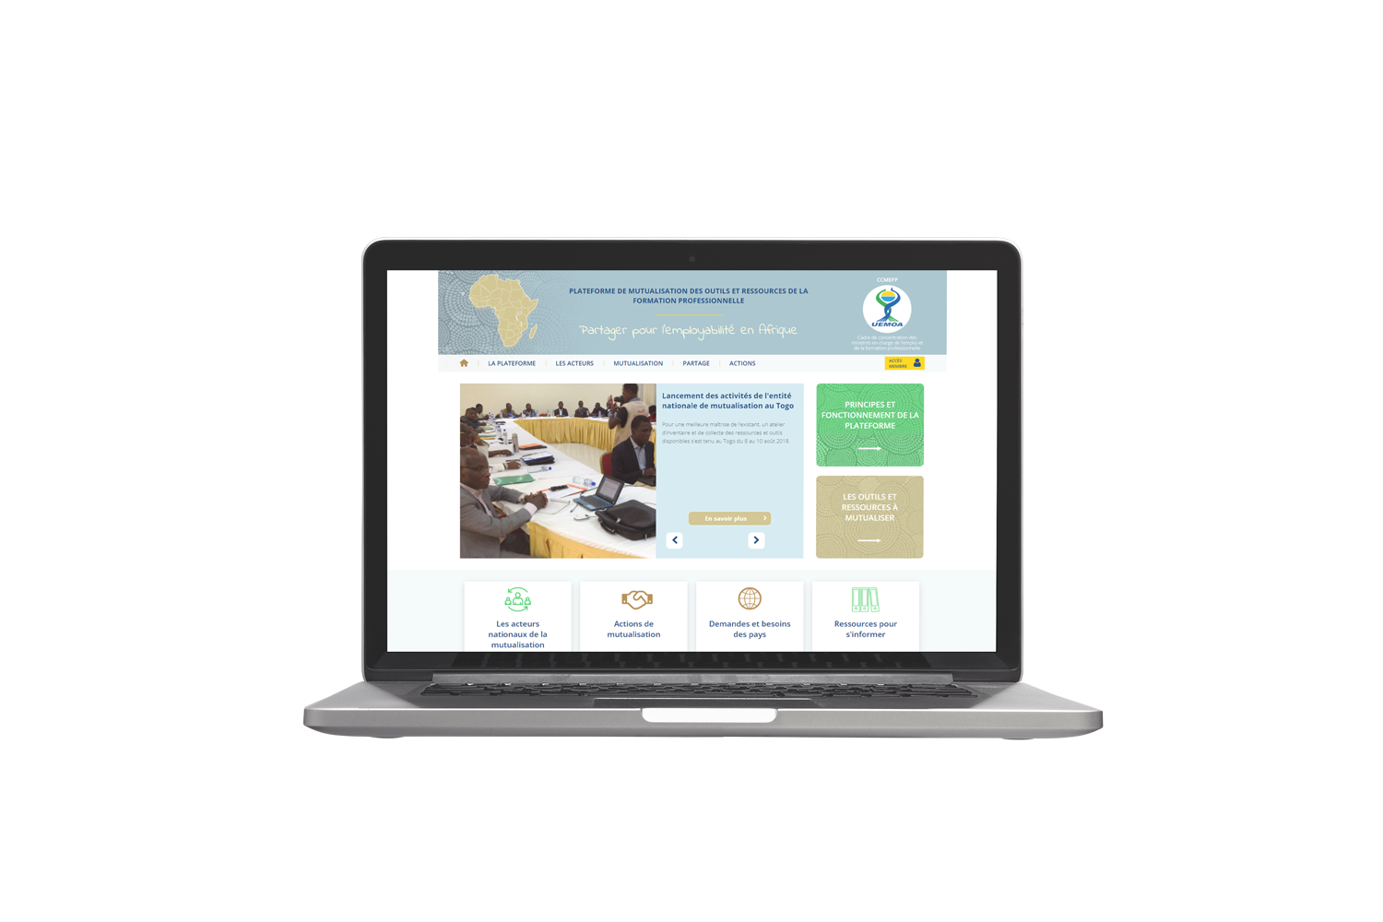
6- The digital portal of the Pooling Platform
II-PLATEFORM OF MUTUALIZATION (5/6)
The platform = web portal for sharing and using resources with normative and pedagogical content with a view to developing and strengthening the vocational training offer and facilities of the Member States.
https://mutualisation.ccmefp-uemoa.org/
ACCESS TO DISTANCE WITH
A PUBLIC SPACE
A MEMBER SPACE

Slide 11
II-PLATEFORM OF MUTUALIZATION (6/6)
7- Interests and benefits of the pooling platform
Pooling=integration process that offers a time-saving and financial resource-saving advantage of at least 60%.
Pooling platform = support tool for strengthening national vocational training systems based on the adaptation and contextualisation of existing tools and resources.
Pooling =development and rational use of financial means and skills to support economic development, access to employment and occupational mobility. It better addresses the challenge of employability of young people and women.
Approximately 1159 training programmes / 5000 vocational training resources identified in the nine (09) member countries of the pooling platform.
To date, 1481 resources have been shared on the platform and 487 resources have been shared. A country’s membership of the platform = potentially access to the 5000 identified resources

Slide 12
III-PERSPECTIVES (1/1)
Implementation of the Community Support Program for Youth Employment Integration to Combat Irregular Migration and Insecurity in the WAEMU Region : 196 580 000 000 FCFA
develop and/or adapt 2000 training programmes in the eight (08) WAEMU countries;
train 100 000 young people in priority occupations in the WAEMU area;
create 50,000 micro-enterprises in WAEMU countries.
develop and implement a Community strategy for the digitalisation and integration of Artificial Intelligence (AI) into vocational and technical training in the WAEMU area;
Develop and implement a Strategic Development Plan (SDP) for the Labour Market Information System (LMIS) in the WAEMU area.
Development of a Regional Qualification Framework for 2030;
Establishment of a regional EAV mechanism;
Virtual UEMOA stakeholder strengthening session on CNC and VAE/ACQF;
Advocacy and awareness-raising among countries, TFPs and organisations on the existence of the platform and its importance for strengthening national FP schemes with a view to attracting buy-in: Contact with Gabon, Madagascar, Mauritius and Comoros/Accession

Slide 13
CONCLUSION
Pooling =a formidable tool for sub-regional and inter-regional integration, the aim of which is to strengthen national vocational training systems in support of the economic and social development of the Member States.
In view of its noble objectives, it is necessary to popularise the platform and support all those involved in vocational training (public authorities, the private sector, the PTF) in order to finance the activities of the National Mutualisation Entities (ENM).
Our ambition: to make employment and vocational training a priority for the Member States and to ensure better funding for the initiatives undertaken;
Our Vision: make the CCMEFP-UEMOA an effective tool for integration, development and culture of peace, through training, professional integration and SIMT
Strategic partnerships, in particular with the ACQF, are a sine qua non for strengthening our training and professional integration systems.

Slide 14
Thank you for your kind attention!!!

